Slide 1
Design and development of organisation structure in a Entrepreneurship Knowledge Centre ENCORE Entrepreneurship Knowledge Centers to Foster Innovative Entrepreneurship Practices in Education and Research
Dr. Reija Anckar
Haaga-Helia University of Applied Sciences, Finland

Slide 2
Aaron Dignan: The Operating System
Organisations are complex* systems.
Organisations are not machines. They are not clockworks but gardens. People and processes do not always fit together.
Culture is vital
“Culture is like a shadow. You cannot change it, but it changes all the time. Culture is read-only.”
Trying to change culture is like trying to change the weather…
The operating system can be designed and developed, however!
*complex but not complicated

Slide 3
The Operating System (OS) Canvas
PURPOSE | AUTHORITY | STRUCTURE
STRATEGY | RESOURCES | INNOVATION
WORKFLOW | MEETINGS | INFORMATION
MEMBERSHIP | MASTERY | COMPENSATION

Slide 4
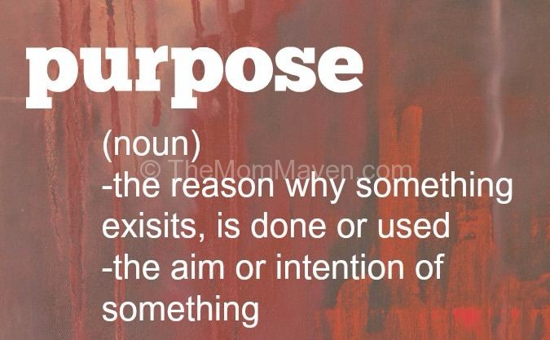
1. PURPOSE
How we orient and steer; the reason for being at the heart
of any organization, team, or individual.
What is our reason for being?
What is meaningful about our work?
How does our purpose help us make decisions?

Slide 5
2. AUTHORITY
How we share power and make decisions; the right to make decisions and take action or compel others to do the same.
Who can tell others what to do?
How do we make important decisions?
What is safe to try? What is not?

Slide 6
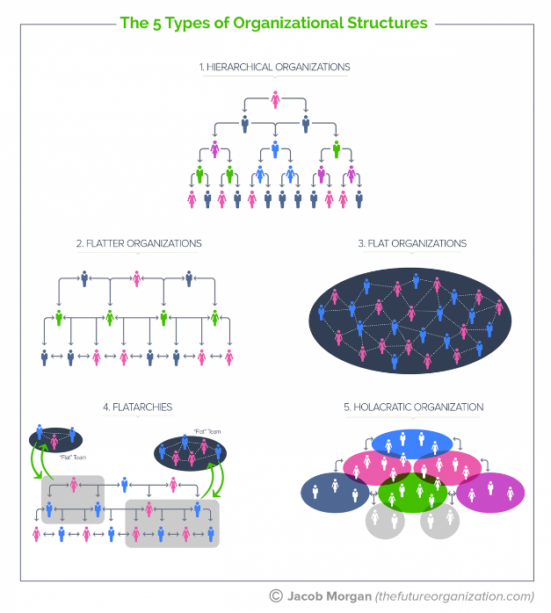
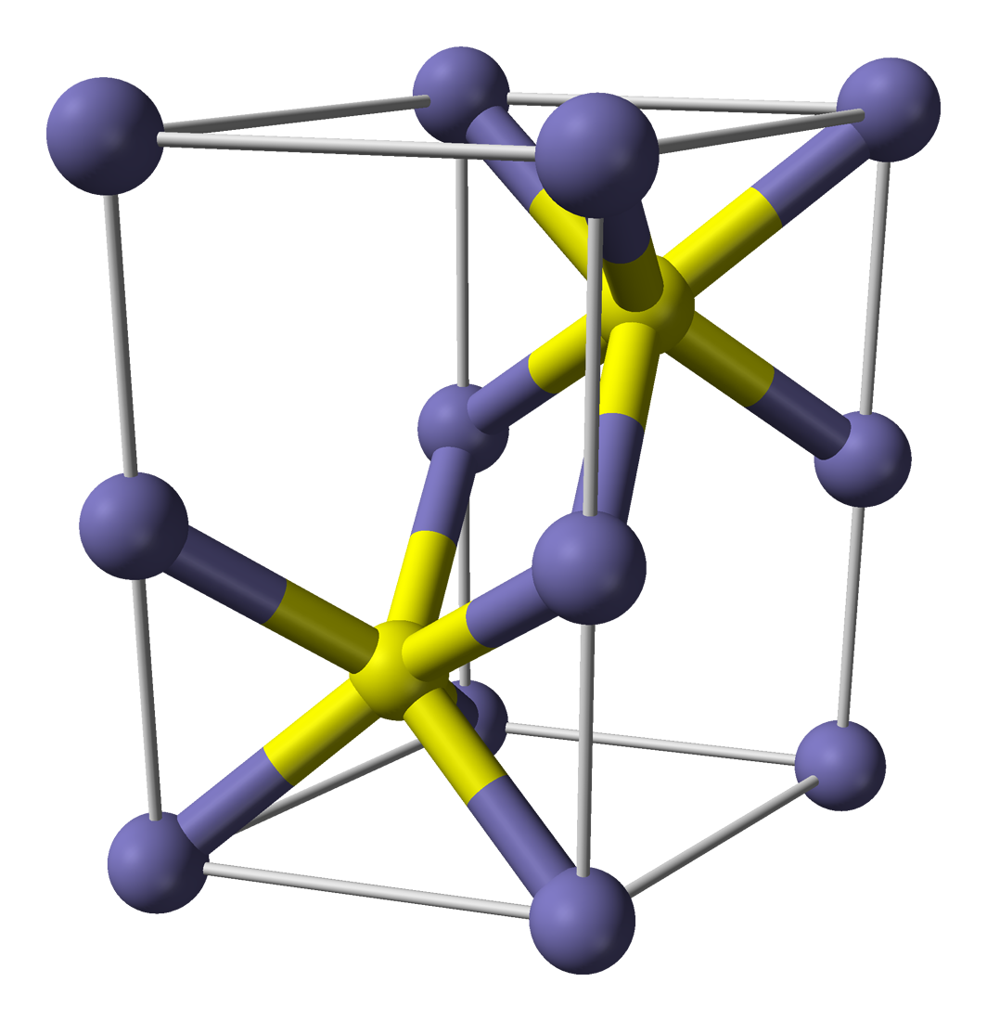
3. STRUCTURE
How we organize and team; the anatomy of the organization; formal, informal, and
value-creation networks.
What is centralized? What is decentralized?
Within teams, how do we approach roles and accountabilities?
How does our structure learn or change over time?

Slide 7
4. STRATEGY
How we plan and prioritize; the process of identifying critical factors or challenges and the means to overcome them.
What are the critical factors that will mean the difference between success and failure?
How do we develop, refine, and refresh our strategy?
How do we use strategy to filter and steer day-to-day?

Slide 8
5. RESOURCES
How we invest our time and money; the allocation of capital, effort, space, and other assets.
How do we allocate funds, effort, space, and other assets?
How do strategy and planning influence resource allocation?
How does our approach enable us to respond to emergent events?

Slide 9
6. INNOVATION
How we learn and evolve; the creation of something new; the evolution of what already exists.
Who participates in innovation? Who has the right to innovate?
What is the role of failure and learning in innovation?
How do we balance the short term and the long term?

Slide 10
7. WORKFLOW
How we divide and do the work; the path and process of value creation.
What is the relationship between our workflow and our structure?
How do we maintain visibility across all our projects?
How are projects initiated, cancelled, or completed?

Slide 11
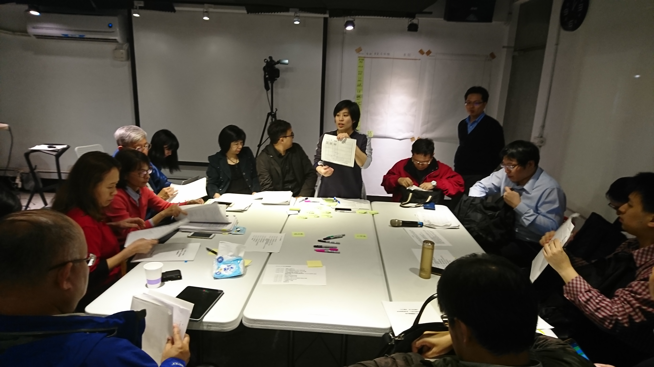
8. MEETINGS
How we convene and coordinate; the many ways members and teams come together.
Does each of our meetings have a clear purpose and structure?
How are meetings facilitated and documented?
How do we improve or eliminate meetings that are no longer serving us?

Slide 12
9. INFORMATION
How we share and use data; the flow of data, insight, and knowledge across the organization.
What information is shared freely?
What information is contained or controlled?
What tools, systems, or forums support storing and sharing?

Slide 13
10. MEMBERSHIP
How we define and cultivate relationships; the boundaries and conditions
for entering, inhabiting, and leaving teams and organizations.
How is membership (in the org or team) gained? How is it relinquished? How is it revoked?
What do all members expect of one another?
How do members move between teams and other boundaries?

Slide 14
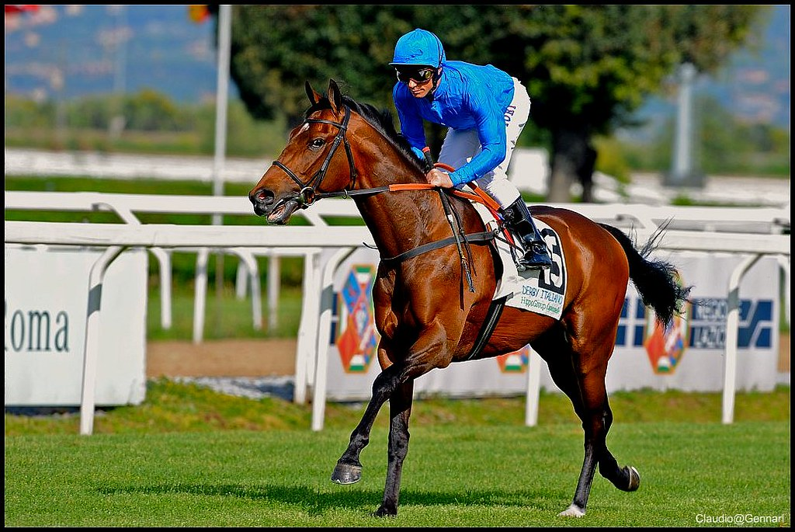
11. MASTERY
How we grow and mature; the journey of self-discovery and development; our approach to nurturing talent, skills, and competence.
What is our approach to learning and development?
How do we give and receive feedback?
How does competence influence the roles we inhabit?

Slide 15
12. COMPENSATION
How we pay and provide; the wages, salaries, bonuses, commissions, benefits, perquisites, profits, and equity exchanged for participation in the organization.
What is our approach to compensation?
What mechanisms have we put into place to reduce bias in compensation?
How are changes in compensation triggered and conducted?

Slide 16
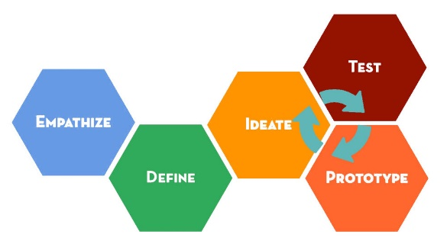
Learning and developing organisations
Vision and strategy are a process that creates a common vision
Leaders by vision inspire continuous learning and development
Engaging organisational culture
Indicators that guide and direct development and learning
Systematic learning support
Process-oriented, systemic approach
Effective personnel development for the future
Incentive reward scheme

Slide 17
Encouraging team leaders
Atmosphere of community
Interaction between team leader
and member
Group competence
Individual competences
Empowerment
Managers must also keep
their competence up-to-date!

Slide 18
Organisational Development
Organisational knowledge: data, surveys, insights
Leadership plan: sharing, caring, empowerment, trust, values
Support plan: structures, roles, fair objectives
Improvement plan: development possibilities, change, learning
Progress evaluation: reviews, framework, continuous improvement

