Slide 1
ENCORE
Entrepreneurship Knowledge Centers to Foster Innovative Entrepreneurship Practices in Education and Research CANVANIZER WORKSHOP University of Alicante, may 9 - 11 th 2022
Duration
15.01.2021 - 14.01.2024

Slide 2
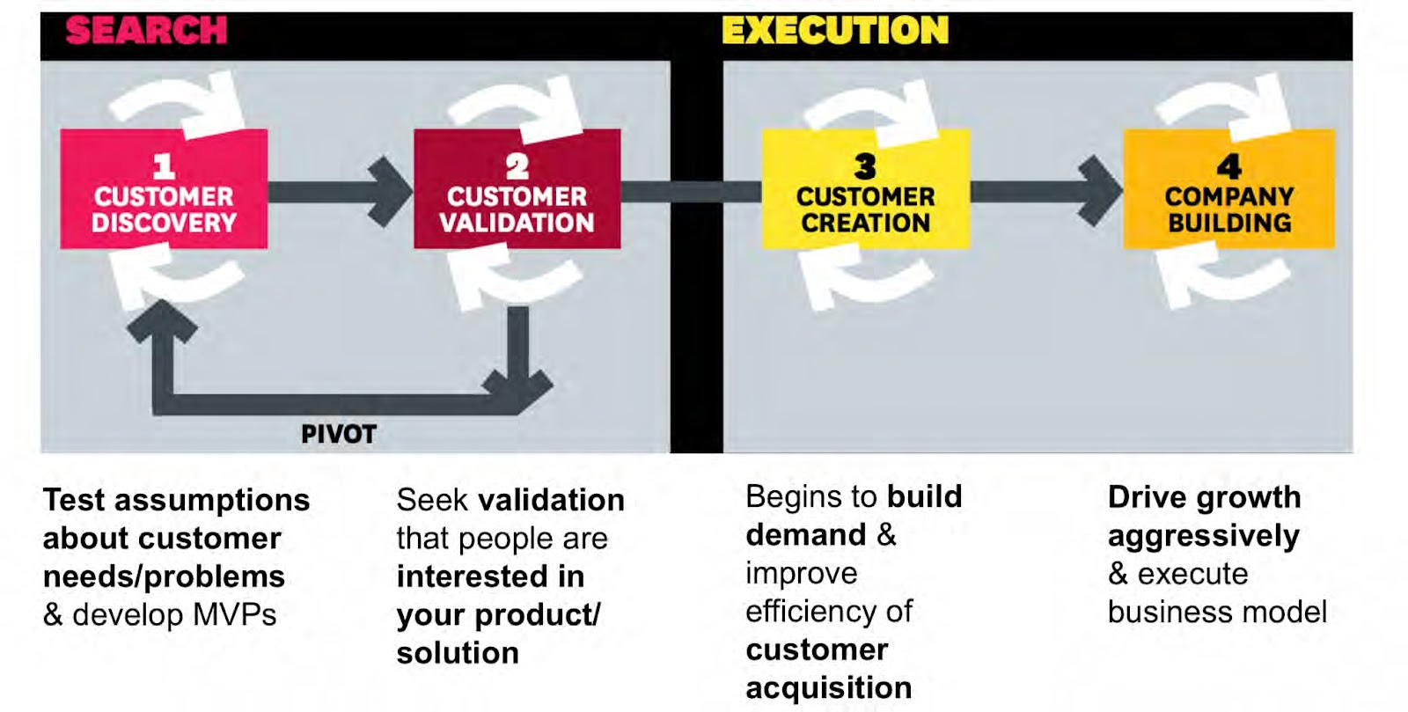

Slide 3
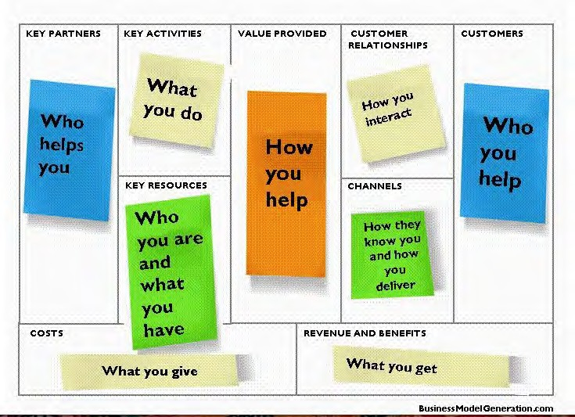

Slide 4
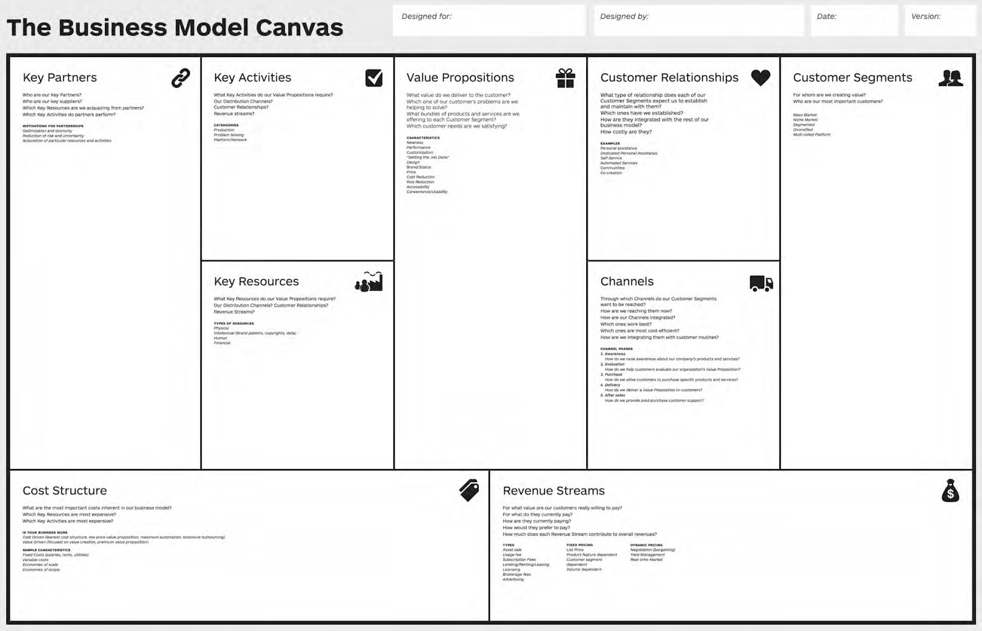
Feasible
Desirable
Viable

Slide 5
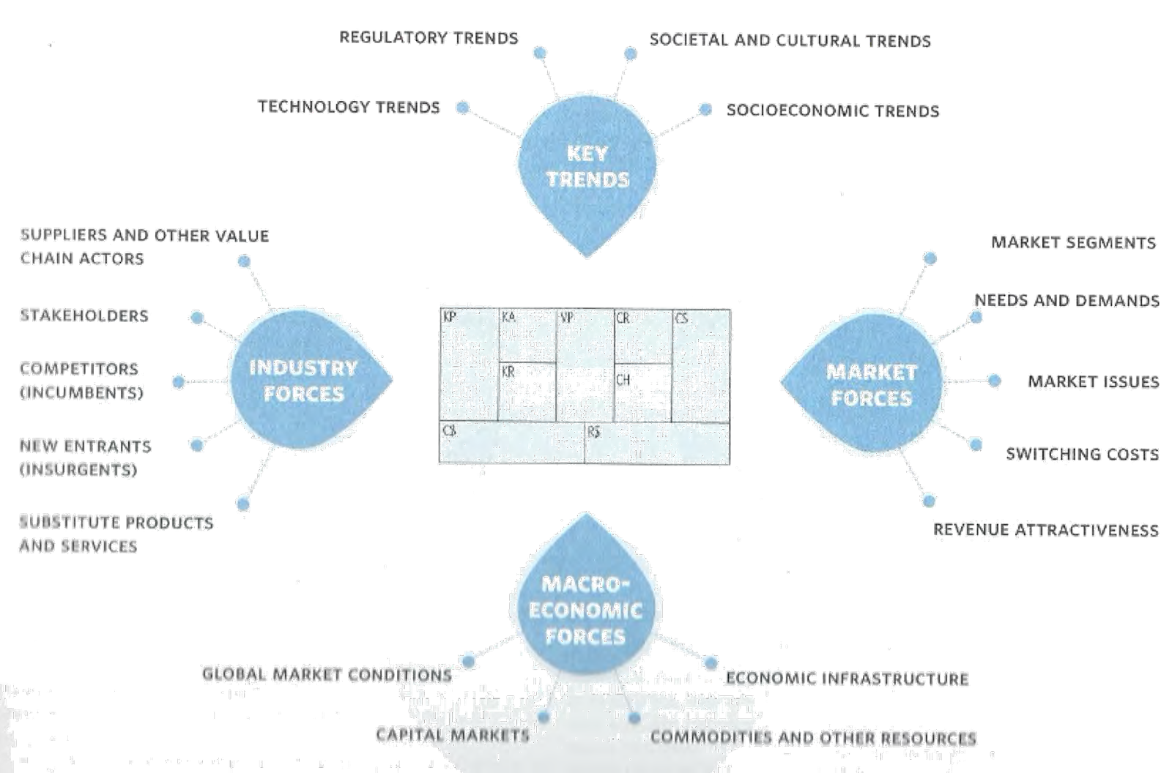

Slide 6
https://canvanizer.com/

Slide 7
Challenge:
WORK IN GROUPS
BUILDING A CASTLE

Slide 8
Partners
Fachhochschule Joanneum / Austria
University of Alicante / Spain
Haaga-Helia UAS / Finland
Royal University of Bhutan (Gedu College of Business Studies) / Bhutan
Royal Thimphu College in Bhutan
Tribhuvan University (Institute of Crisis Management Studies) / Nepal
Global College International / Nepal
Souphanouvong University / Laos
National University of Laos / Laos

