Slide 1
Financial management for entrepreneurs – insights into financial strategies and guidance to support students and entrepreneurs
Overview
Paul Hofmann

Slide 2
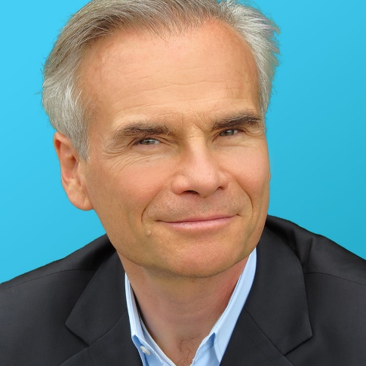
Paul Hofmann
FH-Joanneum:
Professur für den Bereich Produktionsoptimierung mit dem Schwerpunkt: Digitalisierung am Studiengang IWI
Uni Wien: Studium der Fachrichtung Biochemie, Chemie & Physik
TU Darmstadt: Doktor rer. nat.
30+ Jahre Berufserfahrung als Executive
BASF: Design, Bau und Einführung MES und Betriebsleiter
SAP: Dir EMEA Strategic Board Initative
Dir Corporate Venturing
VP Research & Development, Palo Alto Labs
CTO zweier erfolgreich verkaufter Silicon Valley Startups
Saffron Technology (now Intel) → AI und Graphs
    SpaceTime Insight (now Nokia) → IOT und AI
Accenture: CTO AI and Data Science NA
Akademische Karriere
MIT: Visiting Scientist
Northwestern University: Assistant Professor
TU München: Postdoctoral Fellow
Paul Hofmann
Paul.Hofmann@fh-joanneum.at
www.paul.bio

Slide 3
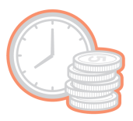



Traditional Funding Options
Friends & Family
Bank Loans
Angel Investments & Venture Capital
Equity
Probability of Approval
57%
0.016%
0.0091%
0.00004%
Average Funding
$17k
$145k
$500k
$10M+

Slide 4
Traditional Funding Options – Pro’s & Con’s
Friends & Family
Bank Loans
Angel Investments & Venture Capital
Equity
Pro‘s | Quick to obatin | Quick Closing | Larger Checks | Almost any requested amount
Con‘s | Small amounts Strained relationships | Personally guaranteed Potential debt trap | ROI of 2000% in 7 to 10 years Business Involvement | Lost Control Committed to created share holder value

Slide 5
Impact of Risk on Investment Decisions
Investors prefer to have a safe income rather than a risky one of the same average amount.
When cash flows are risky, we must discount them at a rate equal to the risk-free interest rate plus an appropriate risk premium.
The appropriate risk premium will be higher the more the project’s returns tend to vary with overall risk in the economy.
The risk of a security must be evaluated in relation to the fluctuations of other investments in the economy.

Slide 6

Possible Solution?
Funding the project or venture by raising money from a large number of people backing the project and the idea of the project.
Crowdfunding

Slide 7
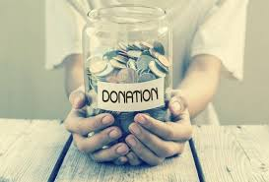



Funding size differs by type of Crowdfunding
Donation Rewards Lending Equity
Crowdsupporting
Typically raising < $20k
Crowdfunding
Typically raising < $50k
Crowdlending
Typically raising < $500k
Crowdinvesting
Typically raising $50k to $10M

Slide 8
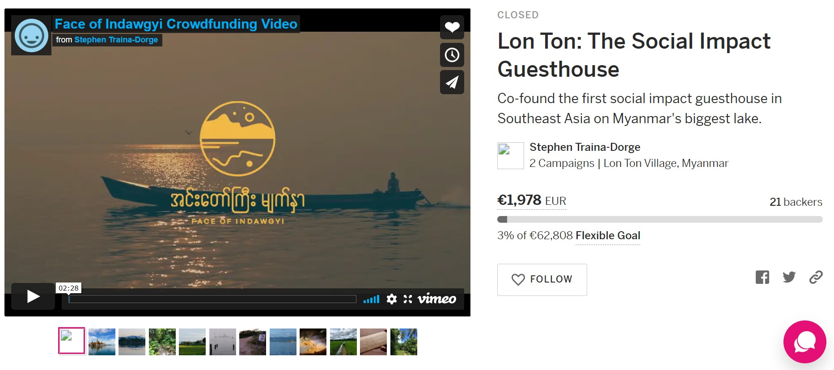
Case Study N1
Lon Ton: The Social Impact Guesthouse | Indiegogo
https://www.faceofindawgyi.org/blog/2018/6/6/crowdfunding-campaign

Slide 9
3 areas
What we have
What we need
What we give
Idea
Connections
Project
Team
Money
Support
Endorsement
Visibility
Discounts
Belonging
Pre-Sales

Slide 10
Crowdfunding Terminology: Campaign Terms
campaign: all activities of the project to reach out to potential supporters
time: (often) specified time in which to reach the funding goal
goal: sum of money specified by the project owner
threshold: minimum funding goal (where applicable)
maximum: maximum funding goal (where applicable)
Rewards: material or immaterial items given to the supporter during reward-based Crowdfunding

Slide 11
Uses of CF
Crowdfunding can be used for marketing, market research, community outreach and press activities.
For Tourism, it can be used in promotion, pre-sales, marketing, tests, maintenance and protection, and many others

Slide 12
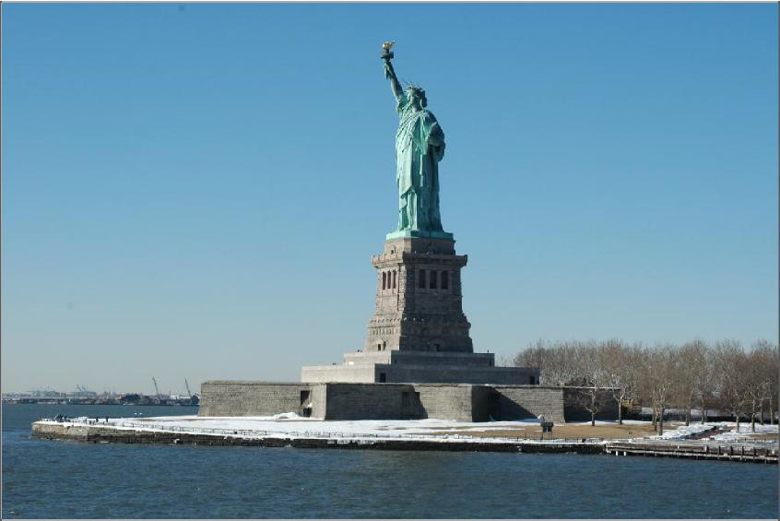

Crowdfunding can be used for For Tourism, it can be used in
marketing, market research, promotion, pre-sales, marketing, community outreach and press tests, maintenance and protection,
activities. and many others
Crowdfunding is not a new concept: The Statue of Liberty is thought to be one of the first documented crowdfunding projects.

Slide 13
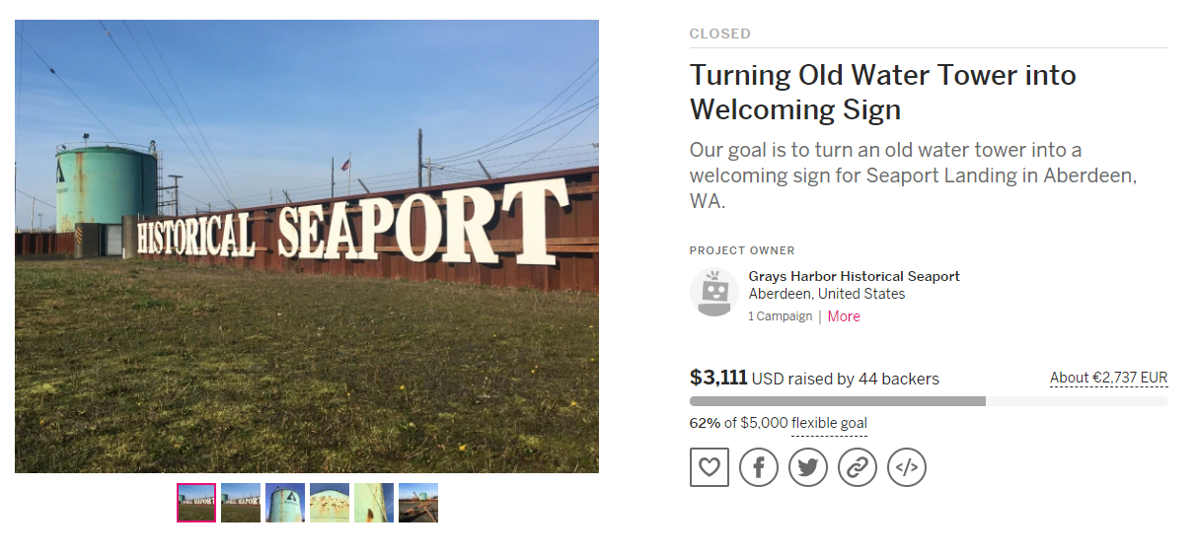
Examples: Donation based Crowdfunding

Slide 14
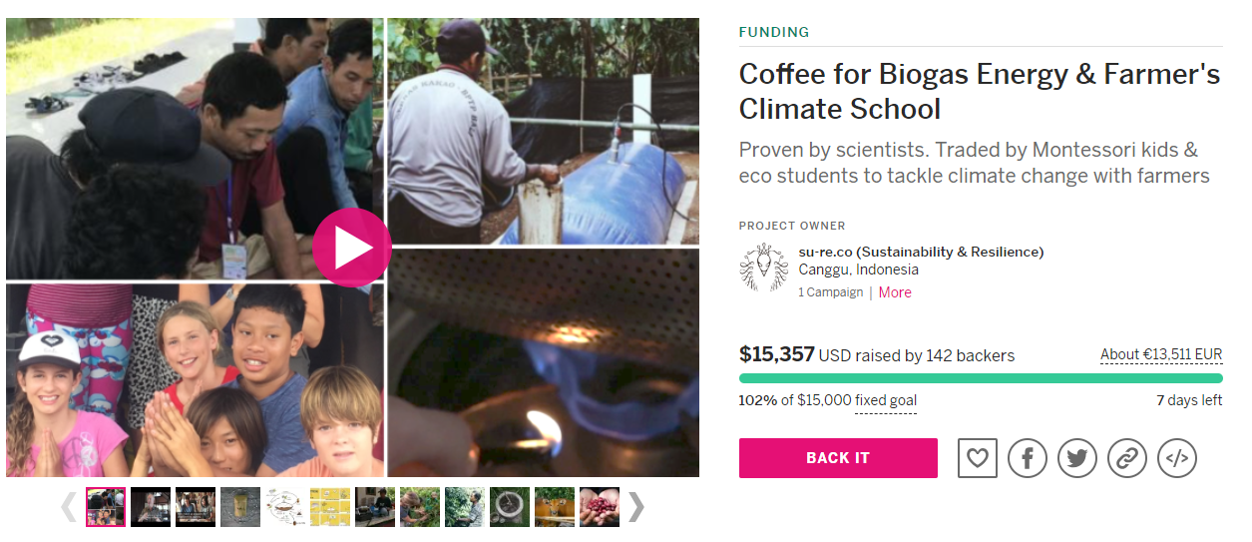

Examples: Reward based Crowdfunding

Slide 15
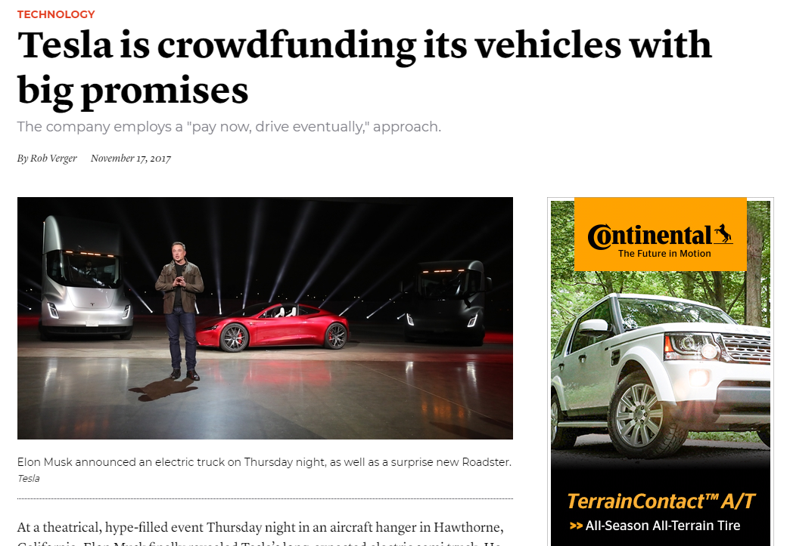

Slide 16
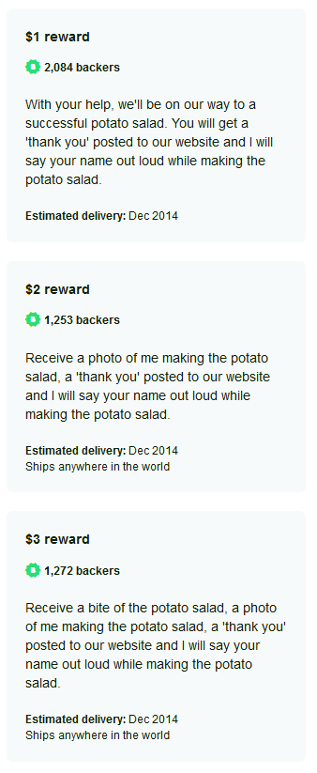
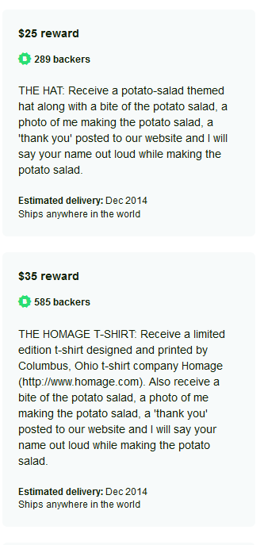
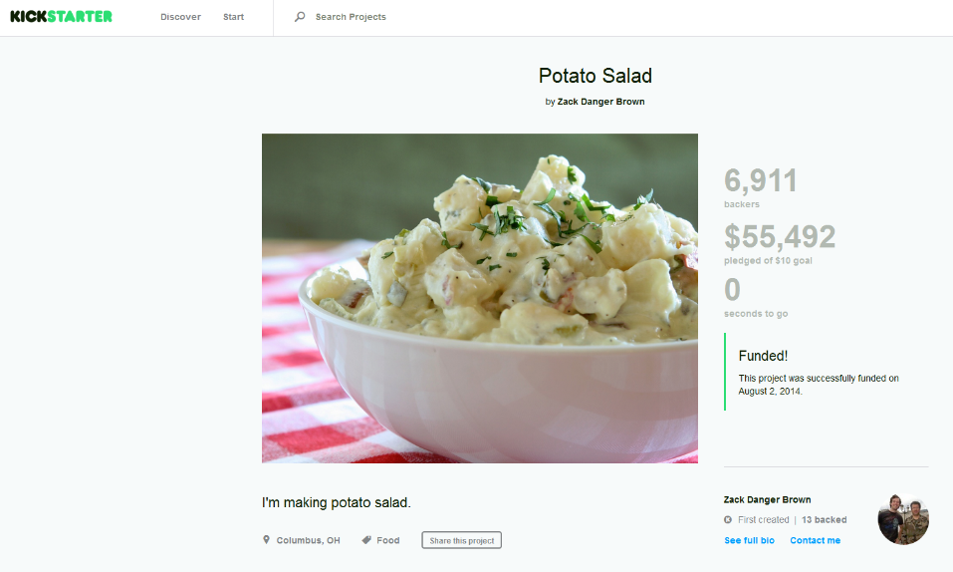

Slide 17
Another type of crowdfunding:
Subordinated debt with optional additional profitsharing
Subordinated means that all other debt is to be paid first in case of bankruptcy
More attractive to crowdfunding investors because of profitsharing
Benefits for company owners:
  Subordinated debt could be assigned to equity and its therefor easier to obtain loans or credit
  No loose of control of the firm
  Profit sharing with crowdfunding investors is time limited vs. unlimited with equity investors.
  Lower interest rate could be offered to investors
  Interest payment requires profit in previous year

Slide 18
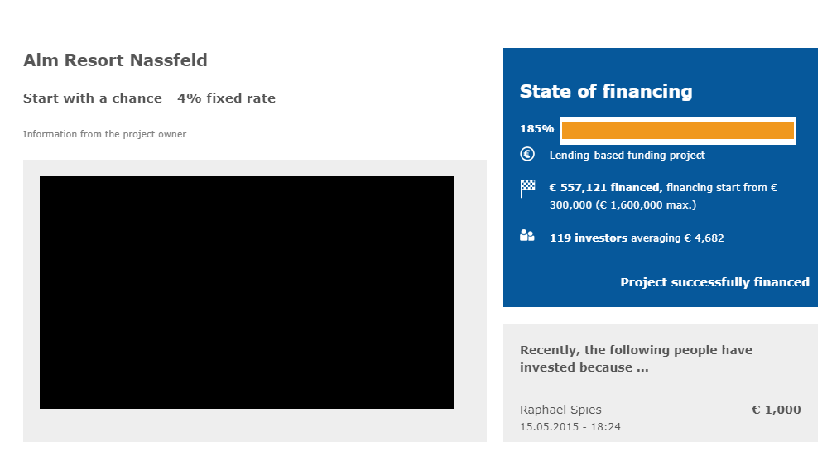
Examples: Lending based Crowdfunding
Alm Resort Nassfeld
Beim Projekt „Alm Resort Nassfeld“ handelt es sich um eine abgeschlossene Crowdinvesting-Kampagne, die auf der österreichischen Crowdfunding-Plattform „1000x1000“ abgewickelt wurde. Die Kampagne konnte ein Gesamtvolumen von € 557.121 über die Crowd einsammeln.

Slide 19
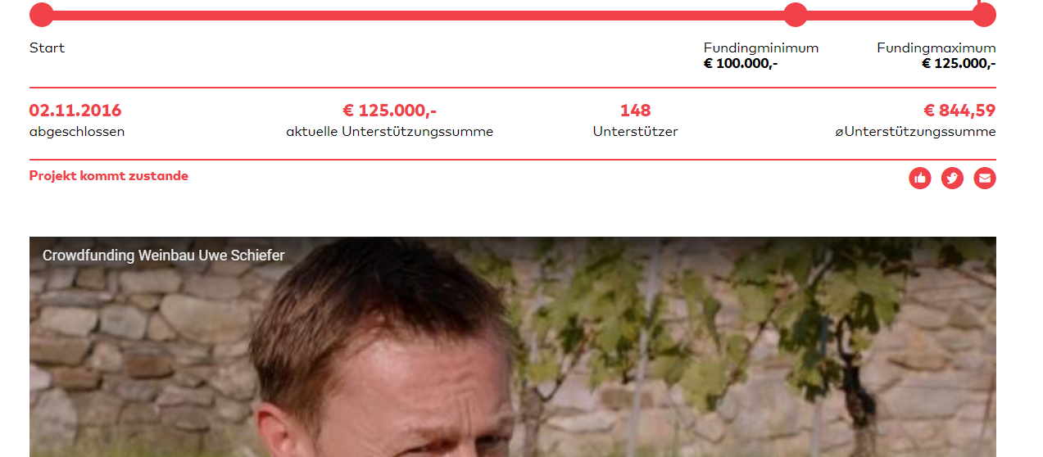
Examples: Equity based Crowdfunding

Slide 20
Developments
Before 2003
2008
2009
2011
Fundraising projects were managed offline or remotely (call centers); with the friction of analogic payments and enrollments
Sellaband launches as a fan-funding platform for bands in Europe; “Crowdsourcing” was coined by Wired-author Jeff Howe
Indiegogo launches in the USA from creative
and social projects; Kickstarter follows few months laters
First studies were conducted, e.g. in Germany by ikosom or Fraunhofer; The first Crowdfunding Industry Report was published
Crowdfunding is not a new concept: The Statue of Liberty is thought to be one of the first documented crowdfunding projects.

Slide 21
Today:
$17.2 billion is generated yearly through crowdfunding only in North America.
Funds raised through crowdfunding grew 33.7% last year globally
There were 6,455,080 worldwide crowdfunding campaigns last year.
Successful crowdfunding campaigns have raised $28,656 on average.
The average amount raised by all crowdfunding campaigns last year was $824.
22.4% is the average success rate of crowdfunding campaigns.
Overall crowdfunding projects have an average of 47 backers.
Fully funded crowdfunding projects have an average of 300 backers.
The average pledge for fully funded projects is $96.
The average pledge for all crowdfunding projects is $88.
The crowdfunding market is projected to grow to $300 billion by 2030.
And there are projected to be 12,063,870 campaigns by 2023.
Crowdfunding is not a new concept: The Statue of Liberty is thought to be one of the first documented crowdfunding projects.

Slide 22
Crowdfunding campaigns with videos earn 105% more than those without videos.
Campaigns that updated followers regularly raised 126% more than those with no updates.
Crowdfunding campaigns that raise at least 30% of their goal within their first week are more likely to reach their goal.
53% of email shares of crowdfunding campaigns convert into donations.
12% of Facebook shares convert to donations vs 3% of Twitter shares convert to donations.
All-or-nothing model campaigns funded fully at twice the rate of keep-it-all campaigns.
Adding personal information to your campaign could get you 79% more backers.
42% of funds are raised in the first and last three days of an average crowdfunding campaign.
The average word count for successful crowdfunding campaigns is 300 to 500 words.
Team-driven crowdfunding campaigns raise 38% more than solo campaigns.
Those aged 24-35 are much more likely to participate in crowdfunding campaigns.
Those over 45 are significantly less likely to back campaigns.
Successful crowdfunding campaigns take an average of 11 days to prepare.
An average crowdfunding campaign lasts 9 weeks.
A successful campaign admin posts an average of 4 times throughout their campaign.
Crowdfunding campaign admins that shared fewer than 2 times have a 97% chance of failure.
Kickstarter has had 319,051 completed projects—the most overall for any platform.
Fundrazr projects have a 41.8% chance at success—the best chance of success of any platform.
Indiegogo projects have raised an average of $41,634 each—the highest average amount of any platform.
Crowdfunding is not a new concept: The Statue of Liberty is thought to be one of the first documented crowdfunding projects.

Slide 23
Areas
CROWDFUNDING
CROWD- WISDOM | CROWD-VOTING |  | CROWD- CREATION | CROWD-FUNDING
Crowdfunding is often seen as a subset of the term Crowdsourcing, originally coined by Jeff Howe in 2006

Slide 24
Comparing financial markets with crowdfunding
Financial Markets
Debt: Market assesses the credit rating and determines the yield (interest rate for debt).
Equity: Market assesses the value of the firm.
Crowdfunding
Debt: Company manager determines the interest rate he/she offers.
Equity: Company manager determines the share price to which he/she is willing to sell a share

Slide 25
Why does crowdfunding work?
Emotional motivation, in terms of an emotional relationship to product, geographics or to the company itself is more important for Crowdfunding investors than a financial return.
Herding
Numerical deafness
Small amounts cause lack of judgment in terms of risk and return

Slide 26

Different Types of Investment
Angel Investment Venture Funds
Bank Financing
.
Subsidies, grants, collateral
Crowdfunding
0 € 250k € 750k € > 3m €
There are three phases: the pre-campaign phase, the campaign-phase itself and a post-campaigning-phase

Slide 27
Pipeline of investments and CF
IDENTIFY
PREPARE
BUILD
Define your goal
Define your budget
Define your milestones
Define your brand
Write a business plan*
Start a company*
Build your team
Explore Crowdfunding
Choose the model
Choose the platform
Imagine different scenarios
Set up project & communication plan
Assign tasks to team
Start a pre-launch page
Produce campaign video
Produce graphics/pics
Write campaign texts
Write FAQs
Clarify legal issues
Open account & add profile
Set up payment
Add campaign title
Add thumbnail & short text
Add description texts
Add graphics & pictures
Add rewards
Add your team
Upload campaign video
Upload businessplan*
Test your campaign & adjust it
Publish your campaign
There are three phases: the pre-campaign phase, the campaign-phase itself and a post-campaigning-phase

Slide 28

Venice Municipality will co- invest 50% of the 4 most funded projects out of those collected in the field of environmental protection, ethical tourism and proximity
There are three phases: the pre-campaign phase, the campaign-phase itself and a post-campaigning-phase

Slide 29
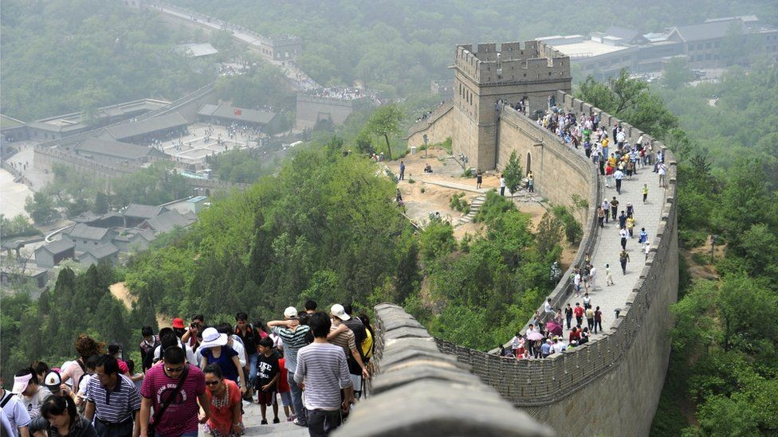
China uses crowdfunding for great Wall Restoration
There are three phases: the pre-campaign phase, the campaign-phase itself and a post-campaigning-phase

Slide 30

Yokkye allows the creation of a network of local guides for proximity tourism
There are three phases: the pre-campaign phase, the campaign-phase itself and a post-campaigning-phase

Slide 31

Raise funds to support a tourist complex in Sardinia.
At the center of the crowdfunding campaign is the Santina Resort & Spa, a 7,500 m2 hotel facility
The House4Crowd investors, whose campaign will be used to complete the structure, will become partners and will have a return of approximately 7.81% a year, and for those who stay up to three years, returns between 13 and 14% are expected.
There are three phases: the pre-campaign phase, the campaign-phase itself and a post-campaigning-phase

Slide 32
Intitial Coin Offering – ICO
Unregulated & dezentralized fund raising of cryptocurrency
Pros
1. Readily accessible for investors and startup companies
2. Accessible online
3. High liquidity
4. Less paperwork
5. High return of investment
Cons
1. Volatile
2. A potential fraud
3. May lack accountability

Slide 33
Intitial Coin Offering – ICO imore detail part 1
Pros
1. Pros
1. Readily accessible for investors and startup companies.
2. Accessible online
– Whitepaper that includes vital project details such as the problem to be solved and the solutions or actions to take
– Team background, including Github & Linkedin profiles of the team members
– Community pages in Telegram and Bitcointalk forums
– Milestones and plans for the coming months and years
3. High liquidity

Slide 34
Intitial Coin Offering – ICO imore detail part 2
Cons
1. Volatile.
2. A potential fraud
investor, has to diligently look at the profiles of the team members and see if they have the experience, technology, or blockchain knowledge to pull off their claims in the whitepaper. However, not every investor is well informed enough to distinguish one good ICO from a bad and fraudulent one.
Many ICOs don’t undergo the same regulatory process as IPOs and other traditional assets.
3. May lack accountability

Slide 35
Intitial Coin Offering – ICO Steps
Define Project
White Paper including features
Marketing

Slide 36
Financial management for entrepreneurs – insights into financial strategies and guidance to support students and entrepreneurs
Overview
Paul Hofmann

