Slide 1
ENCORE Entrepreneurship Knowledge Centers to Foster Innovative Entrepreneurship Practices in Education and Research
Training of the Trainers 1
Setting up and managing a center of excellence
23rd until 26th of November 2021
Project ref.: 617589-EPP-1-2020-1-AT-EPPKA2-CBHE-JP

Slide 3
Agenda
Welcome & expectation check
Introduction to the training
Introduction to the learning platform
Team introduction
Introduction to business modelling & the business model canvas

Slide 4
Expectation check

Slide 5
Expectations
Expectations decide about satisfaction or dissatisfaction!
So, let´s manage them!
Let me know yours!
Please go to menti.com and use the code
2978 9663 or use the QR code

Slide 6
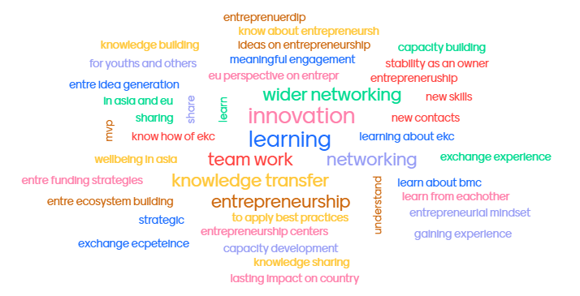
Expectations

Slide 7
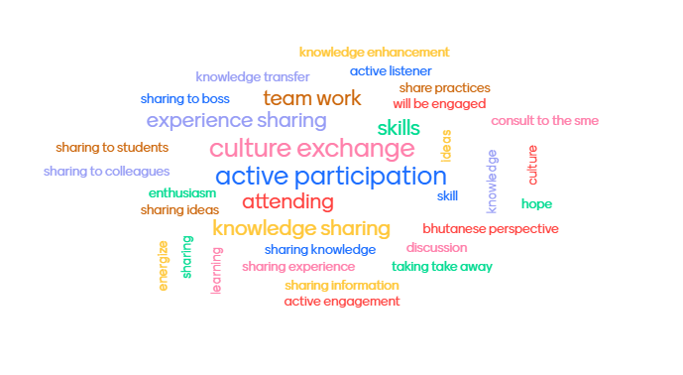
Contributions

Slide 9
Hopes & dreasms from our side
Interactive training with free opinion exchange
We are sitting in the same boat – one big team to be successful
accept the challenge and don´t give up!
motivation and fun ahead
first possibility for creating a branding for your center

Slide 10
Introduction to the training & trainers

Slide 11
Introduction to the training
Framework
4 days training (Tuesday to Friday)
Input sessions EU & Asian partners
Working sessions for Asian partners including presentations
Output oriented training with international exchange

Slide 12
Introduction to the training
Aims
Build up knowledge based on theoretical concepts and sharing experiences
Generate knowledge to support the further project´s implementation – center operation
Create a stronger network among the partners

Slide 13
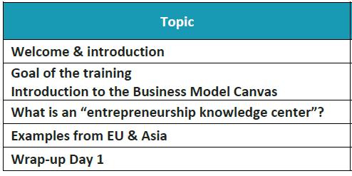
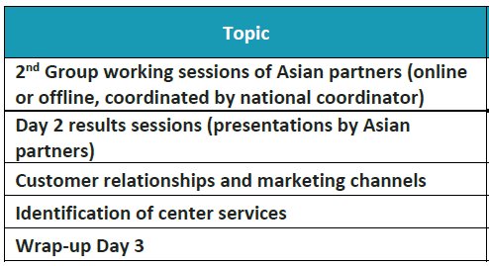
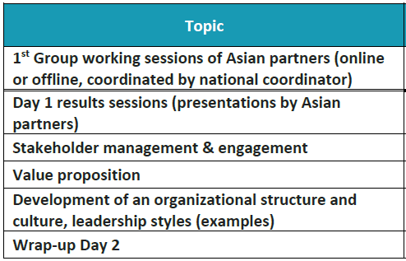
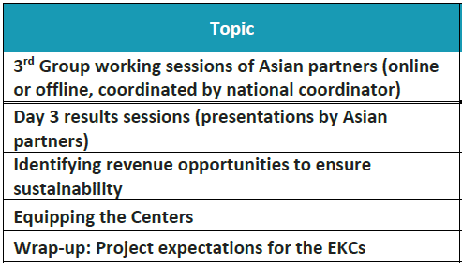
Introduction to the training
Agenda
Day 1
Day 3
Day 2
Day 4

Slide 14
Introduction to the trainers
Eva Holmberg
Econ.Lic (Corporate geography)
Senior lecturer at Haaga-Helia AUS, Finland
Lecturing: tourism and research and development methods
Thesis supervision
Research interests: responsible tourism, destination management
Over 20 years experiences of lecturing and doing research in the field of tourism, tourism geography and pedagogy
Been involved in several Erasmus+ and national projects related to tourism and pedadogical development
LinkedIn: https://www.linkedin.com/in/evaholmberg/
E-Mail: eva.holmberg@haaga-helia.fi

Slide 15
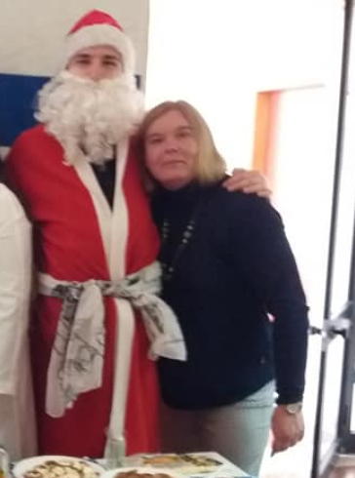
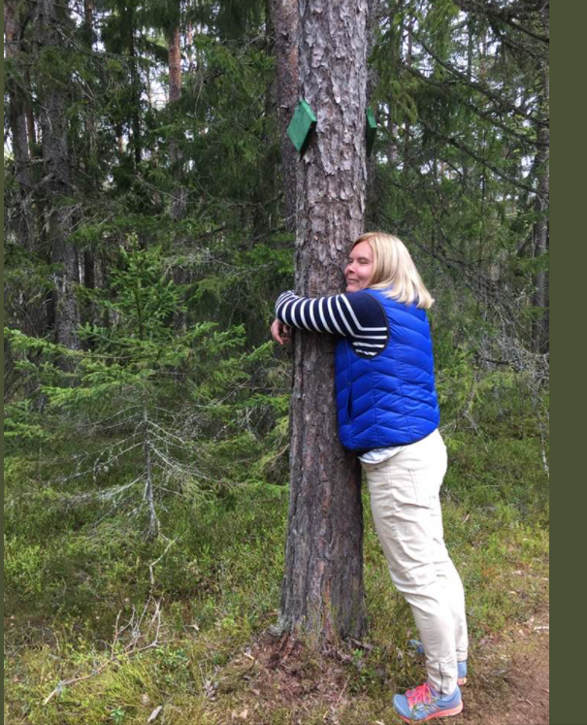
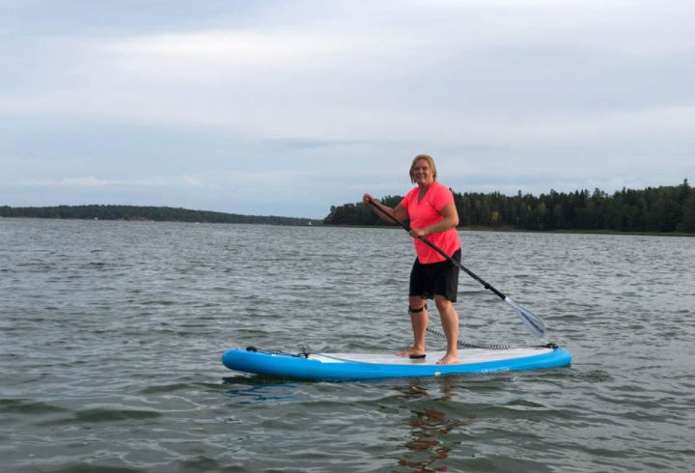
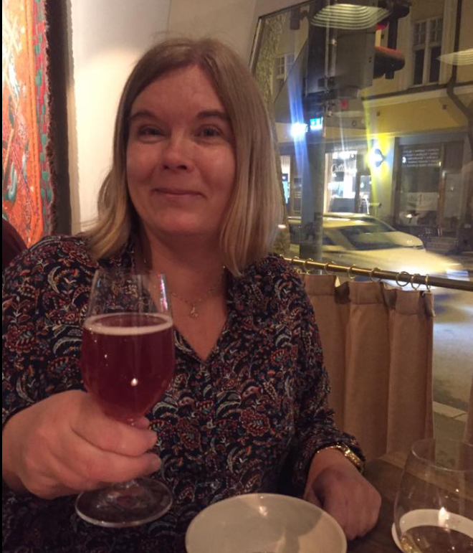
Introduction to the trainers
Eva Holmberg

Slide 16
Introduction to the trainers
Dr. Reija Anckar
Ph.D. (Econ.) entrepreneurship, eMBA Service Excellence
Long experience in higher education and educational management at Haaga-Helia UAS, Finland
Entrepreneur at Anckar Stamina Ltd: business coaching, development of organisations
Expertise in coaching, leadership, higher education, entrepreneurship, teacher education, projects
Research focus in entrepreneurship, education

Slide 17
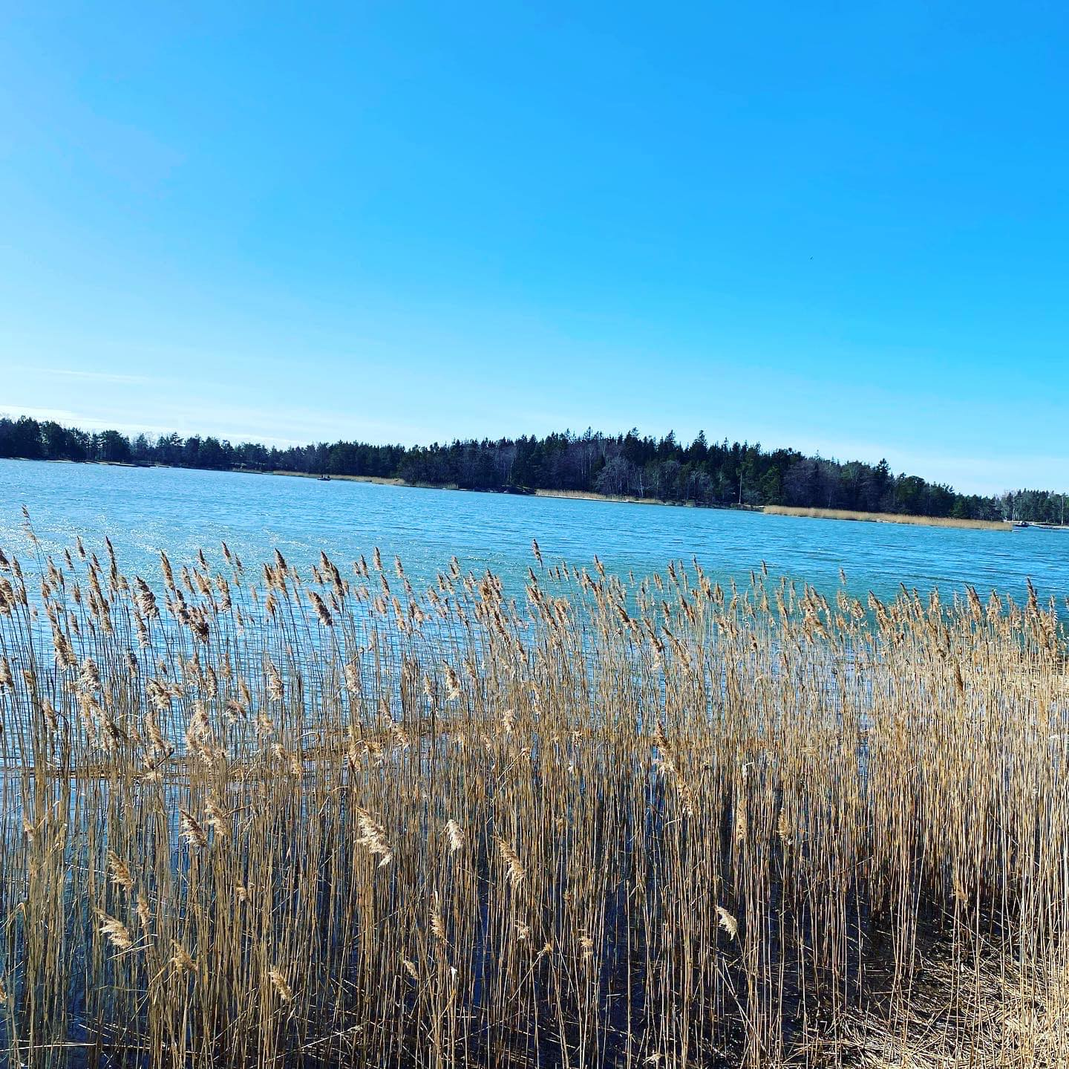
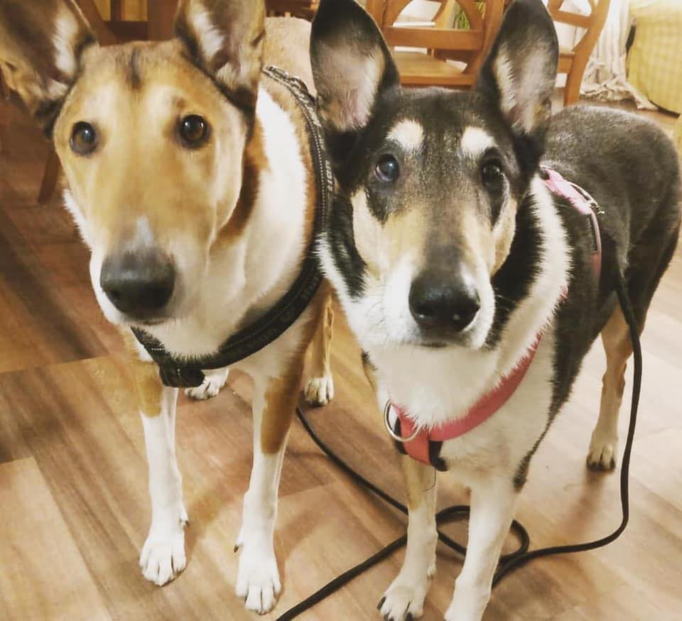
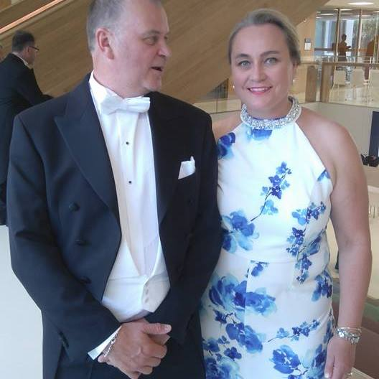
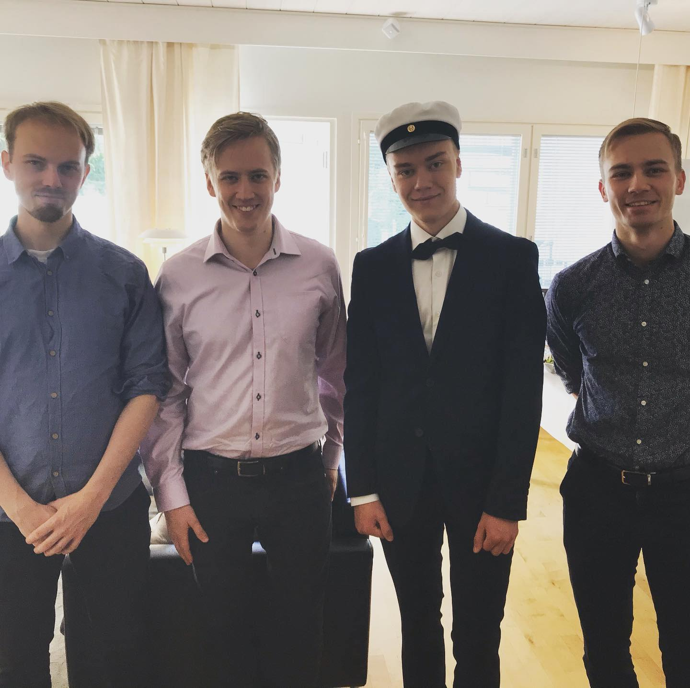
Introduction to the trainers
Dr. Reija Anckar

Slide 18
Introduction to the trainers
Cristina Beans - c.beans@ua.es
Got her Bachelor’s Degree in Biology at the University of Alicante (Spain) last century! And her Master’s Degree in Oceanography way back in 2001 at the University of Liège (Belgium). More recently has an MBA specializing in Project Management and for some crazy reason is currently enrolled in a Master’s in History of Science and Science Communication…
Work Experience in Research, Teaching, Science Outreach, International Relations & International Projects,
Senior Project Manager @ University of Alicante’s International (now Institutional) Project Management Office since May 2014 – experience drafting proposals and coordinating CBHE projects in the Erasmus+, Tempus & Edulink programmes.
Topics developed through CBHE: Employability & Entrepreneurship , Social Innovation, Environment & Climate Change, Sustainable Campuses, Research Skills & Research Management, Curriculum Development
@BeansCristina

Slide 19
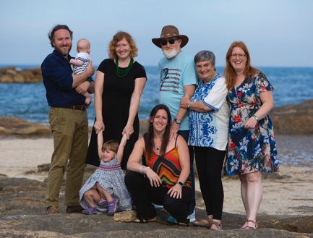
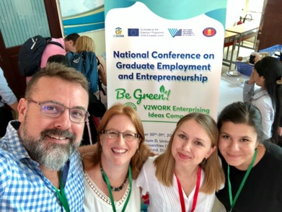
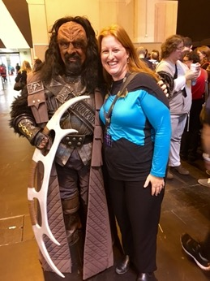
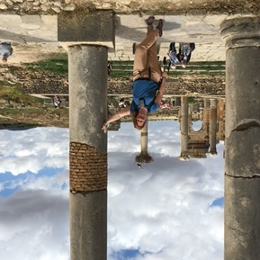
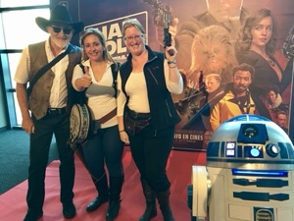
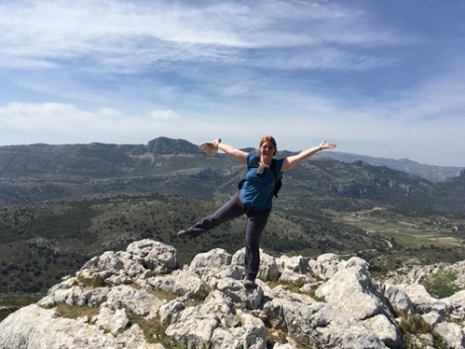
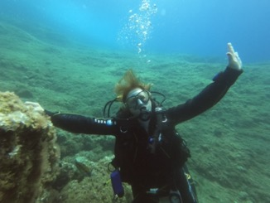
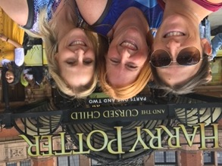
Introduction to the trainers
7th Continent!
Cristina Beans
TRAVELER
Not our 1st Project! ☺
Fan of
Sci-Fi &
Fantasy
Book/TV/Film
DIVER
/ HIKER
@crazycrisb

Slide 20
Introduction to the trainers
Lisa Mahajan

Slide 21
Introduction to the trainers
Claudia Linditsch
Studied International Business and International Management @ FH JOANNEUM and in Paris a looooong time ago
Work Experience in Event Management and Marketing as well as Business Development and Key Account Management
International Project Manager @ FH JOANNEUM since February 2011 – many projects with Asia & Eastern Europe; Lecturing @ FH JOANNEUM, Graz since October 2014
Research Focus: (Experiential/Social Media) Marketing, Project Management and International Communication and Business, Entrepreneurship, Business Development and Sustainability
LinkedIn

Slide 22
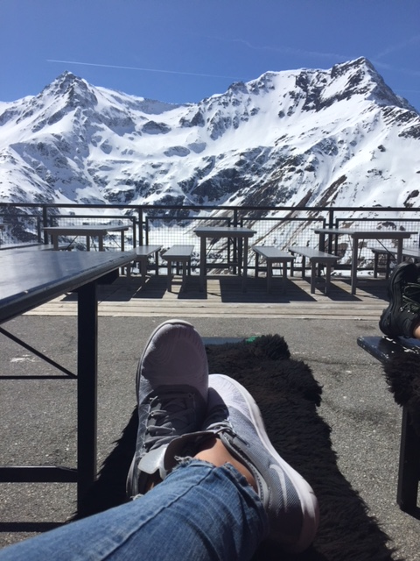
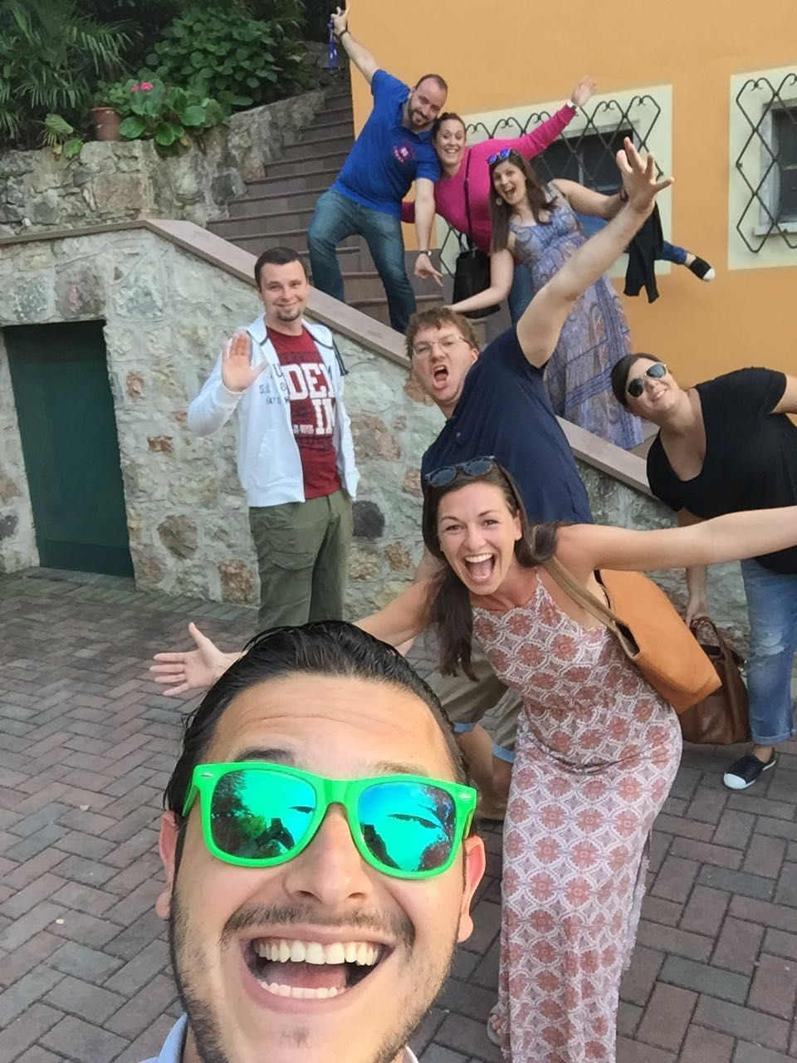
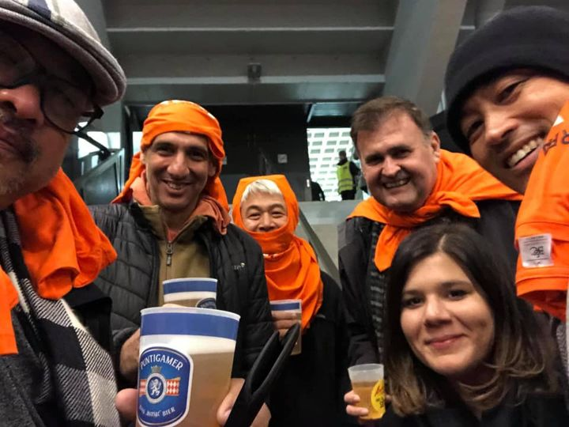
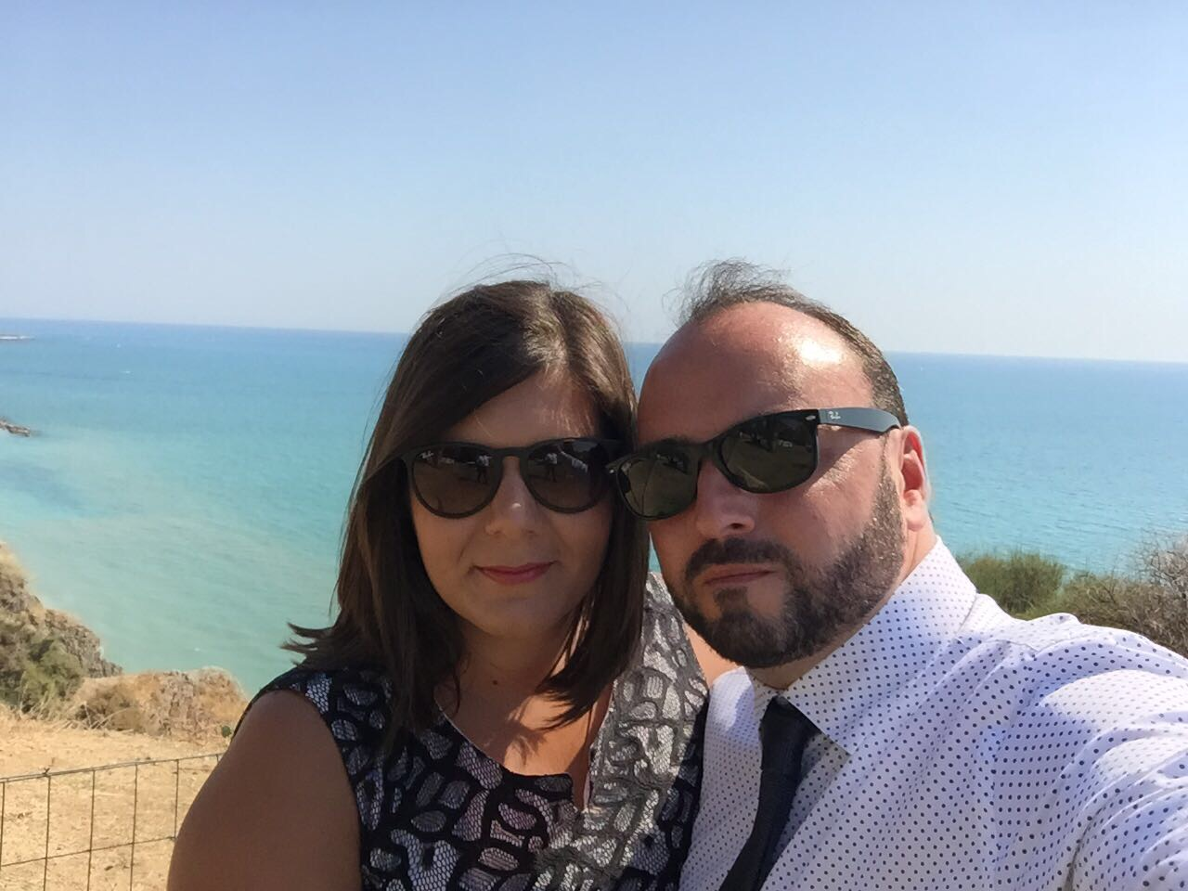
Introduction to the trainers
Claudia Linditsch

Slide 23
Introduction to the learning platform

Slide 24
Learning platform - Moodle
Registration
Everyone has received username and password from „ZML Administration or VC-Training“
Check spam folder please
Email includes info on German course – don´t get confused ;)

Slide 25
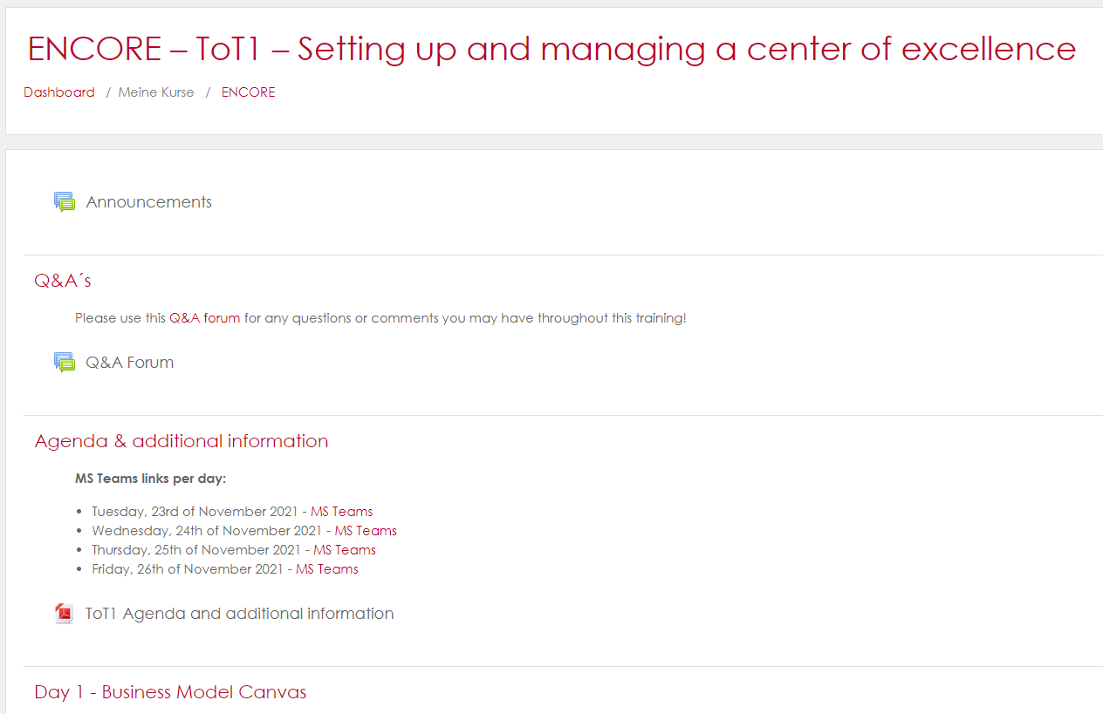
Learning platform - Moodle
Some insights ;)

Slide 26
Team introduction “Same & Different”

Slide 27
Same & Different
Aim
Getting to know your team members (break-out room per country)
Also interesting to find out new things about people in already established teams ;)

Slide 28
Same & Different
What to do?
Get into your break-out rooms
Write down a list on an online whiteboard (e.g. Padlet or any other you know) or on a piece of paper ;) with all the interesting things that you all have in common and something unique to each participant
Take 15 minutes time to get to know a tool and identify common and individual things
Please present your team in 5 minutes ☺

Slide 29
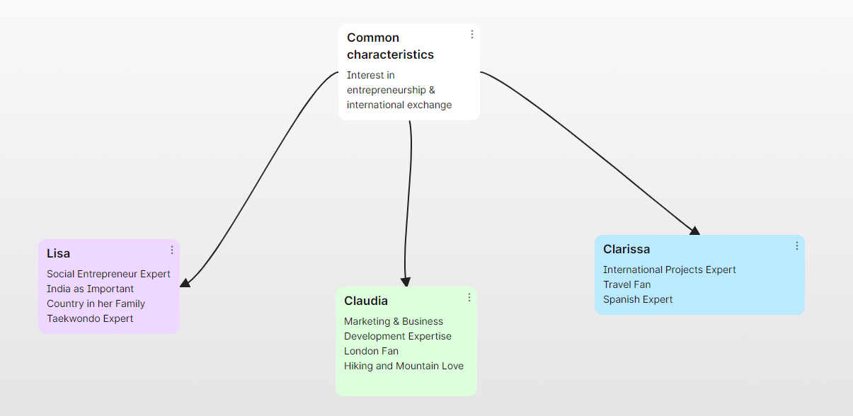
Same & Different
Tools that could be used:
Padlet

Slide 30
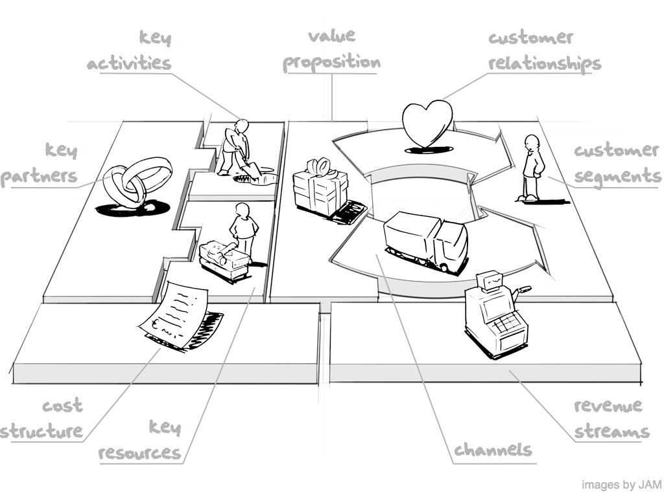
Introduction to business modelling & the business model canvas

Slide 31
Learning objectives
Understanding the key concepts of business model thinking.
Acquiring knowledge of the 9 blocks of the Busines Model Canvas for value creation.
Learning how to apply the Business Model Canvas to map current business model understanding and analysis.
Gain basic knowledge on how to apply the Business Model Canvas in HEI teaching.

Slide 32
Content of this introduction module
Introduction to business model thinking
The Business Model Canvas and the 9 building blocks
Application of the Business Model Cavas for HEI teaching

Slide 33
3 traits of successful entrepreneurs
Do not focus on product innovation alone.
Do not copy an existing business model.
Willing to take risks and experiment with their businesses to grow.

Slide 34
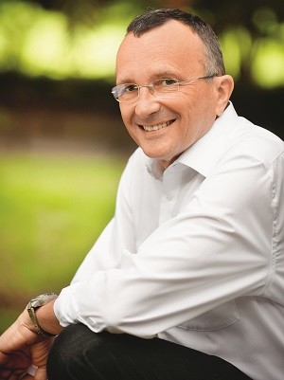
“While product innovation and process innovation are important aspects in entrepreneurship, having the right business model more often than not would make the difference between success & failure.”
Yves Pigneur

Slide 35
Definition of a business model
“ A business model describes the rational of how an organization creates, delivers and captures value.”
Source: Strategyzer

Slide 36
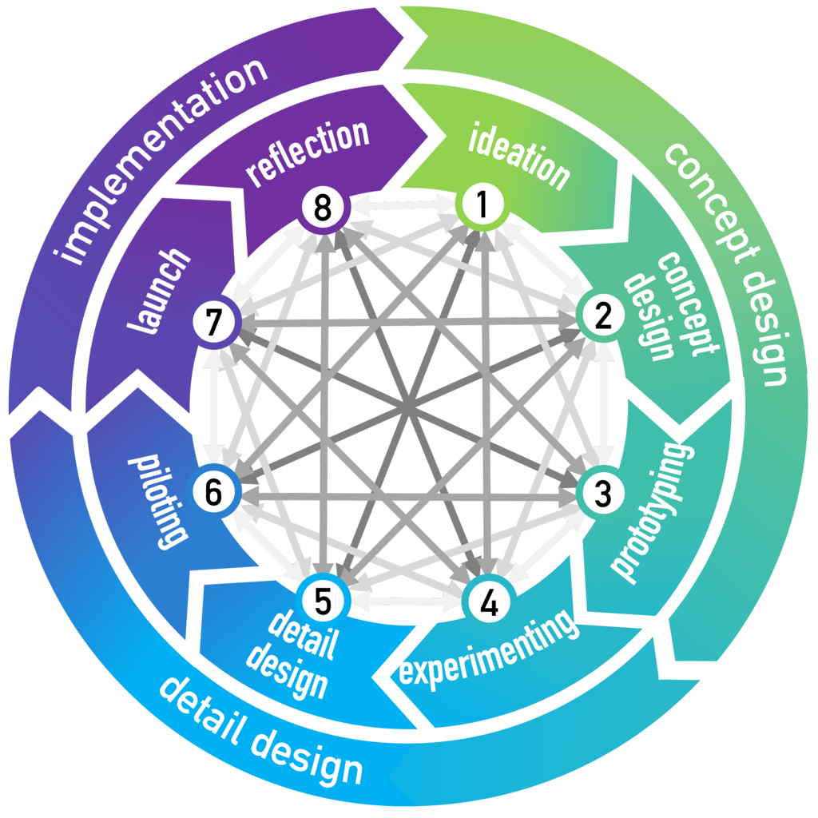
Business model (create, deliver & capture value)
Source: The Camebridge Business Model Innovation Process, 2017

Slide 37
How do these companies create value?
Product & service sales
Ad revenues
Product sale & subscription to a service

Slide 38
Business model canvas
Source: Strategyzer | Corporate Innovation Strategy, Tools & Training

Slide 39
Business model canvas
Strategic management framework for developing business models to create new business models or update existing business models
A visual representation of the various element of your business model
Used in real life and also teaching
Post-its are your best friends (also possible online through e.g. Miro)

Slide 40
Business model canvas
The canvas allows you to:
See relationships among the parts of your model
Identify hypothesis, assumptions and risks
Plan validation testing (market, channels & pricing)
Find ways to add value or reduce costs
Brainstorm market disruption strategies

Slide 41
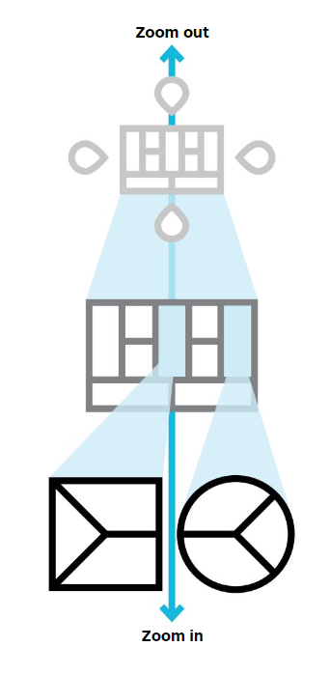
Business model canvas – an integrated suite of tools
The Environment Map helps you to understand the context in which you create = industry analysis
The Business Model Canvas helps you to create value for your business.
The Value Proposition Canvas helps you to create value for your customers.

Slide 42
Applications of the business model canvas
Strategizing | Organizational alignment
Dashboard | Strategy co-creation
Understanding competition | Shared language across functions
Portfolio of business models | Investments
Innovation | M&As
New idea template | Exit strategies
Understanding

Slide 43
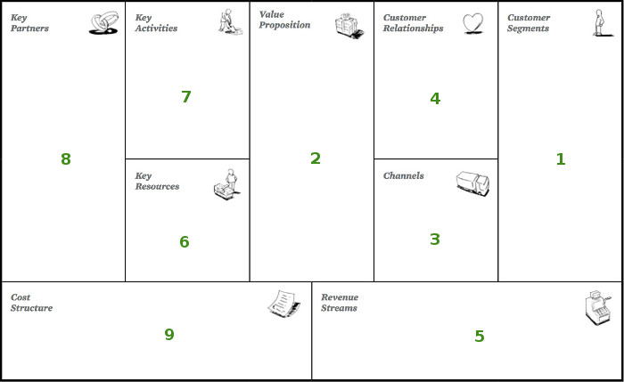
9 generic building blocks for the development of business models

Slide 44
Left canvas vs. Right canvas
Left canvas = efficiency
Right canvas = value

Slide 45
9 generic building blocks
1
Customer segments
For whom are we creating value? Who are our most important customers/users?
Market decision (mass or niche market), segementation (personas)
2
Value proposition
What value do we deliver to the customers? Which problems do we solve? Which needs to we satisfy? Which products/services to each segment?
3
Channels (communication & distribution)
Through which channels do our customers want to be reached? How can we reach them? Which work well? Which are cost-efficient? How do we integrate them with customer routines?
Notes:
Customer segments – e.g. Twitter: User, company & developer
Value proposition – e.g. User – connectiveness & follow news and hottest topics; companies – targeted marketing; developer – Twitter apps for different platforms
Channels – e.g. user – website, desktop, mobile app; developer – Twitter API

Slide 46
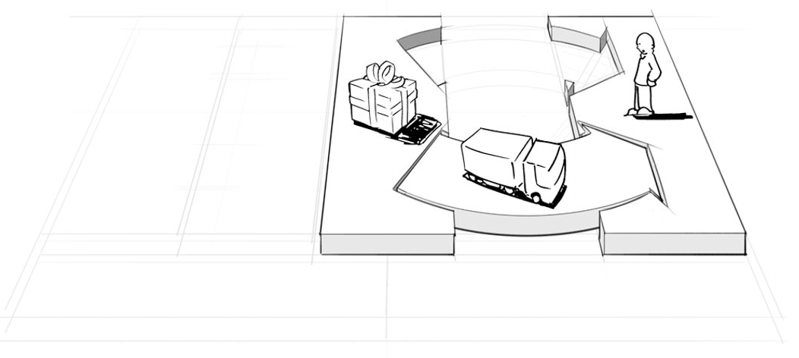
9 generic building blocks – summary blocks 1-3

Slide 47
9 generic building blocks
4
Customer relationships
What type of relationship does each customer segment/persona expect? How costly are they to maintain? Works for my business model?
Personal assistance, self-service, communities, …
5
Revenue streams
What are customers willing to pay? How are they currently paying and prefer to do so in the future? How much does each revenue stream contribute to the overall ones?
6
Key resources
What key resources do our value proposition require? Our distribution channels? Customer relationships? Revenue streams?
Physical, intellectual, human, financial, …
Notes:
Revenue streams – lisencing for data streams, sponsored tweets, promoted accounts
Key ressources – platform twitter itself but also HR/expertise

Slide 48
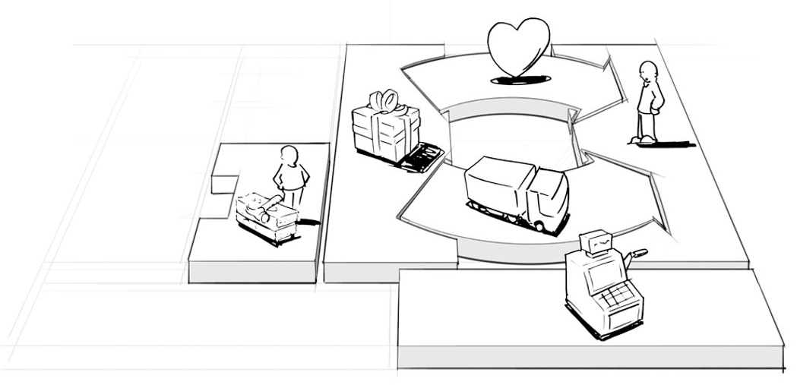
9 generic building blocks – summary blocks 1-6

Slide 49
9 generic building blocks
7
Key activities
What key activities do our value proposition require? Our distribution channels? Customer relationships? Revenue streams?
Production, problem solving, network
8
Key partners
Who are our key partners? Who are our key suppliers? Which resources are we acquiring from partners? Which key activities do partners perform?
Motivation: optimization, reduction of risk & uncertainty, acquisition of resources
9
Cost structure
What are the most important costs inherent in our business model? Which key resources are most important and most expensive?
Cost-driven, value-driven, fixed & variable costs, economies of scale & scope

Slide 50
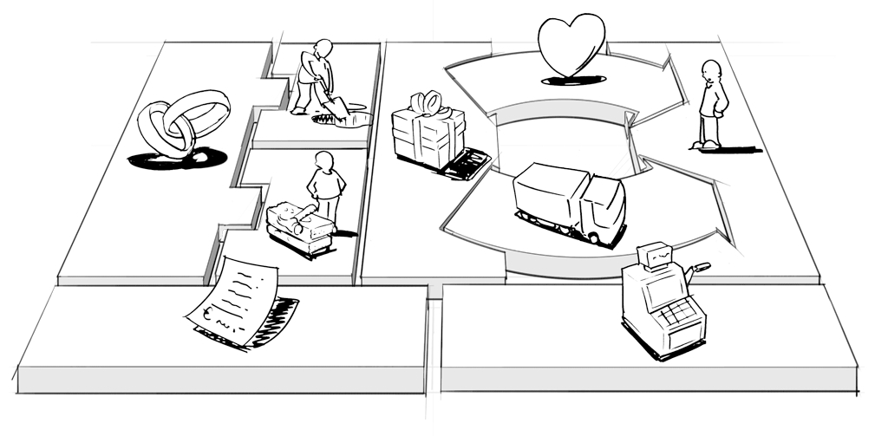
9 generic building blocks – summary blocks 1-9

Slide 51
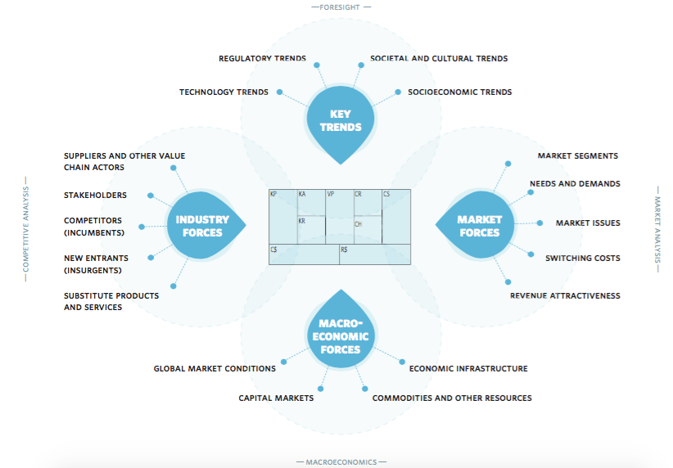
Business model canvas – not a stand alone model
Great exercise to do with students once having a business idea in mind: How To Scan Your Business Model Environment For Disruptive Threats And Opportunities (strategyzer.com)

Slide 52
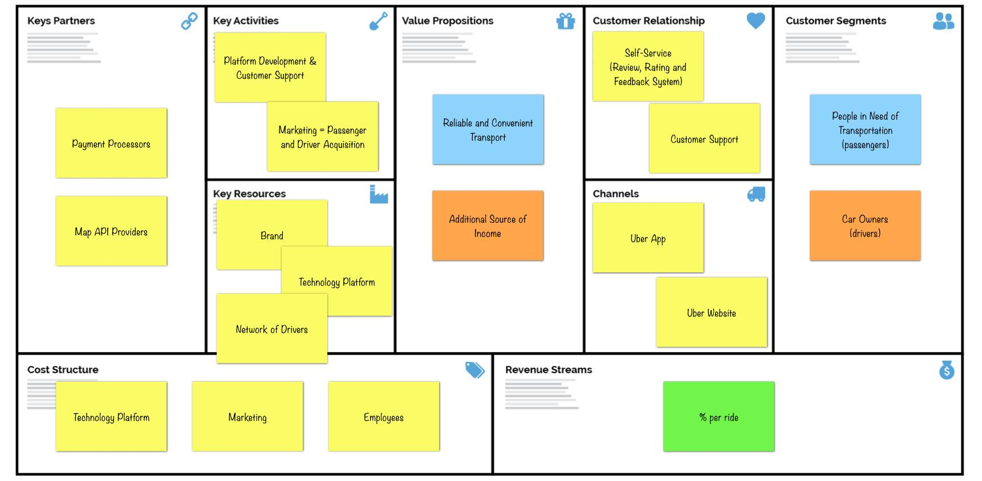
Business model canvas – example Uber

Slide 53
Business model canvas – Don´ts
Treating the canvas like a checklist – understand the connections
Too much details & too many ideas in one canvas
Confusing intent with value proposition
Don´t leave out numbers/blocks
Too much information
Listing features rather than benefits

Slide 54
Business model canvas – HEI teaching
Substantial part in the business lab in the Master´s programme
Ideation – first step into a idea creation and business modeling
Perfect tool for group work and opinion exchange and for further tasks in terms of market and industry analysis

Slide 56
ENCORE
Entrepreneurship Knowledge Centers to Foster Innovative Entrepreneurship Practices in Education and Research
Project ref.: 617589-EPP-1-2020-1-AT-EPPKA2-CBHE-JP

