Slide 1
ENCORE Entrepreneurship Knowledge Centers to Foster Innovative Entrepreneurship Practices in Education and Research
Training of the Trainers 4
Understanding your target groups
9th until 11th of May 2022
Project ref.: 617589-EPP-1-2020-1-AT-EPPKA2-CBHE-JP

Slide 2
Identifying and understanding target groups

Slide 3
Learning Objectives
Be able to identify various target groups of your respective EKC
Create targeted profiles for each customer type
Understand what process customers go through when engaging with the EKC

Slide 4
Insights into target groups

Slide 5
What is a target group?
A simple definition of Investopia is, "A target market refers to a group of customers to whom a company wants to sell its products and services, and to whom it directs its marketing efforts."
But there is more to be said about this.
A target group is made up of different people on the basis of their same or similar characteristics.
As an entrepreneur try to understand the nature of your target groups on different levels.

Slide 6
Three levels of better understanding your target group
1
Cohorts
Individual cohorts share a world view because they have grown up in the same time and have had similar experiences. As a rule, this applies to generations, e.g. millennials or baby boomers.
By taking a closer look, one can recognize patterns in the attitudes, but this distinction alone is not enough.
Notes:
e.g. Gen Z – work/ life balance, rather become entrepreneurs because they don’t want the 9-5 job, enterprises with sustainability focus

Slide 7
Three levels of better understanding your target group
2
Segments (1)
Customer segmentation is a way to split customers into groups based on certain shared characteristics. All customers share the common need of a product or service; beyond that, they possess distinct demographic differences (i.e., age, gender) and tend to have additional socio-economic, lifestyle or other behavioral differences that offer companies useful marketing insights.
Data used for segmentation – location, products/services purchased, how the customer got in touch with a business, demographic information, buying behaviour, …

Slide 8
Three levels of better understanding your target group
2
Segments (2)
Segmentation of customers can be done according to the following models:
Demographic segmentation – age, gender, income, occupation, … - straight forward but limited in relevance and scope
Behavioral segmentation – purchasing behavior, benefits sought, buyer journey stage, usage behavior, timing of usage/purchase, … - can be tracked if systems are in place – investments needed and often based on complex data analysis – worth it for a start-up?
Notes:
Behavioral: how they want to consume the service of the EKC- independent learners, lot of assistance..

Slide 9
Three levels of better understanding your target group
2
Segments (3)
Segmentation of customers can be done according to the following models:
Geographic segmentation – cultural preferences, population type and density – putting people in the same location into one box – often combined with other segmentation types such as behavioral to improve the meaningfulness
Psychographic segmentation – personality, attitudes, beliefs or personal traits – often implemented in form of a survey – more difficult to obtain data and data collected is self-reported by “potential customers”
Notes:
Having a segmentation is the first step for understanding your customer, but it doesn’t explain why customers do what they do.

Slide 10
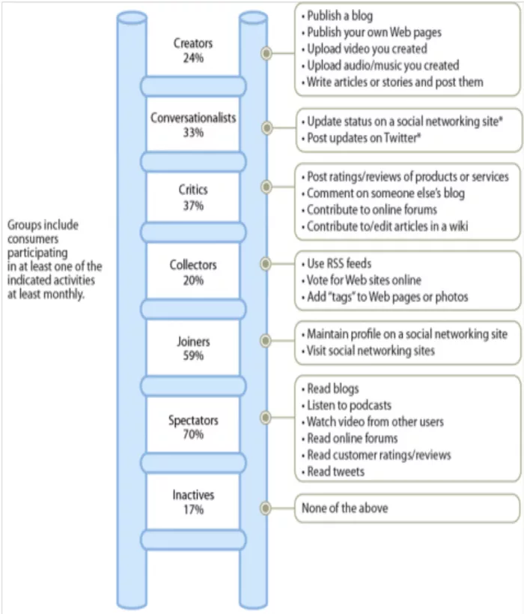
Three levels of better understanding your target group
3
Archetypes
Archetypes are user profiles within segments. These differ in psychographic characteristics, such as character traits, habits, values, motivations, life goals, self-image and image of others, and dream role. It can be advantageous, especially in the digital age, to analyze the online surfing behavior of customer groups.
Notes:
Archetype is a type of segmentation
Segmentation: “1-to-1” definition, meaning a customer can only belong to one segment. This approach makes it easier to direct a message in the form of an advertisement or offer. when the goal is to reach customers as broadly as possible, while still maintaining relevance, the traditional segmentation ways show flaws.
Archetypes allow for the largest impact- customers can be more than one archetype- asking for the WHY
For example, a bargain hunter is someone who looks for bargains. One person may be looking for bargains because they need to keep as much income as they can for essentials. Another person looks for bargains because it’s fun and feels good to find a deal. Same behavior, different motivations, two customer archetypes.
Entrepreneur- wants to start a business. Might be because they lost their job or can´t find any job, or because they want to be independent, identify as their own boss etc.

Slide 11
Strategies for target group identification & the importance of personas

Slide 12
Strategies for target group identification
Determining target groups is an ongoing process. The environment and people adapt to changing circumstances. Thus, the needs and requirements of a brand also change.
Just think of the progressing digitalization!
Data collection is key for the target group identification!
Target group analysis is essential no matter if a company is at the beginning, a new product is introduced, or existing ones need to be optimized!
Notes:
Step-by-Step Guide to a Successful Target Group Analysis (mynd.com)

Slide 13
Process of target group analysis
When entrepreneurs or students are aiming to identify their target groups, then the following process can be followed.

Slide 14
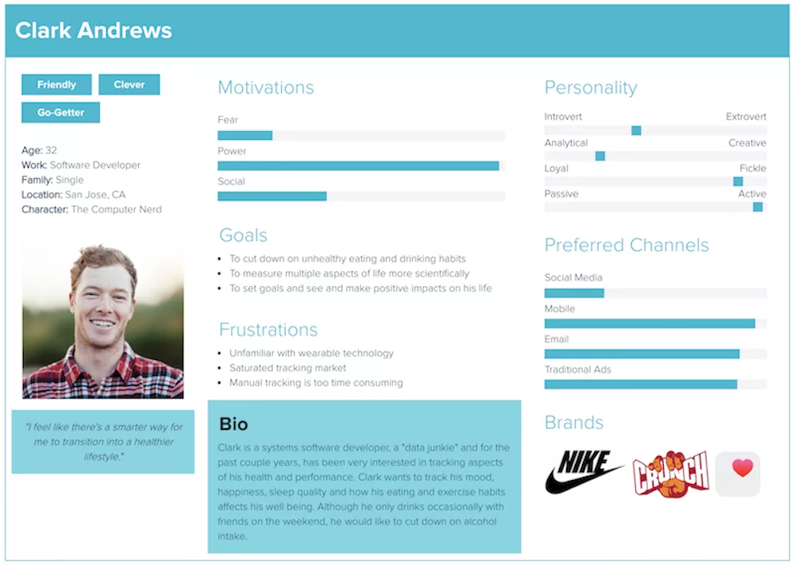
Process of target group analysis - Persona
A persona combines all the findings you have gathered on the target group with the help of qualitative and quantitative research in a fictitious person.
In this way, Persona, as an example person, represents all real characteristics and needs of a certain target group. In other words, anonymous target groups are personified with the help of personas.

Slide 15
Process of target group analysis - Persona
Task of a persona is to give marketers and business developers orientation when designing products, content and offers.
They also help evaluate new ideas. By and large, personas simplify the decision-making process.
The more detailed the persona information, the better effective marketing measures can be derived. Particularly in the area of content, you can offer your target group great added value through needs-oriented content.

Slide 16
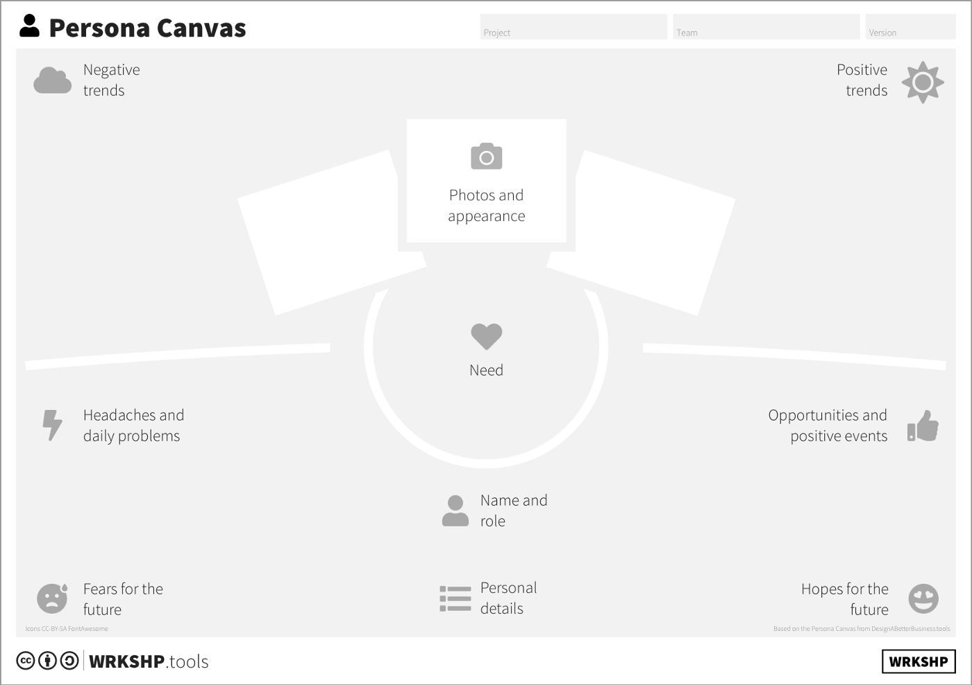
How to develop a persona with students
Persona Canvas – most important steps
Define your goals
Gather data
Process and cluster data
Define the personas and make a rich picture

Slide 17
How to develop a persona with students
Some supportive tools
Hubspot – Make my persona tool
Online tool to create a persona with an avatar – can be created and downloaded for free
Canva – Persona templates/presentations
Some more online tools can be found here – more complex and to be paid

Slide 18
Exercise (20 min.)
Get together in your EKC groups
Select one customer type to analyze
Create a persona with the help of one of the online tools
Volunteer group presentation

Slide 19
Customer Journey Map

Slide 20
Data collection par excellence …
Customer segmentation is vital for entrepreneurial success
An example
Invest as early as possible in data collection to target advertising more effectively.
As an entrepreneur, one needs to think about the following aspects:
Search queries via Google
Data published by a company on social media (e.g. demographics, interests)
A company´s interaction in social networks
The website performance (e.g. clicks, impressions, length of stay) associated with your cookie ID

Slide 21
The online offer will grow over the next few years …
… which means data capture options for companies at all sizes.
Entrepreneurs should make better use of the big data trend as the demands of the target group regarding a demand-oriented approach also increases.
So do your homework and ensure happy customers! The success will be seen in your account numbers.

Slide 22
Customer Journey Map
Visual representation of a customers experience as they interact with a business → combines this information into a visual map.
Buying process
User actions
Emotions
Pain Points
Solutions
Notes:
From: https://blog.hubspot.com/service/customer-journey-map

Slide 23
Customer Journey Map (2)
→ 70% of Online shoppers abandoned their cart in 2021. Why do customers spent hours adding products just to abandon it?
→ 80% of customers consider their experience with the company as important as its products.
→ 33% of customers will consider switching companies after just one bad experience.
A customer map helps EKC staff members to get into the mind of the customer by understanding the normal questions they have and the emotions they are feeling.
Notes:
From: https://blog.hubspot.com/service/customer-journey-map

Slide 24
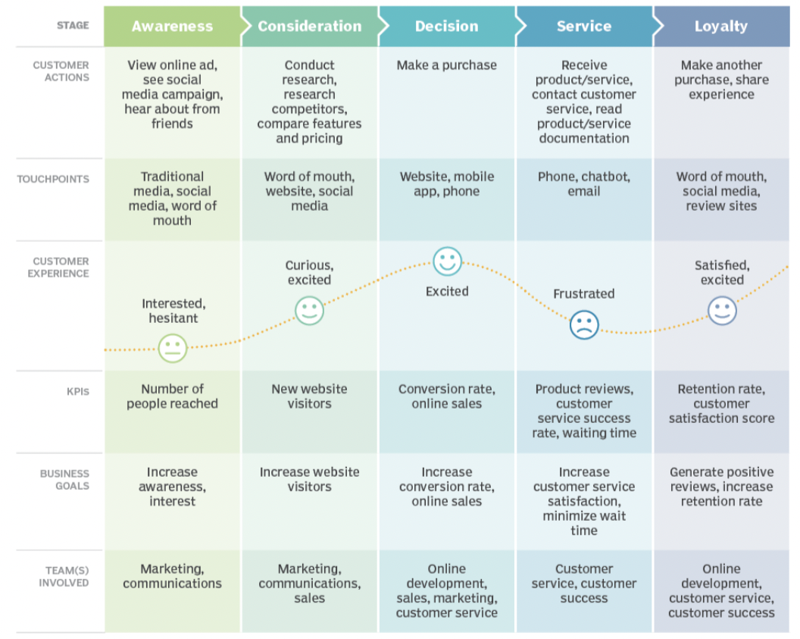
Customer Journey Map (3)

Slide 26
ENCORE
Entrepreneurship Knowledge Centers to Foster Innovative Entrepreneurship Practices in Education and Research
Project ref.: 617589-EPP-1-2020-1-AT-EPPKA2-CBHE-JP

