Slide 1
ENCORE
Entrepreneurship Knowledge Centers to Foster Innovative Entrepreneurship Practices in Education and Research
Training of the Trainers 1
Setting up and managing a center of excellence
23rd until 26th of November 2021
Project ref.: 617589-EPP-1-2020-1-AT-EPPKA2-CBHE-JP

Slide 2
Customer relationships & marketing strategic planning & channels

Slide 3
Content of this module
Types of relationships & importance of customer segmentation/personas
Marketing channels to be used for the customer segments of the EKCs
Tipps and tricks to consider in marketing activities

Slide 4



Learning objectives
Understanding the relevance of customer relationships in regards to customer segments and personas for business models.
Identifying marketing channels suitable for certain customer segnments.
Gaining the knowledge on how to tailor marketing channels for better customer relations.

Slide 5
Customer relationships

Slide 6
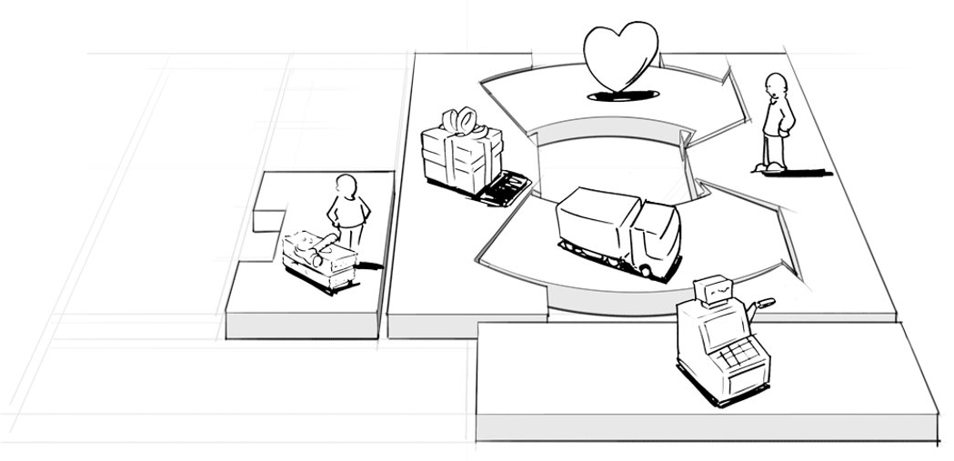
Customer relationships in the business model canvas
Customer relationship management concerns the way you engage with customers to deliver the customer experience.

Slide 7
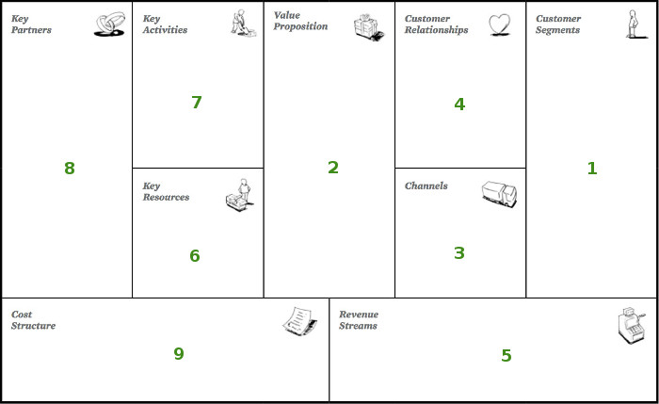
Left canvas vs. Right canvas
Left canvas = efficiency
Right canvas = value

Slide 8
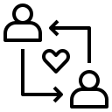
Customer relationships in the business model canvas
4
Overall, the building block deals with the nature of relationships that an organisation/EKC will develop with ist various customer segments/stakeholders.
The customer relationships that an organization opts for are based on the company’s business model and greatly impact the overall customer experience.
Customer relationships are not just about the customer service department. Sales teams, marketing teams, customer service teams, customer support, customer success, and product development all play important roles in building successful customer relationships.

Slide 9
Customer relationships in the business model canvas
4
Customer relationships
Questions to be asked
What type of relationship does each of our customer segments expect us to establish and maintain with them?
Which ones have we established?
How costly are they?
How are they integrated with the rest of our business model?

Slide 10
Types of customer relationships (1)
We need to distinguish but different types can co-exist in your center
Transactional | Automated services
Long-term | Communities
(Dedicated) personal assistance | Co-creation
Self- service
Switching costs – also relevant for EKCs if you want to sell services after the end of the project
Notes:
Transactional
This means there is no real relationship between the company and the customer. The company interacts with the customer on a transactional basis. A kiosk at an airport, for example, usually doesn’t really establish a relationship with its customers.
Long-term
This means a long-term and maybe even deep relationship is established between the company and the customer. The company interacts with the customer on a recurring basis.
Personal assistance
This relationship is based on human interaction. The customer can communicate with a real customer representative to get help during the sales process or after the purchase is complete. This may happen onsite at the point of sale, through call centers, by e-mail, or through other means.
Dedicated personal assistance
This relationship involves dedicating a customer representative specifically to an individual client. It represents the deepest and most intimate type of relationship and normally develops over a long period of time. In private banking services, for example, dedicated bankers serve high net worth individuals. Similar relationships can be found in other businesses in the form of key account managers who maintain personal relationships with important customers.
Self-service
In this type of relationship, a company maintains no direct relationship with customers. It provides all the necessary means for customers to help themselves.
Communities
Automated services
This type of relationship mixes a more sophisticated form of customer self-service with automated processes. For example, personal online profiles give customers access to customized services. Automated services can recognize individual customers and their characteristics, and offer information related to orders or transactions. At their best, automated services can stimulate a personal relationship (e.g. offering book or movie recommendations).
Communities
Increasingly, companies are utilizing user communities to become more involved with customers/prospects and to facilitate connections between community members. Many companies maintain online communities that allow users to exchange knowledge and solve each other’s problems. Communities can also help companies better understand their customers. Pharmaceutical giant GlaxoSmithKline launched a private online community when it introduced alli, a new prescription-free weight-loss product. GlaxoSmithKline wanted to increase its understanding of the challenges faced by overweight adults, and thereby learn to better manage customer expectations.
Co-creation
More companies are going beyond the traditional customer-vendor relationship to co-create value with customers. Amazon.com invites customers to write reviews and thus create value for other book lovers. Some companies engage customers to assist with the design of new and innovative products. Others, such as YouTube.com, solicit customers to create content for public consumption.
Switching costs
Switching costs indicate how easy or how difficult it is for a customer to switch to a different alternative. For example, when a customer of a data storage provider stores all his data in a proprietary format it might be difficult for him to switch to an alternative provider.

Slide 11
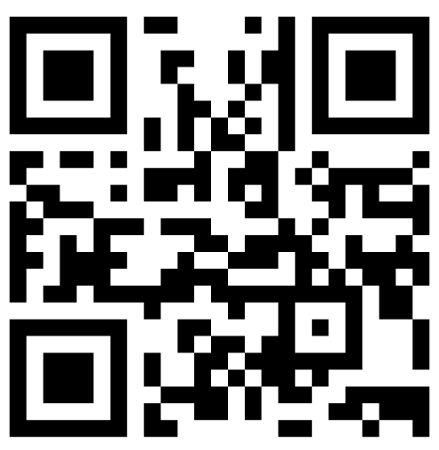
Types of customer relationships (2)
Which type of customer relations is a good approach for your EKC?
Let us know your opinion!
Please go to menti.com and use the following code 1372 9941 OR use the QR code

Slide 12
Building relationships through engagement
Attract, inform, inspire, and engage your audience
Imagine that our goal is more than marketing but to build relationships through engagement. In this case, marketing becomes a means to that end.
Marketing is just one component of your comprehensive communications strategy. The most successful organizations focus on nurturing relationships; employing a marketing plan and applying it to specific campaigns is part of an engagement continuum.
What is an Engagement Continuum?
An engagement continuum is a series of touch points between the organization and the intended audience whom you are trying to reach.
Your marketing activities must attract, inform, inspire, and engage donors and stakeholders. Along this continuum, you will find what you consider to be “marketing” will decrease, while relationship-building will increase.
A marketing plan is the path you and your audience follow to arrive where you nurture and steward the relationships formed along the way.

Slide 13
From strangers to relationships
Experience + Engagement
TOUCH POINTS
ATTRACT
INFORM
+
INSPIRE
ENGAGE
Publications
Marketing
Sponsorships
Video
Website
Mobile
Social Media
Programming
Events
Relationships
Marketing decreases while relationship building increase, leading to stewardship
STRANGERS
ACQUAINTANCES
COMMUNITY
MEMBERS
VALUES ALIGNMENT TO ENGAGEMENT
THE ENGAGEMENT CONTINUUM

Slide 14
Customer relationships – what to consider
EKC needs to clarify the type of relationship it wants to establish with each customer segment / persona
Relationships are established through your different channels and marketing channels to support the business value
The type of customer relationship you put in place deeply influences the overall customer experience in your center
The type(s) depend on the overall available resources

Slide 15
Motivation for customer relationships
Customer acquisition
Customer retention (loyalty)
Sales expansion

Slide 16
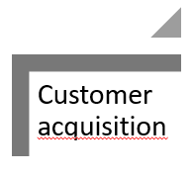
Customer acquisition is the process of persuading a customer to select your organization’s product over choices available in the market.
Cost intense process – so right choice of mediums and tactics is essential
Options for successful customer acquisition for your EKC:
Social media marketing
Email marketing
Search engine optimization together with your university´s website
Conversion rate optimization on website or social media platforms

Slide 17
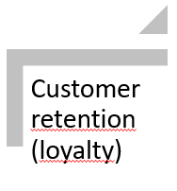
= refers to the long-term relationship a company establishes with its customers. The more repeat customers, a company has, the more it is assured of champions who will market its products and help it acquire additional customers.
Some strategies for your EKC:
Stand for something
Utilize social proof
Use the words they love to hear
Reduce pain points and frictions
Make it personal
…
Notes:
Stand for Something: customers are more loyal to brands that they identify with or which they feel represent traits and characteristics that they would like to emulate. So it is imperative for a company to select what its brand stands for and communicate that to its customers.
Utilize positive social proof: websites that provide customers with facts that show how the use of their product will improve their social standing are more likely to help the company retain customers in the long term.
Use the words they love to hear: certain words have a deep impact on the buying behavior of customers, and if the product fulfills the promise of these words, customer retention becomes easier.
Reduce pain points and frictions: if you address a pain point for your customer or resolve a problem for him, you will be retaining him for much longer.
Make it personal: by providing a personal service to the customers, you increase your chances of creating a repeat customer.

Slide 18
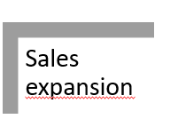
Convince customers to select (buy) more of your products/services
Use product/service bundles
Think about incentive programmes for customer segments including employees
When thinking about your EKC – this could be:
Networking event organization and coaching sessions
Incentives for students and/or employees if they recommend your EKC for training

Slide 19
Matching with customer segments/personas
Ensure that the type of customer relations is matching with the characteristics and expectations of your customer segments/personas
How to find out?
Ask them ;)
Surveys, interviews, personal talks

Slide 20
Marketing strategic planning & channels

Slide 21
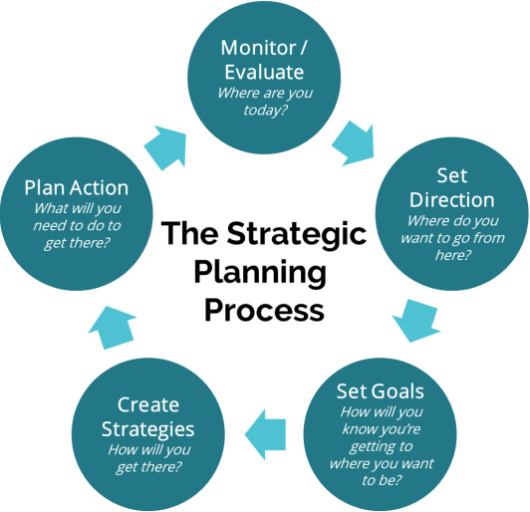

Marketing Strategic Planning
Planning is deciding in advance what to do, how to do it, when to do it and who is to do it. Planning is simply a rational approach to accomplish an objective.
It bridges the gap from where we are & where we want to go.

Slide 22
Marketing strategy – know your target audience/major stakeholders
Target Market
Target Audience
A set of individuals sharing common needs or characteristics that the organization decides to serve. These individuals are usually the end users of a product or service.
A group that has significant potential to respond positively to a brand message. Effective marketing communications, or messages, each target a particular kind of reader or viewer. These individuals make up the message’s target audience.
- Philip Kotler and Gary Armstrong
- Tom Duncan
Who is the primary (intended) audience you’re trying to reach? Remember that everybody (or the general public) is not your audience and the more specific you can be about your audiences, the better. Think of the one person who best represents the audience you’re seeking to reach and keep them in mind as you create the strategy.
To figure out how to approach your different audiences, start thinking about what you already know about them.
  What phase of life are they in?
  What motivates them to care about what you do?
  What do they already know about your work?

Slide 23








An educated guess about major stakeholders/target groups
HEIs leaders and managers of the areas of entrepreneurship and entrepreneurship education
Academic staff focusing on entrepreneurship development and education
Students and student associations interested in entrepreneurship activities and education
Entrepreneurs, local development associations, …

Slide 24



Guide questions for creating the marketing mix for EKCs
PRODUCT: What your beneficiaries/donors want form your cause/project? What needs does it satisfy? Does your cause/project meet those needs? How does it differentiates from other organizations?
PRICE: How valuable is your cause or project to the beneficiaries? And to the donors? How much funding can you ask to the donors? Does it cover the project expenses? How can you increase the perceived SROI, in order to increase the funding?
PLACE: Where will your stakeholders find you or your project? Does that place fit your stakeholders profile? How can you access the right distribution channels? What are other organizations and companies, that have a similar offer, doing? What can you learn from that, to collaborate or differentiate?
PROMOTION: What will you communicate to your target audience? What messages will make sense? When and where will you reach them? How will you deliver each message?
Source: umundze.com

Slide 25

Marketing Objectives
What is the purpose for your marketing activities? What are the goals you follow with your marketing objectives?

Slide 26
Objectives of the ENCORE project
Capacity Building
Knowledge Centers
Cooperation
Capacity building of experts on entrepreneurship and entrepreneurship education at HEIs in Bhutan, Laos and Nepal
Implementation of 6 knowledge centers at partner HEIs to increase awareness and expertise in entrepreneurship activities and education
Foster university-business cooperation through the ENCORE centers
Student Employability
Industry Analysis
International Network
Increase of employability of students due to upgraded knowledge on entrepreneurship and foster entrepreneurial activities
Current status analysis of efforts in entrepreneurship activities and education in Bhutan, Laos and Nepal , and the European partner countries and the identification of gaps/necessities in each participating region
Creation of a nationwide and international network

Slide 27

Marketing objectives
Which objectives will be addressed with your marketing activities?
Make sure your marketing goals are tied directly to your organizational/ project objectives.
Here are examples of the most common nonprofit marketing goals:
New donor or member acquisition
Community engagement
Raise awareness
Become a thought leader and go-to resource on an issue
Since nonprofit organizational priorities are always changing and shifting, it is important to review your marketing plan every quarter (3 months). This may not mean creating a new one from scratch, but rather examining the plan to see where it can be tweaked and analyzing your progress.

Slide 28
Marketing objectives – the SMART way
The best way to refine your objectives is by using something called the SMART objective framework. SMART goals for your nonprofit stands for:
S
M
A
R
T
Specific
Measurable
Achievable
Relevant
Time-bound
Who, What, Where, When, Why, Which
From and To
How
Worthwhile
When
Define the goal as much as possible with no ambiguous language
Can you track the progress and measure the outcome?
Is the goal reasonable enough to be accomplished?
Is the goal worthwhile and will it meet your needs?
Your objective should include a time limit.
WHO is involved, WHAT do I want to accomplish, WHERE will it be done, WHY am I doing this (reasons, purpose), WHICH constraints/ requirements do I have?
How much, how many, how will I know when my goal is accomplished?
Make sure the goal is not out of reach or below standard performance.
Is each goal consistent with other goals you have established and fits with your immediate and long term plans?
It will establish a sense of urgency and prompt you to have better time management.

Slide 29
Examples of SMART goals
If your primary marketing goal is “raising awareness”, then some sample SMART goals could be:
Results
Increase website traffic by 25% by adding social media content starting posting by April 1, 2022
Acquire 20 new donors through Facebook by June 30, 2022
Increase email list sign-ups through social media channels by 500 names by June 30, 2022
Increase online and print mentions by 25% by July 31, 2022
Tactical
Increase audience connections through Facebook to 1000 by September 1, 2022
Increase mentions by 20% on Twitter before, during, and after trainings and special events for 2023
Increase likes and comments with fans on Facebook to 6 comments per post by August 30, 2022
Increase views on YouTube Channel by 50% by January 2023
Increase number of retweets and @replies on Twitter by 20% by September, 30, 2022
Recruit 40 organizations to join your LinkedIn organization page by August 30, 2022
Increase website traffic by 20% by September 30, 2022
Identify top 25 influencers on Instagram to build relationships to help blog, repost, and spread the word by September, 30, 2024
Capacity
Conduct an audience survey to determine where to expand, grow, and diversify social media presence for 2022
Create one video per month to tell stories about the impact of our organization by January 2022
Enhance visual storytelling capacity and diversify type of content shared with a goal of increasing videos by 10%, photos by 20%, and photos and text by August 1, 2012

Slide 30
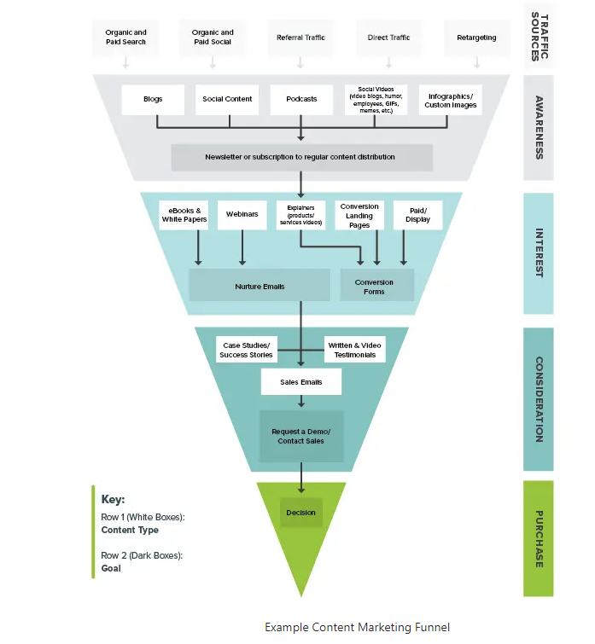
Content marketing funnel

Slide 31
Your online and offline marketing mix tailored to your objectives
Which media and tactical touch points will bring you the most success in reaching your target audience?
ONLINE
OFFLINE
Website
Print Media (brochures, flyers, posters)
Social media (Facebook, YouTube, Instagram, etc.)
Direct mail
Email marketing (e-newsletter, advocacy alerts)
Newsletter
Public relations placements on websites/blogs
Public Relations (radio, TV, newspapers, magazines)
Special events pages
Paid advertising (billboards, signage)
Donation pages
Special events
Paid advertising (banner ads, Google AdWords)
Telemarketing and donor outreach

Slide 32

Online Tools & Digital Marketing

Slide 33

Website optimization through great content
First impressions are often online impressions
Your website is your most important piece of marketing = it’s your face to the world and the place where you usually make that meaningful first impression.
Publish content on your website to inform and inspire your intended audience, drawing them into your cause and making them want to be part of your story.
The content that you create on your website can be shared and cross-posted on social media platforms like Twitter, Facebook, and LinkedIn, further promoting awareness of your organization.
Content creation also allows you to increase your Search Engine Optimization (SEO) profile, generate more traffic, and get around ad-blockers, among other benefits.

Slide 34






Social media platforms to share your message
Each social media platform has its unique strengths. In order to maximize your impact, it’s important to tailor your message based on each platform’s strengths and focus.
Facebook is great for showcasing impact, expanding reach, and engaging debate or conversation among different supporters.
Twitter is useful for sharing news around an issue or tagging specific people in your updates.
Storytelling is increasingly important to donors, and one effective way to do this is by sharing videos on YouTube.
LinkedIn is great for networking and connecting with other organizations, volunteers, prospective staff members and other professionals in your industry.
Instagram is an excellent venue for visual storytelling where you can post images and videos to create more of a personal vibe with your network.
Using Google+ improves your SEO, which bumps your organization up in Google’s search results.

Slide 35


Social media platforms to share your message
Website Content
Social Media
Include content to learn about your cause on your website: When you’re spreading the word through other marketing channels, it’s good to have an informative page to send people to so they can learn more about your top issues.
Add a short description of what you do at the top of your homepage: Visitors can get a good idea of what you do right off the bat.
Include calls to action on your website: A good call to action example could be joining your email newsletter.
Provide an easy way for visitors to sign up for your email list: This could be a page with a form on your website, or even a call to action that appears in the sidebar and/or footer of your nonprofit’s site.
Optimize blog posts for search engines (SEO): Publish blog posts about topics related to your cause and optimize them for search engines to drive additional traffic.
Research social media channels before joining: Make sure that your target audience regularly engages on those networks before dedicating the time to be active on new channels.
Maintain an active presence on all the networks you use: To accomplish this, consider creating a posting schedule and sticking to it.
Consider creating a social media ambassador program: Supporters can then become ambassadors and spread awareness among their followers.
Research and use #hashtags related to your cause: Make sure to follow the best practices for using hashtags on each network.
Engage and communicate with influencers in your field: Research potential partners and supporters to strike up a conversation with them on the social media channels that they’re active on.
*Source: wiredimpact.com

Slide 36
Marketing for a cause
Quality content that adds value to your audience
Infographics inspire and inform
Infographics work as a perfect channel to send information and make seemingly boring facts look fun. Without having to read huge amounts of text, your audience gets a chance to explore a topic in a more engaging way.
Give free advice relating to your cause
Write helpful how-to articles and checklists or create easily consumable images with tips, resources and helpful tools.
Be the trusted expert
Publish research, case studies, or trends data where you can establish your presence as a trusted expert on your cause, and that can lead to interviews, people sharing your content, and free marketing of your cause and your organization.
Share Your Gratitude
Bring attention to and share your gratitude for others who are doing good work on your issue and show appreciation to your current donor base, partners and supporters.
Newsjack
Add your story on to an existing news story. By providing reporters with a story they can use to update breaking news on the following day, your story becomes the second paragraph of the story on the second day.

Slide 37

Marketing for a cause
Quality content that adds value to your audience
Have a social media contest
While the results of the Ice Bucket Challenge aren’t easily attainable, having a contest via social media is a great way to spread awareness and get people engaged with your cause and excited to be a part of it.
Email Marketing
Email remains an effective method of connecting with your audience. Sending out regular email newsletters also help educate your subscribers and keep them engaged in the cause.

Slide 38





Some helpful online tools
Canva for Nonprofits (Free premium version available for registered nonprofits)
Canva is an excellent tool to create visuals of all kinds. From infographics to ebooks to Facebook ads to email headers and more, it’s a one-stop graphic design shop for non-graphic designers.
Hootsuite (Free entry-level version)
Hootsuite is a tool that allows you to schedule posts for Twitter, Facebook, LinkedIn, Instagram, and Google+ anytime you like. Their “freemium” version makes juggling multiple social channels simpler — which leaves you more time to actually engage with your audience.
WordStream Keyword Tool (Free!)
WordStream is a free keyword tool to help increase the chance people finding your website online. It helps your website rank higher in Google searches by telling you which phrases people are searching for on Google that may be related to your nonprofit (these phrases are called, “keywords"). You can then reflect those phrases in your website copy and blog posts.
Grammarly (Free, with premium features)
Whether you’re writing an email, creating copy for marketing materials, or drafting social media posts, Grammarly can help you check your documents for grammar mistakes, typos, spelling errors, and overly complex sentences.

Slide 39

Building Offline Connections

Slide 40

Traditional print media
Print remains an effective medium to reach your audience. Not only can print be disruptive in a digital age, it engages more of the audience’s senses than digital media.
Pamphlets, brochures and flyers are a great way to locally spread the word about the Competence Centers.
Postcards are a great way to put a personal spin on direct mail. They are delivered directly to the hands of potential donors and supporters. They don’t require an envelope and also beautifully combine visuals and text into a nice, neat piece.
Create a well-written and informative Press Release. This will allow your cause to be seen by those in your immediate vicinity via the local paper. This can also lead to a larger audience seeing your work if the press release is picked up by other outlets around the country.
Business cards are affordable and very mobile. You can take them everywhere you go - events, tradeshows, social gatherings, etc. HINT: Your business cards should include a call to action, donation instructions, and contact information.

Slide 41

Forming partnerships with other organizations
Partnering with local organizations is a great way to promote awareness of your nonprofit organization.
Many businesses and companies are constantly seeking nonprofit partners to help them build their CSR program and increase their prominence in the public eye. This could be as simple as having a themed fundraiser night, or partnering for a charity drive or a service day.
However, you shouldn't just partner with any organization. Find a company that truly shares your views, and a dedication to your cause.

Slide 42
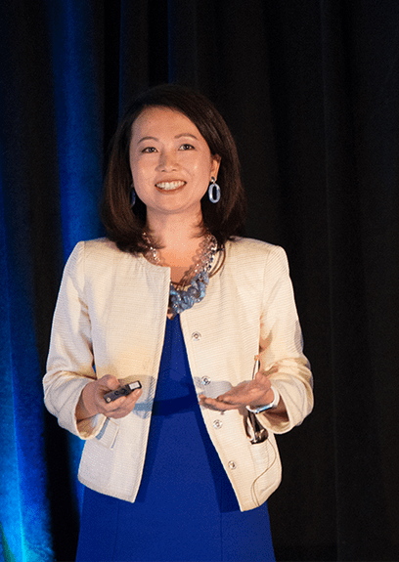
Forming partnerships with other organizations
By adding their voice to the discussion of the causes that they support, nonprofit organizations can increase their credibility and prove themselves to be trusted experts.
When organizations take the time to engage with their audience, answer questions, share stories and relate successes, their supporters become immediately involved in who they are and what they do.
Some examples for cementing credibility though public speaking:
Speaking engagements, lectures and presentations, conversations, speeches and participation in relevant conferences and events
Doing interviews or pitching stories to the media
Distributing Public Service Announcements (PSA) at local and national radio or TV stations

Slide 43
Special events create visibility
For nonprofits, nothing beats face-to-face contact
Nonprofits are generally in the human services business and in-person meetings can go a long way to forming and strengthening connections.
While utilizing the Internet is one of the most cost-effective ways to reach a lot of people and spread the word about your organization, in-person interactions remain very important.
Organizations that are able to visibly show a commitment to the community are more likely to have a stronger reputation and attract supporters and donors who care deeply about what the organization stands for.
Don’t forget to capture your special event online: to a blog post for your site - or other sites!
Take video clips from the event - these can be shared on YouTube and shared by others across social media. Since you already put in the effort to organize the event, you might as well produce content about it and share it as much as possible.

Slide 44

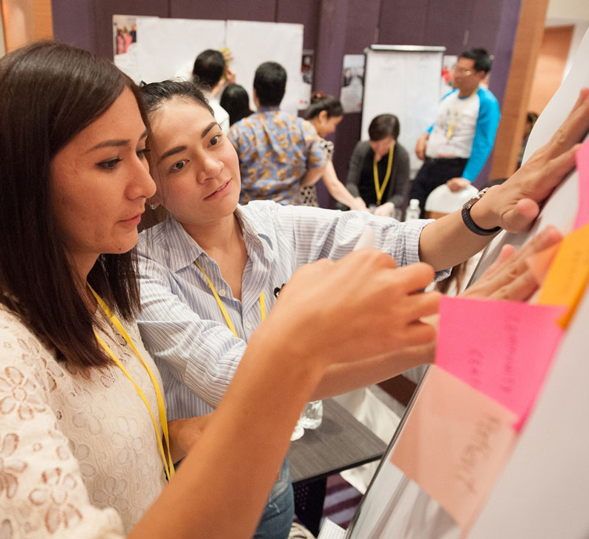

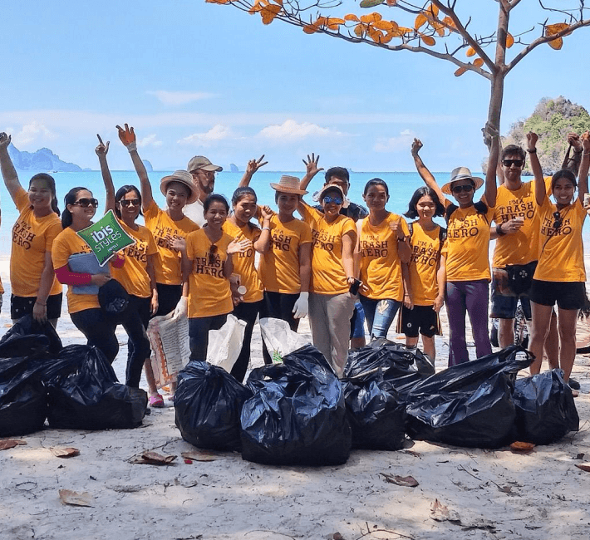
Special events you can organize
Have an Open House
Conduct Trainings
Matchmaking Events
Service Projects
Arrange small luncheons and in-house tours with partners, government and business leaders. Events where you make personal contact with your supporters are immensely important.
Offer trainings to ensure the effective transfer of knowledge to relevant stakeholders.
Invite people to attend events where they can learn something useful for their own lives, while also learning about your cause.
Empower and connect others
Bring together people who have a common interest and facilitate their sharing and networking.
Allow groups (ex. service clubs, employees at a company, etc.) to volunteer together in some way related to your cause, perhaps on a special volunteer day.
Reception dinners, Networking events with alumni who are entrepreneurs
Tree-planting, “clean-up” and recycling drives, etc.
Open House luncheons or dinners, weekend picnics and barbecues, etc.
Trainings, Educational events

Slide 45
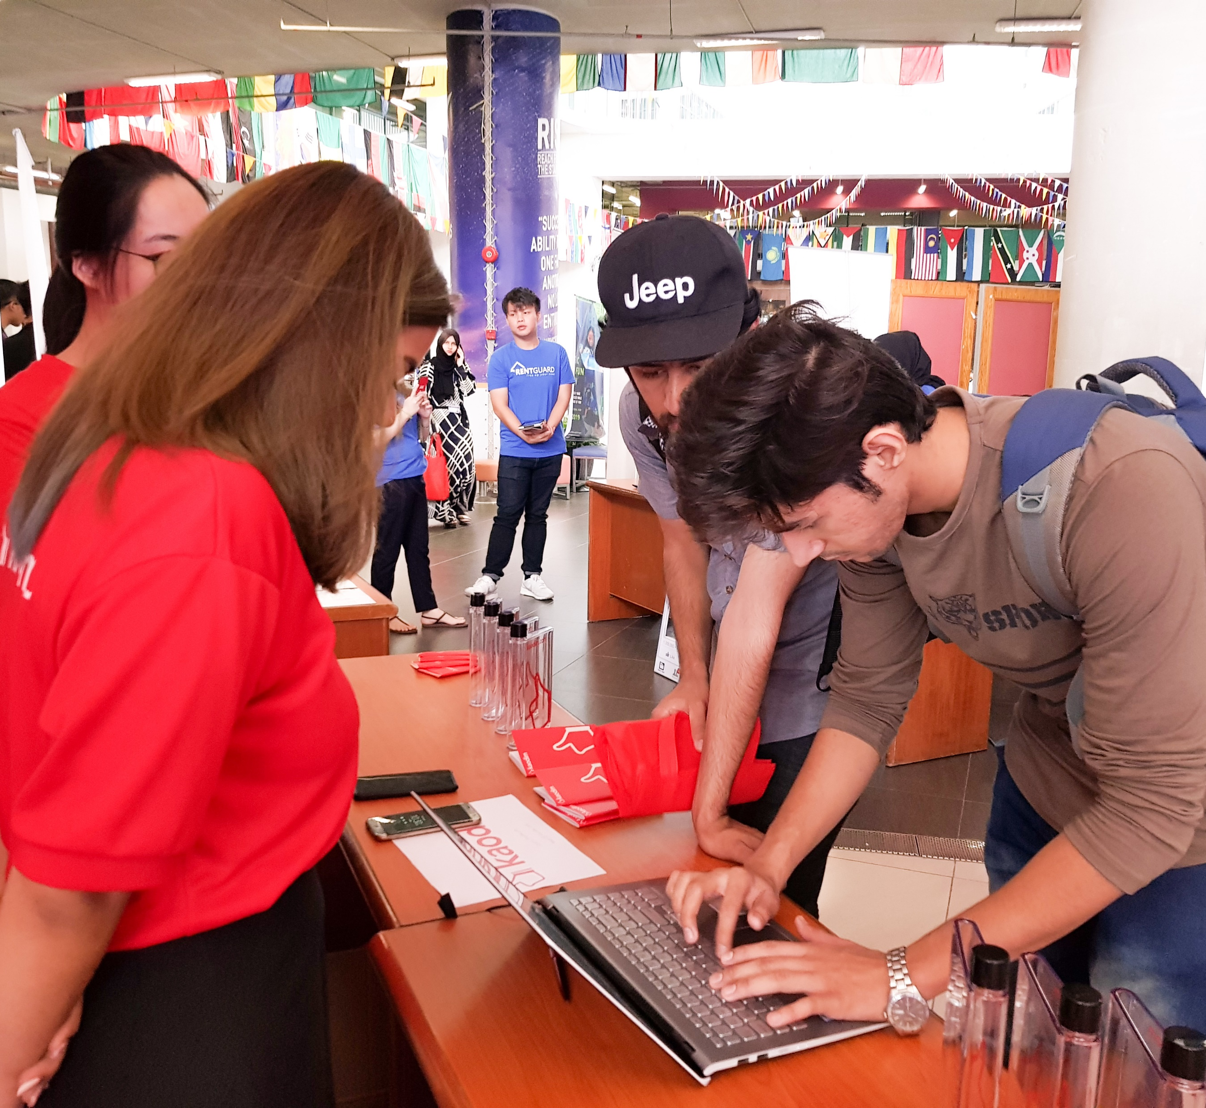

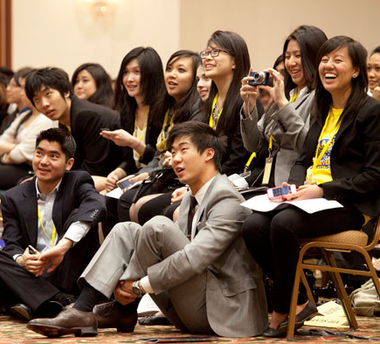

Special events you can organize
Community Outreach
Fundraising Events
Campaign Kickoffs
Celebrate Successes
Engage with the Community
Set up a booth at small fairs and local community events. Your presence in these gatherings is a great opportunity to spread awareness and build up your network.
Organize fundraising events to bring people together for some fun and social activities, and then tack on some information about your cause during the gathering.
Invite the public for campaign kickoffs
Host an event at the beginning of a new campaign to bring community awareness and generate excitement.
Bring people together to celebrate milestones and achievements. You can also plan a gathering to thank and recognize your donors and supporters.
Small luncheons or dinners, weekend picnics and barbecues
Booth and kiosk at fairs and local events
Fun runs, bake sales
Press conference, open forums, information nights

Slide 46

The Power of Storytelling

Slide 47
Stories worth telling
Put your stories at the heart of your marketing
Storytelling is one of the most powerful ways in which you can build your brand. It is a valuable tool that can help your audience understand your cause and get passionate about it.
Sometimes it takes a story to truly convey just how important the work of an organization is. Storytelling can help you build meaningful relationships with your audience, creates trust and credibility, and helps your nonprofit stand out – which is all you want when it comes to nonprofit branding.
Here are some tips for using storytelling as a tool for branding:
Tell authentic stories about your work. Today’s audience can easily differentiate between a sales pitch and a genuine story.
Stories come in all shapes and forms. Don’t forget about visual storytelling, particularly the video – which is one of the most effective mediums to relay messages.
Always have a central character. A central character (the hero) is usually a beneficiary of your organization. It’s much easier for people to relate to individuals than to large groups of people or abstract concepts. Paint a clear and vivid picture of a life of your central character.
*Source: donorbox.org

Slide 48



Examples of storytelling
charity: water
World Bicycle Relief
charity: water raised $2.4 million at a fundraising event by taking donors on a virtual trip to a small town in Ethiopia.
At the event, the organization provided attendees with virtual reality (VR) headsets so they could watch a movie that documented a week in the life of an Ethiopian family accessing clean water for the first time.
Ethel’s Dream
The World Bicycle Relief who focuses on “mobilizing people through the Power of Bicycles” has tapped into the power of personal stories by letting the people they serve share their own experiences with the organization. And when you hear directly from someone like Ethel, who walked two hours to school and back every day just to get an education until World Bicycle Relief cut her commute down to 45 minutes, you can't help but feel connected to her and to the organization’s mission.
VIDEO:
https://youtu.be/nlVIsVfWwS4
STORY and VIDEO:
https://worldbicyclerelief.org/en/impact/education/#ethel%20video

Slide 49

Marketing Action Planning

Slide 50
Marketing action planning
Create a 30-day or 90-marketing action plan
Identify your planned initiatives, including planned activities for each of your specific stakeholders/customer segments for each of your center goals.
In addition, it is important to add mechanisms of measurement deriving from the objectives and set deadlines and responsibilities for each of the actions planned.
Here are some tips for creating an action plan for your marketing initiatives/activities:
Use a tool that supports you with planning. It can be a simple excel file but also an online software such as Wrike, or Asana – free to use for educational purposes.
Start with the most objectives and develop an action plan which is also feasible in terms of the available resources.

Slide 51

Marketing action planning
Goal – Increasing the awareness among students by 15% until the 30th of June 2022
Activities – Social media posting on Facebook of the university
Media used – Facebook – content prepared for target group
Audience/stakeholders – students
Measurement – number of likes on Facebook of the center

Slide 52

Group work for each EKC
Please determine the customer relationships you want to follow within your EKC
Identify strengths and weaknesses of your customer relationships
Identify your marketing strategy and the marketing action plan according to the template presented

Slide 53


Slide 54
ENCORE
Entrepreneurship Knowledge Centers to Foster Innovative Entrepreneurship Practices in Education and Research
Project ref.: 617589-EPP-1-2020-1-AT-EPPKA2-CBHE-JP

