Slide 1
ENCORE
Entrepreneurship Knowledge Centers to Foster Innovative Entrepreneurship Practices in Education and Research SOCIAL ENTREPRENEURSHIP University of Alicante, may 9th 2022
Duration
15.01.2021 - 14.01.2024

Slide 2
Definition
The creation of new products, services and business behaviours that a part of satisfying social demands also means a sustainable social transformation (Dacin et al., 2010)
It defines the social entrepreneurship in an innovative way, as the creation of social value from activities that can occur within and out of profit-making organisations in the private or public sectors (Austin et al., 2006)

Slide 4
Some data:
The world-wide average of adults aged between 8 and 64 years that are in the process to create a social company is of 3,2%
7,6% find a way to set a startup with commercial target
1% of Spaniards among 18 and 64 years begin a social entrepreneurship initiative
0,7% of the population has stable projects

Slide 5
Social entrepreneur profile:
55% are men and 45% women
People of 18-34 years are more willing to set organisations with social targets
The levels of education of social entrepreneurs differ significantly among regions:
In Africa Sub-Saharian the social entrepreneurs are much less formed that in the rest of regions of the world
USA and Australia the highest concentration of social entrepreneurs with higher education level (62%)
In Europe 50% entrepreneurs have higher education level.

Slide 6
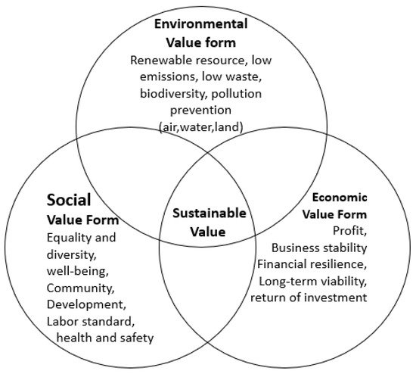
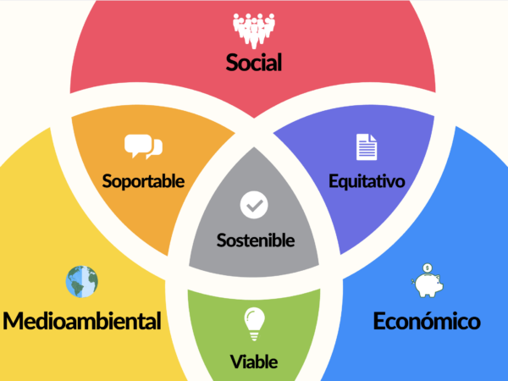
Social entrepreneurship factors determining success

Slide 7
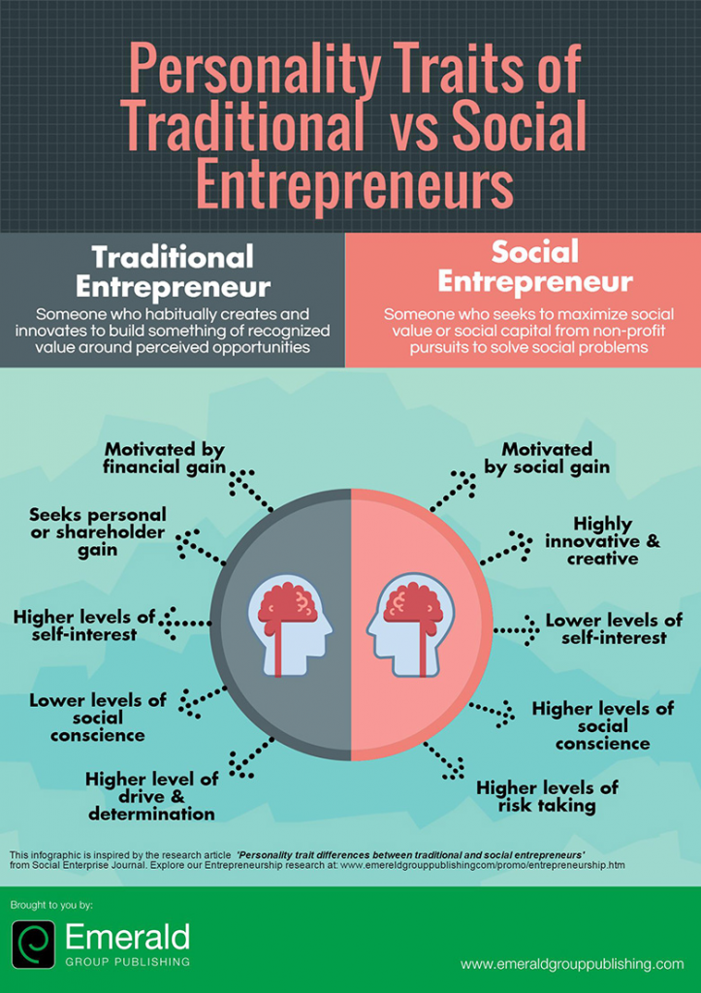
Social vs traditional entrepreneur

Slide 8
Social entrepreneur ecosystem

Slide 9
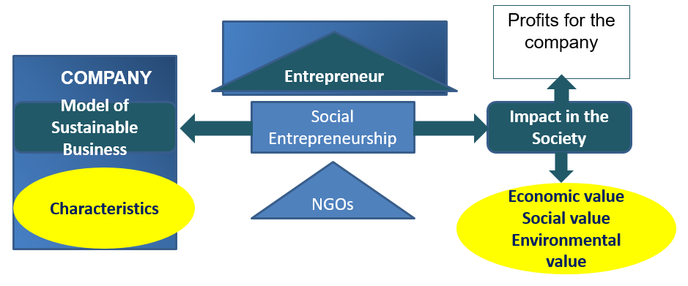
Social entrepreneur ecosystem

Slide 10
Partners
Fachhochschule Joanneum / Austria
University of Alicante / Spain
Haaga-Helia UAS / Finland
Royal University of Bhutan (Gedu College of Business Studies) / Bhutan
Royal Thimphu College in Bhutan
Tribhuvan University (Institute of Crisis Management Studies) / Nepal
Global College International / Nepal
Souphanouvong University / Laos
National University of Laos / Laos

