Slide 1
ENCORE
Entrepreneurship Knowledge Centers to Foster Innovative Entrepreneurship Practices in Education and Research
Duration
15.01.2021 - 14.01.2024

Slide 2
Experiential learning to enhance entrepreneurial competences
Jarmo Ritalahti
Principal lecturer
Haaga-Helia University of Applied Sciences
3 March 2022

Slide 3
Competences
Competence can be understood as a combination of practical and theoretical knowledge, (cognitive) skills, behavior and values needed to do something; or of being adequately or well qualified, having the ability to perform in a specific position.
Changing competences:
EU: Digital and green skills
Finland (new competence framework for UAS, 2022):
Learning to learn
Act in work community
Ethicalness
Sustainable development
Internationalism and multi-culturalism
Anticipation

Slide 4
COMPETENCES
How to include competences in degree programmes:
Competences as a part of programme structure
Modules and specialisations
Competences as a part of course content and aims
E.g. SDGs and business ethics
Enhancing competences through pedagogy
E.g. inquiry learning, problem-based learning
Enhancing competences through learning methods
Flipped learning
Learning diaries
Assignments

Slide 5
ENTREPRENEURIAL COMPETENCES
Source: EntreComp, https://www.eee-platform.eu/the-entrecomp-competence-framework/

Slide 6
Activity 1
What (entrepreneurial) competences are emphasised in your degree programmes?
Discuss in groups and write your insights on Flinga
https://edu.flinga.fi/s/EP4G5CN

Slide 7
EXERIENTIAL PEDAGOGICAL APPROACHES
Problem based learning
Inquiry learning
Project based learning
Case based learning
Student-centered approach in which students learn about a subject by working in groups to solve an open-ended problem.
Students are in the active role of problem solvers
This problem is what drives the motivation and the learning.
Based on constructivist and socio -constructivist theories of learning
Emphasizes the student’s role in the learning process.
Students are encouraged to explore the material.
Students learn by doing. This allows them to build knowledge through exploration, experience, and discussion.
Students acquire content knowledge and skills in order to answer a driving question that is challenging and constructive
It is done collaboratively and within groups using critical thinking, communication, and creativity.
Involves an ongoing process of reflection
Instructional design model that is a variant of project-oriented learning.
Oriented toward a case, which from different perspectives generates different and equally correct problems
Questions with no single right answer.

Slide 8
INQUIRY LEARNING AT HAAGA-HELIA PORVOO CAMPUS

Slide 9
WHY INQUIRY LEARNING?
Real-life projects inspire and motivate.
Competences are developed:
Project management
Team work
Time management
Problem solving
Creativity
First step to life-long learning
Applying knowldge instead of only memorising

Slide 10
WHAT IS INQUIRY LEARNING?
Inquiry learning is learning...
where students take responsibility of their own learning by using the Campus inquiry learning process
where the learning process is shared with other learners by
setting goals,
defining and explaining phenomena,
searching for information independently and
building knowledge through collaboration
where the student is in the center and supervisors guide the learning process as facilitators and coaches
where observation, reflection, assessment and development are emphasised throughout the process

Slide 11
INQUIRY LEARNING ON HAAGA-HELIA PORVOO CAMPUS
Global megatrends, changing world of work...and the pedagogical strategy of Haaga-Helia
Learning takes place in larger activities and projects (implementations: business idea competition, study tour)
Projects are carried out together with companies and student and supervisor teams
These methods give you competences that are needed in the work life >
Competence-based curriculum
Students
Companies - Commisioners
Supervisors

Slide 12
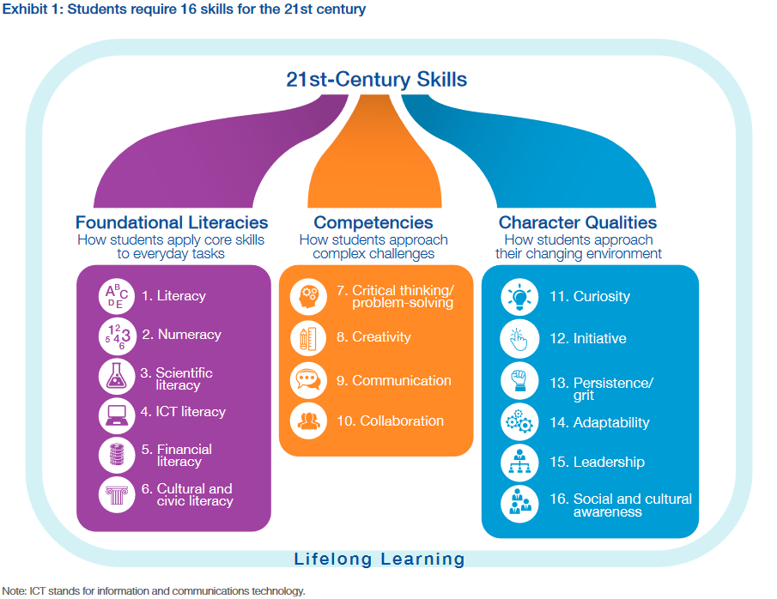
”Students require 16 skills to compete in the 21st century”
World Economic Forum in collaboration with BCG.

Slide 13
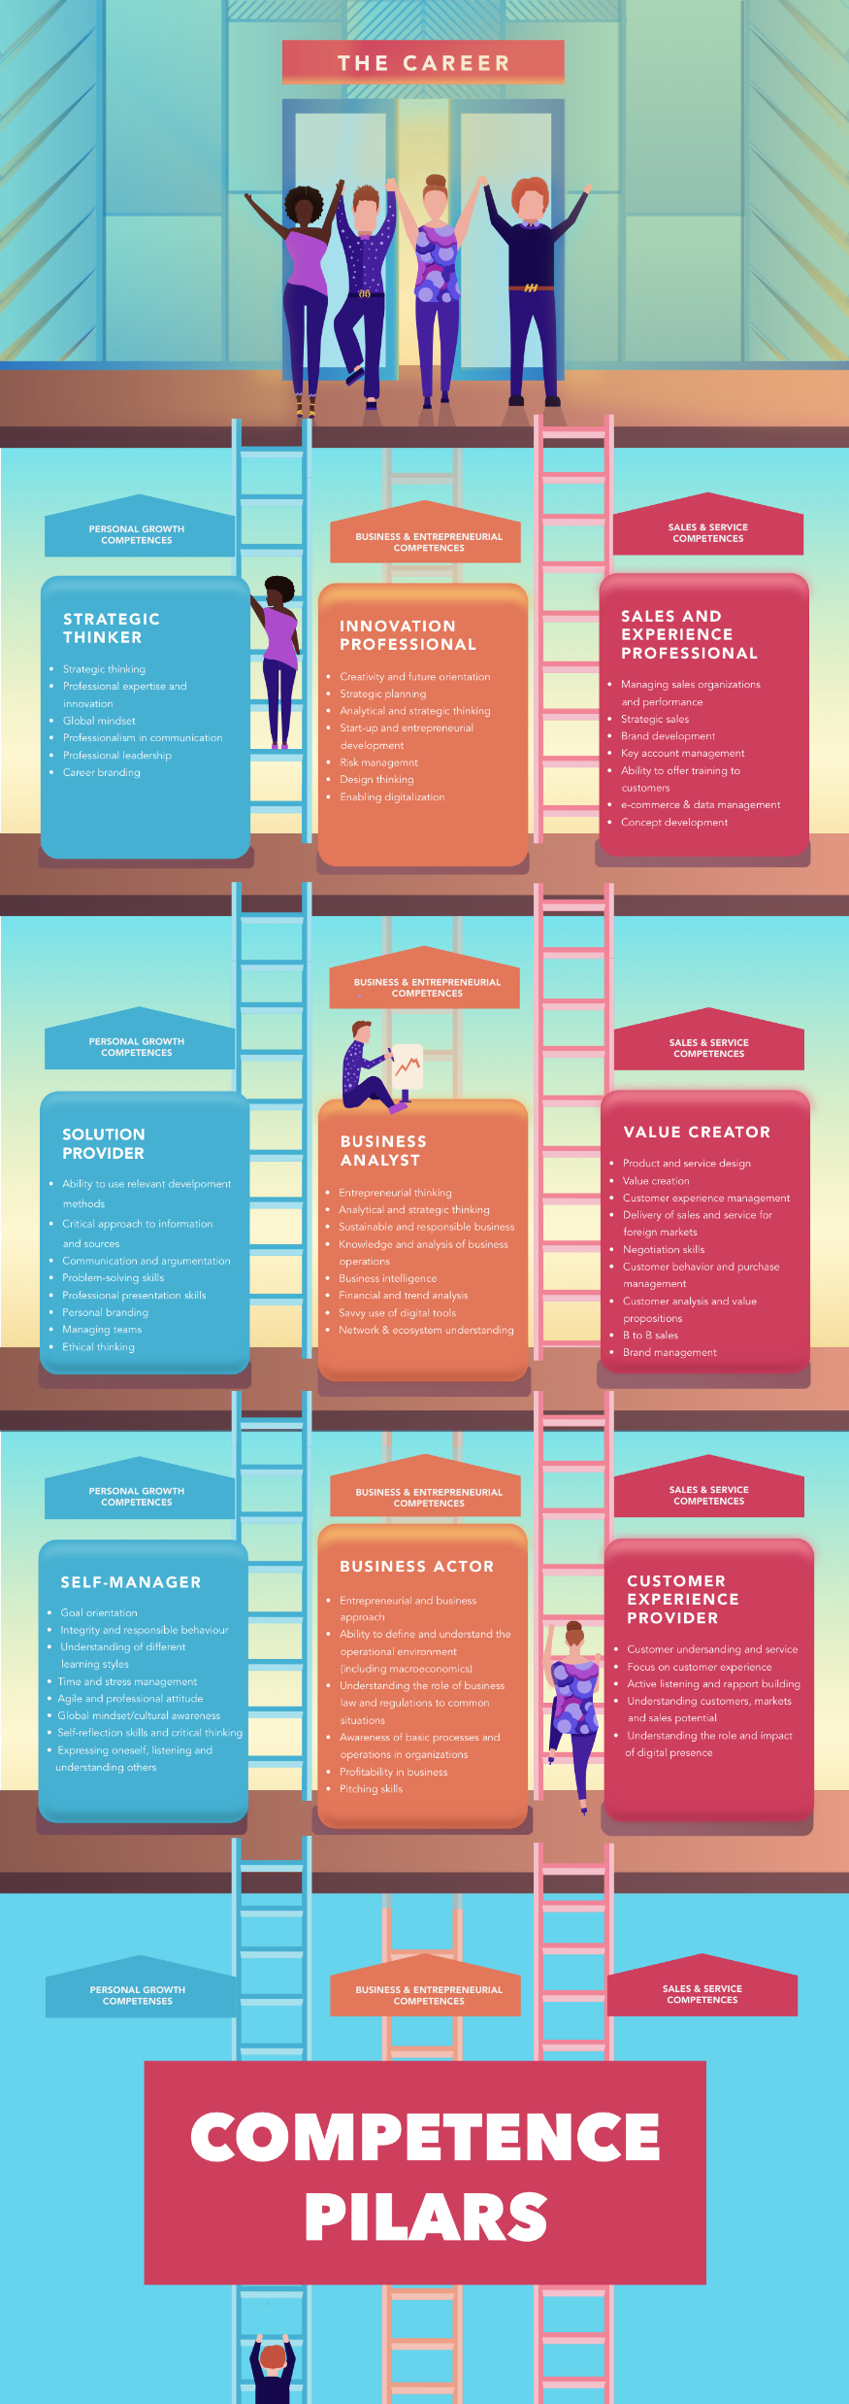
Competence
Pillars

Slide 14
Competence
Pillars

Slide 18
Steps of inquiry learning on Porvoo Campus
Development task
Building up the goals and content
Agreeing on theoretical framework
Working together to build knowledge
Reflection
Knowledge sharing

Slide 19
INQUIRY LEARNING IS…
Commitment and responsibility
Initial anxiety and stepping outside one’s comfort zone
Complex and challenging problem-solving
Trusting others and learning to work in teams
Sharing information, knowledge, experience and expertise
Questioning, experimenting, co-creating and developing
Learning critical thinking and finding reliable information sources
Motivating collaborative learning experiences

Slide 20
WAYS OF WORKING
Commissioner briefings
Team meetings
Problem solving in teams, learning to find and use reliable sources, meeting skills, network learning
Reading circles
Theoretical framework, learning methods, skillful use of sources and business terminology
Lectures
Context and theoretical framework
Guest lecturers and industry representatives, company visits, study tours
Workshops, learning cafes, peer teaching, debates, discussions…
Assignments: presentations, sales pitches, competitions, blog posts, reports, etc.

Slide 21
Activity 2
What specific pedagogies do you use in your degree programmes to enhance (entrepreneurial) competences?
Discuss in groups and share your insights on Flinga!
https://edu.flinga.fi/s/ESG6B35

Slide 22
Learning by doing

Slide 23
QUESTIONS?

