Slide 1
ENCORE Entrepreneurship Knowledge Centers to Foster Innovative Entrepreneurship Practices in Education and Research
Training of the Trainers 2
Principles and types of entrepreneurship
The entrepreneurial mindset
2nd until 4th of March 2022
Project ref.: 617589-EPP-1-2020-1-AT-EPPKA2-CBHE-JP

Slide 2
Agenda
Types of Entrepreneurship
Introduction to Entrepreneurial Mindset
Growth vs. Fixed Mindset
Self-Leadership
Improvisation, Creativity exercises
Impact Statements

Slide 3
Principles and types of entrepreneurship
Notes:
Sources:
https://www.researchgate.net/publication/320298564_Exploring_Entrepreneurship_-_Second_Edition

Slide 4
Social Entrepreneurship
Key characteristics
Main building blocks: Sociality, Innovation, Market Orientation
Sociality: social and environmental focus (creation of public goods and positive externalities)
A process through which social entrepreneurs create and develop organisations (Social Enterprises)
Creating new ventures or managing existing organizations innovatively
Innovative, social value creating activities: non-profit, business, or government sectors
A wide set of initiatives with a social impact dimension
Range from For-profit to Non-profit
Notes:
OECD https://www.oecd.org/cfe/leed/social-economy/social-entrepreneurship.htm
SSIR: https://ssir.org/articles/entry/social_entrepreneurship_the_case_for_definition
BLUN: https://www.researchgate.net/publication/320298564_Exploring_Entrepreneurship_-_Second_Edition
INV: https://www.investopedia.com/terms/s/social-entrepreneur.asp
USC: https://www.uschamber.com/co/start/startup/what-is-social-entrepreneurship
ORBI: https://orbi.uliege.be/bitstream/2268/99644/3/Huybrechts%20Nicholls%20social%20entrepreneurship%20book%20chapter.pdf

Slide 5
Social Entrepreneurship
Key characteristics
Starting a business primarily for the greater social good, not the pursuit of profits
To address social or environmental issues
Emphasis on creating social or environmental change
Discovering, defining, and exploiting business opportunities with positive impact on a community, society, or the world
Creating new marktets and market niches
Fair Trade, Microfinance, …
Can be a solution to state failure in welfare provision
Notes:
OECD https://www.oecd.org/cfe/leed/social-economy/social-entrepreneurship.htm
SSIR: https://ssir.org/articles/entry/social_entrepreneurship_the_case_for_definition
BLUN: https://www.researchgate.net/publication/320298564_Exploring_Entrepreneurship_-_Second_Edition
INV: https://www.investopedia.com/terms/s/social-entrepreneur.asp
USC: https://www.uschamber.com/co/start/startup/what-is-social-entrepreneurship
ORBI: https://orbi.uliege.be/bitstream/2268/99644/3/Huybrechts%20Nicholls%20social%20entrepreneurship%20book%20chapter.pdf

Slide 6
Social Entrepreneurship
Key characteristics
Social Entrepreneurs are change agents in the social sector
Mission to create and sustain social value
They recognize and pursue new opportunities to serve their social mission
Continuous innovation, adaptiation, and learning
Great accountability to people served and for the outcomes
Differentiation based on the mission, target group and how social programmes and business activities are connected
Embedded (Social Programmes are inherent in business activities)
Integrated (Social programmes overlap with business activities)
External (Business activities are an external source of funding for social programmes)
Notes:
ORBI: https://orbi.uliege.be/bitstream/2268/99644/3/Huybrechts%20Nicholls%20social%20entrepreneurship%20book%20chapter.pdf (p. 4)

Slide 7
Digital Entrepreneurship
Key characteristics
Entrepreneurial opportunities created and pursued through technological platforms
Use of digital infrastructure for value creation; digital entrepreneurs are not the owners of technological infrastructure
Digital Entrepreneurship involves creating new ventures and transforming existing businesses through the development of new digital technologies or their novel usage
It includes digitalization methods in its activities
Digital business activities
Digital goods and services
Notes:
NCBI: https://www.ncbi.nlm.nih.gov/pmc/articles/PMC7134220/#:~:text=Digital%20entrepreneurship%20can%20be%20defined,business%20%5B1%2C%205%5D
BAIERL: https://www.researchgate.net/publication/333261566_Digital_Entrepreneurship_Interfaces_Between_Digital_Technologies_and_Entrepreneurship
// https://1lib.at/book/5225179/37e787
IJIRMPS: https://www.ijirmps.org/papers/2018/4/160.pdf

Slide 8
Digital Entrepreneurship
Key characteristics
Differs from traditional entrepreneurship in terms of
Type of product (digital good or service)
Workplace (less physical space)
It includes
New ways of finding customers, designing and offering products and services, generating revenue, and reducing costs
New opportunities to collaborate with platforms and partners
New sources of opportunity, risk, and competitve advantage
Notes:
NCBI: https://www.ncbi.nlm.nih.gov/pmc/articles/PMC7134220/#:~:text=Digital%20entrepreneurship%20can%20be%20defined,business%20%5B1%2C%205%5D
BAIERL: https://www.researchgate.net/publication/333261566_Digital_Entrepreneurship_Interfaces_Between_Digital_Technologies_and_Entrepreneurship
// https://1lib.at/book/5225179/37e787
IJIRMPS: https://www.ijirmps.org/papers/2018/4/160.pdf
LEARNDIGITAL: https://www.learndigitalentrepreneurship.com/2019/02/16/what-is-digital-entrepreneurship/

Slide 9
Digital Entrepreneurship
Key characteristics
5 Pillars of Digital Entrepreneurship
Digital knowledge base and ICT market
Digital business environment (virtual place)
Access to finance
Digital skills and e-leadership
Entrepreneurial culture
Importance of digital entrepreneurship
More customers (easy communication between buyer and seller through the internet)
Keeping up with competitors
Reduced costs through the use of digital technologies
Instant feedback (Interaction with the customers)
Notes:
NCBI: https://www.ncbi.nlm.nih.gov/pmc/articles/PMC7134220/#:~:text=Digital%20entrepreneurship%20can%20be%20defined,business%20%5B1%2C%205%5D
BAIERL: https://www.researchgate.net/publication/333261566_Digital_Entrepreneurship_Interfaces_Between_Digital_Technologies_and_Entrepreneurship
// https://1lib.at/book/5225179/37e787
IJIRMPS: https://www.ijirmps.org/papers/2018/4/160.pdf

Slide 10
Ecopreneurship
Key characteristics
“Environmental Entrepreneurship”; ”Eco-Capitalism” market-based strategy, recognising and profiting from possibilities to improve environmental quality in the private sector
Ecopreneurship = combination of ecological and entrepreneurship
Application of entrepreneurial ideas to create enterprises solving environmental problems/operating sustainably
Ventures or initiatives tackling environmental problems
Can range from small, community-based firm to large commercial business
Notes:
Payroll: https://payrollheaven.com/define/ecopreneur/
Blundel: https://www.researchgate.net/publication/320298564_Exploring_Entrepreneurship_-_Second_Edition (pp. 18-19)
101 Entrepreneurship: https://101entrepreneurship.org/ecopreneurship-features-companies-ecopreneur/

Slide 11
Ecopreneurship
Key characteristics
Motivated by a concern for the environment & desire to make profit
Ecopreneurship seeks for profit and environmental sustainability
Focus on “greening” the bottom line, solving problems in society caused by their business
Ecopreneurs pay attention to green values
Involves innovation, long-term sustainability, and environmental concern
An ecopreneur creates/sells environmentally friendly and recyclable/organic products
Driving forces: growing population, increased life expectancy, climate change, decreasing resource availability, inequality
Notes:
Payroll: https://payrollheaven.com/define/ecopreneur/
101 Entrepreneurship: https://101entrepreneurship.org/ecopreneurship-features-companies-ecopreneur/
Radboud: https://repository.ubn.ru.nl/bitstream/handle/2066/187760/187760pre.pdf?sequence=1

Slide 12
Other types
Corporate entrepreneur / intrapreneur
Acting entrepreneurially inside an existing organisation (medium-large corporation, government agency, or charity)
Goal: to build capabilities that enable organizations to accelerate new business growth
Portfolio entrepreneur
Several different ventures at the same time
Lifestyle entrepreneur
Small business pursuing a personal interest
Not actively pursuing commercial goals
Notes:
https://www.researchgate.net/publication/320298564_Exploring_Entrepreneurship_-_Second_Edition (pp. 18-19)

Slide 13
Other types
Rural entrepreneur
On the countryside; often traditional rural industries
Serial entrepreneur
Several different ventures over a period of time
Reinvesting profits from business sales
May be different fields of activity
Technology entrepreneur
Someone who has founded a venture to develop advanced technology
(ICT, biotechnology, nanotechnology, etc.)
Technological innovation
Fast-moving
Notes:
https://www.researchgate.net/publication/320298564_Exploring_Entrepreneurship_-_Second_Edition (pp. 18-19)

Slide 14
Group Activity I
Think about the future clients of the EKCs
Which types of entrepreneurs can you expect (students / external)?
What resources will you need to best address their needs?
One group per country will be asked to present (5´)

Slide 15
The Entrepreneurial Mindset
The ability to quickly sense, take action, and get organized under uncertain circumstances.
It requires constant thinking and rethinking, adaptability, and self-regulation – the ability to control our emotions and impulses.

Slide 16
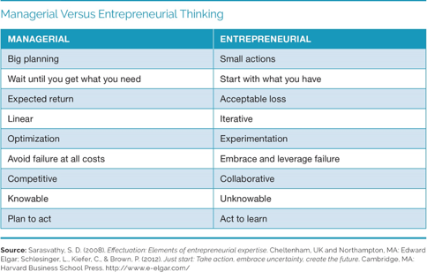
The Entrepreneurial Mindset
Illustration taken from: Entrepreneurship : the practice and mindset, by Heidi M. Neck, Christopher P. Neck and Emma L. Murray; Sage Publishing, 2020
Notes:
Entrepreneurship is not a straight path. It is rather a method of creating opportunities, taking smart action, learning and iterating, and using a portfolio of skills to navigate an ever-changing world.
Although managerial thinking has ist advantages and is necessary, it is not enough in today‘s uncertain, complex and chaotic business environment. In new ventures, managers and entrepreneurs are often one and the same person. So they have to possess both skillsets.
A simple dinner party can serve as an example: if you invite a group of friends to a dinner party, you might chose a recipe or draw up a menu, buy the ingredients and cook a meal according to the instructions in your cookbook. That‘s a managerial approach.
The entrepreneurial approach would be, by contrast, to invite your friends and ask every person to bring one ingredient but not tell them what to bring. Now the group must come together, use the ingredients, plus what you already have in your kitchen, and create dinner.

Slide 17
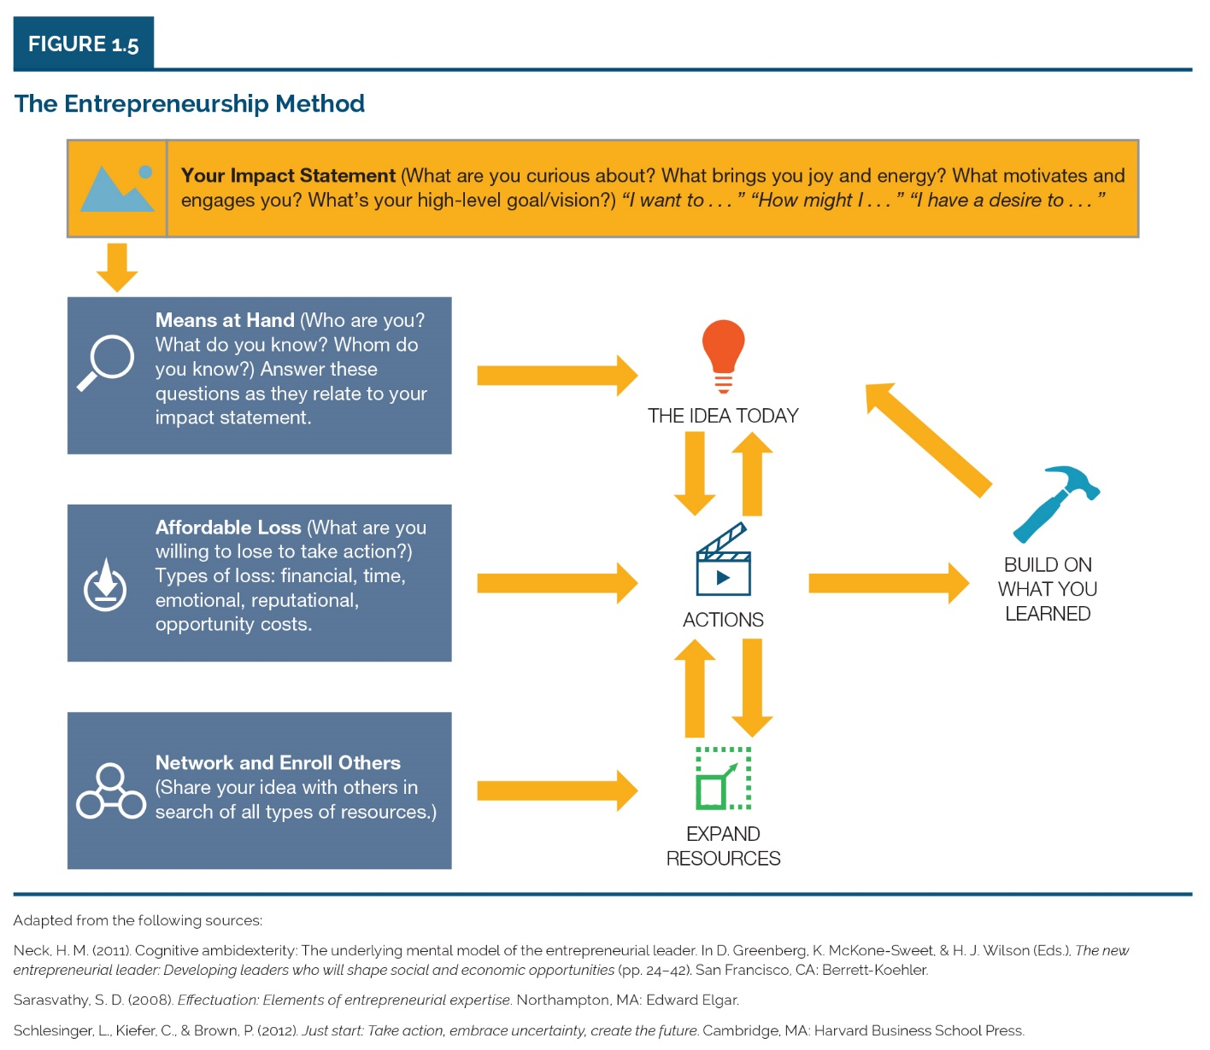
Eight Components of the Entrepreneurship Method
Illustration taken from: Entrepreneurship : the practice and mindset, by Heidi M. Neck, Christopher P. Neck and Emma L. Murray; Sage Publishing, 2020
Notes:
Eight components:
Identify your desired impact on the world
Start with the means at hand
Describe the idea today
Calculate affordable losses
Take small action
Network and enroll others in your journey
Build on what you learn
Reflect and be honest to yourself

Slide 18
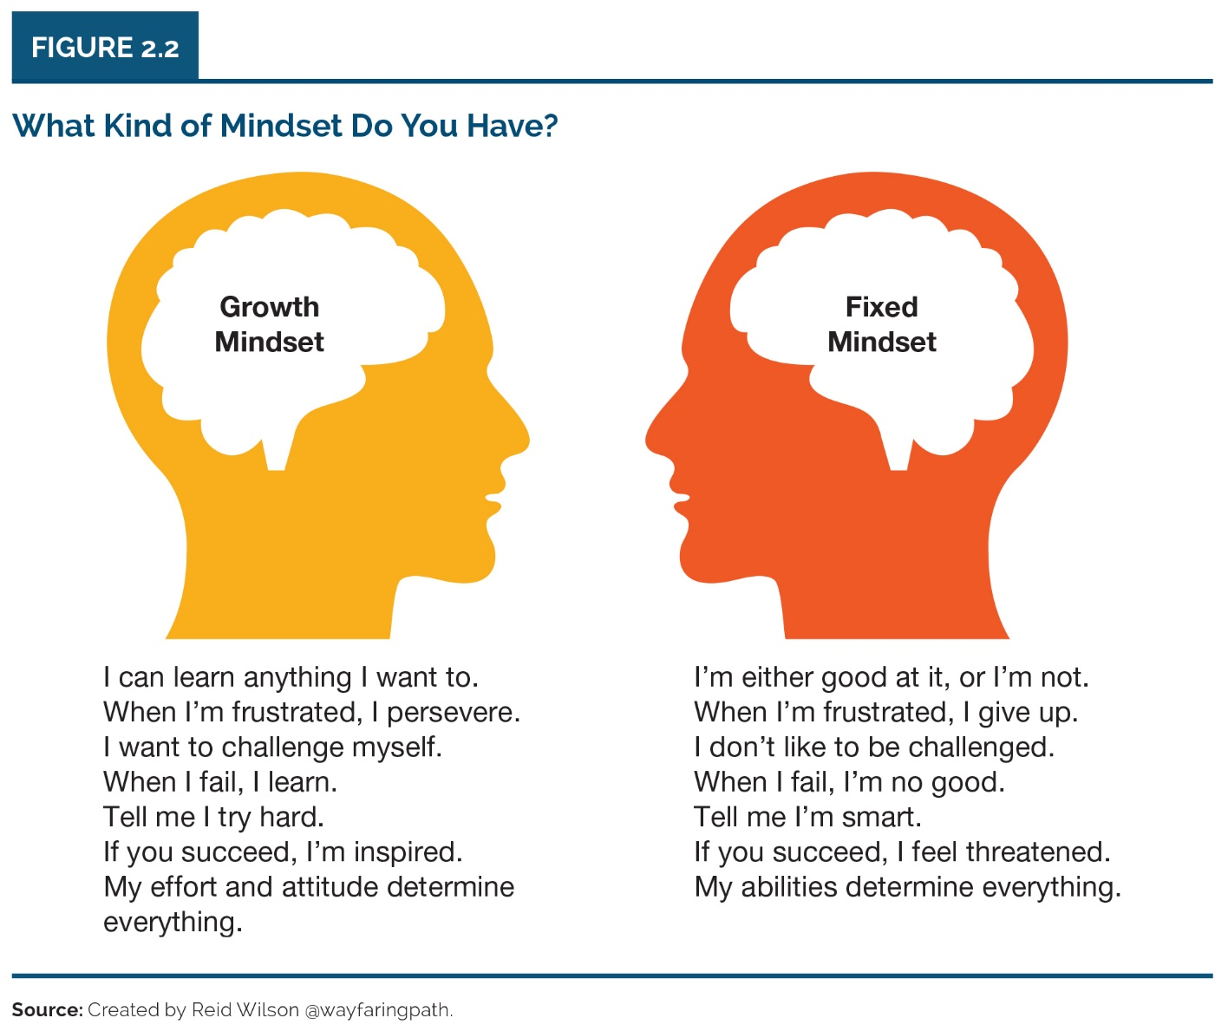
Growth vs. Fixed Mindset
Notes:
Fixed mindset: the assumptions held by people who perceive their talents and abilities to be set traits.
Growth mindset: the assumptions held by people who believe that their abilities can be developed through dedication, effort and hard work.
Examples
Fixed mindset: „Why do you want to start up a business? You need accounting skills. You were always terrible at math at school. Are you sure you can do it?“
Growth mindset: „I might not be good at accounting first, but I think I can learn to be good at it if I commit to it and put in the time and effort.“
Fixed mindset: „if you fail everybody will laugh at you.“
Growth mindset: „Give me the name of one successful person who never experienced failure at one time or another.“

Slide 19
Affirmations Self-Test
Find the 10 affirmations that reflect best how you would like to be as an entrepreneur. Here are some websites that contain suggestions:
https://daysinspired.com/affirmations-for-entrepreneurs/ https://theremoteyogi.com/2020/05/22/affirmations-for-entrepreneurs/ https://smallbiztrends.com/2017/01/small-business-affirmations.html https://www.abundancenolimits.com/business-affirmations/ https://andreabolder.com/111-positive-mantras-and-affirmations-for-successful-women-entrepreneurs/ https://www.evelynlim.com/30-positive-affirmations-female-entrepreneur/ https://thedailygoalgetter.com/blogs/news/positive-affirmations-entrepreneurs

Slide 20
Observation exercise
Visit a place that you are unfamiliar with. It can be a park, somewhere on campus you haven‘t explored or a neighbourhood, a new restaurant – really just about anywhere, provided you are not already familiar with the place. Bring a paper(!) notepad and a pen.
For 10 minutes, just look around and write down a description of what you observe. Use adjectives to describe what you see. For example, you may see a swing set in a park, but you need to describe the swing set. It may be rusty, shiny, empty, broken, vibrant, or dull. A dog you see may be big, cute, dirty, ugly, friendly, or hostile.
After you‘ve finished, sit down and look at the list of words you‘ve written. Circle all words with a positive connotation. Place a square around all words with a negative connotation. If what you see in the world is predominantly negative, then your mindset for entrepreneurship must be developed further. If what you see in the worlds is more positive, it will be much easier for you to identify opportunitites and make a difference.
Notes:
Critical thinking questions:
In what ways did this 10-minute observation exercise confirm your existing assumptions and beliefs about your way of looking at the world? In what ways did it change them?
Did you learn anything about yourself that was unexpected or surprising?
What do you think would happen if you repeated this exercise in a diffferent location?

Slide 21
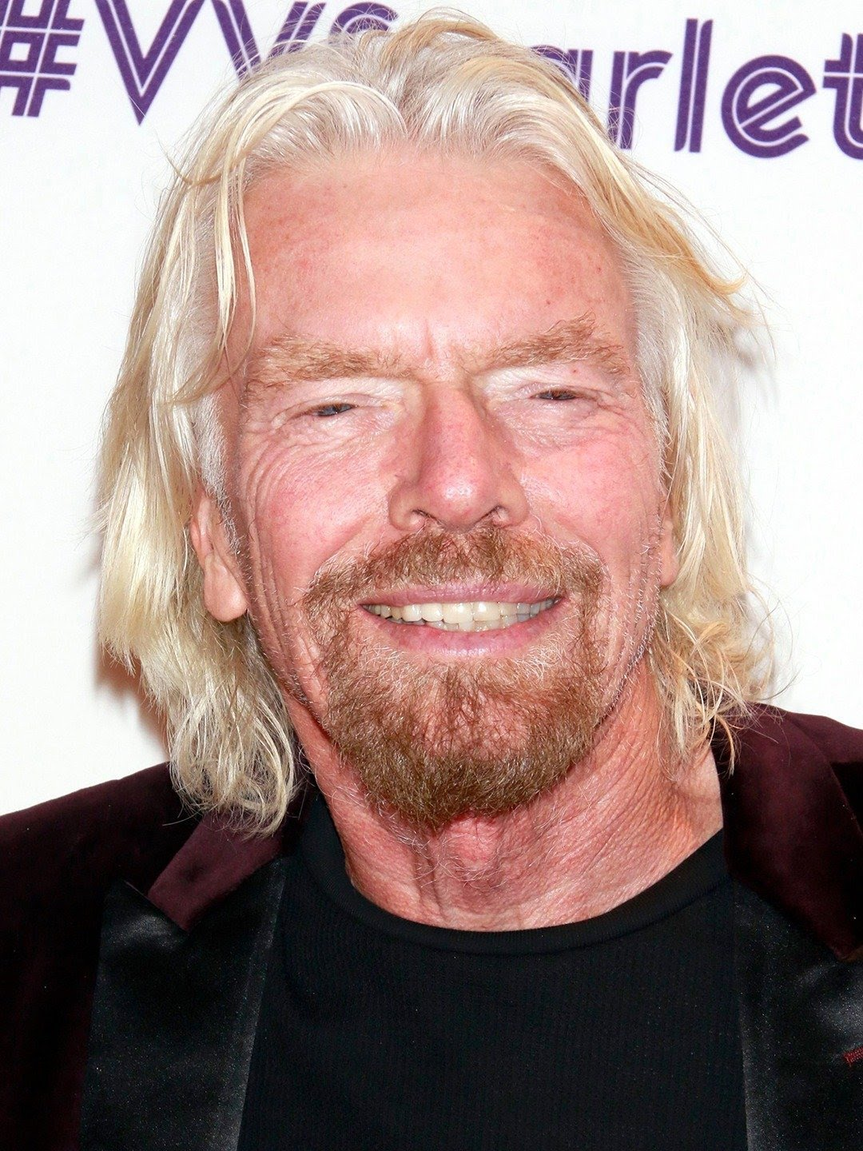
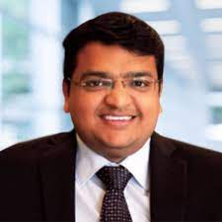
Examples of Successful Entrepreneurs
This short section will focus on good practice cases of actual entrepreneurs, who failed and used their mindset to get back up.
Melanie Perkins, Canva
https://www.youtube.com/watch?v=Ep21f3ncvBk
Richard Brandson, Virgin Group - https://www.youtube.com/watch?v=23Frvd3pp5Q&ab_channel=Megacast
Maneesh Garg, - Managing Director (MD)/Group Chief Executive Officer (GCEO) of Afriglobal Group - https://www.youtube.com/watch?v=4o_O_v8gQpg
Notes:
Melanie Perkins- Filipino / Australian, founded Canva with 30 (graphic design platform)
Richard Branson- talks about entrepreneurial philosophies
Maneesh Garg – talks about his entrepreneurial failures

Slide 22
Examples of Successful Entrepreneurs
Watch the video and try to identify in their discourse aspects like: - Creativity, Improvisation and Self-leadership - Passion and believe about what they do - Getting out of your comfort zone - Embracing Failure
Extract the quotes, relate and justify your thoughts.

Slide 23
Self-Leadership
A process whereby people can influence and control their own behaviour, actions and thinking to achieve the self-direction and self-motivation necessary to build their entrepreneurial business ventures.
It can be lonely, often no one is around to give you feedback, reprimand you or reward you.
Self leadership consists of three main strategies
Behaviour-focused strategies
Natural reward strategies; and
Constructive thought pattern strategies.
Notes:
Behaviour focused strategies: include self-observation, self-goal setting, self-reward, self-punishment and self-cueing. This type of self-awareness is a necessary first step toward changing or eliminating ineffective and unproductive behaviors. Armed with accurate information regarding current behavior and performance levels, individuals can more effectively set challenging and specific goals that can significantly increase individual performance levels.
Natural reward strategies: are intended to create situations in which a person is motivated or rewarded by inherently enjoyable aspects of the task or activity. There are two primary natural reward strategies. The first involves building more pleasant and enjoyable features into a given activity so that the task itself becomes naturally rewarding. The second strategy consists of shaping perceptions by focusing attention away from the unpleasant aspects of a task and refocusing it on the task’s inherently rewarding aspects.
Constructive thought patterns: are designed to facilitate the formation of constructive thought patterns and habitual ways of thinking that can positively impact performance. Constructive thought pattern strategies include identifying and replacing dysfunctional beliefs and assumptions, mental imagery and positive self-talk.

Slide 24
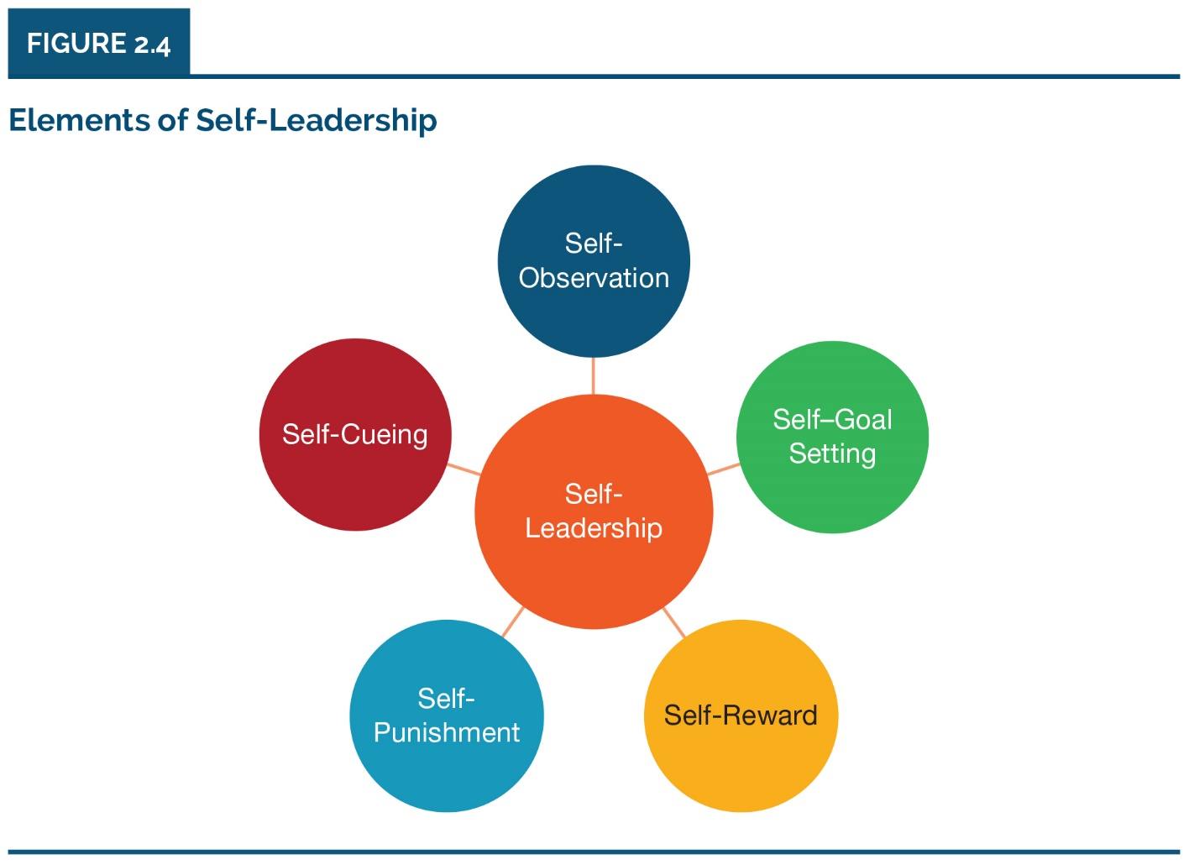
Elements of Self-Leadership
Illustration taken from: Entrepreneurship : the practice and mindset, by Heidi M. Neck, Christopher P. Neck and Emma L. Murray; Sage Publishing, 2020
Notes:
Self observation: raises our awareness of how, when, and why we behave the way we do by asking ourselves regularly these questions. This is the first step towards addressing unhelpful or unproductive behaviour.
Self goal setting: the process of setting individual goals for ourselves. This is especially productive if accompanied by self-reward-ways in which we compensate ourselves when we achive our goals. These rewards can be tangible or intangible.
Self-punishment or self-correcting feedback is a process that allows us to examine our mistakes before making a conscious effort not to repeat them.
Self cueing is a process of prompting that acts as a reminder of desired goals and keeps your attention on what you are trying to achieve.

Slide 25
Self-Goal setting exercise
Set one goal individually for your involvement in the EKC to foster growth mind-set.
How could you reward yourself when achieving this goal?
Think what can be a self-correcting feedback (self punishment)?
What can act as a reminder for staying on course to achieve the desired goal?
What positive self-talk and mental imagery can help you?
Notes:
My personal example:
Goal: I can learn Spanish easily. I only need to practise every day of the week for half an hour (not once a week for several hours).
Reward: A cup of coffee and a cookie after each half hour session of concentrated work.
Self-correcting feedback: Record a few sentences on my phone, listen and improve my pronunciation.
Self-cueing: A timer (on my computer), showing how much time I have left until one session is over.
Mental imagery: I want to finally visit South America and explore the Spanish-speaking countries outside of the touristic paths and to speak with locals. I imagine the scene and how positively surprised everyone will be.

Slide 26
Passion and Entrepreneurship
Passion is one of the most talked-about element of the entrepreneurial mindset.
It is an intense positive emotion, motivating and stimulating entrepreneurs to overcome obstacles and remain focused on their goals.
Can enhance mental activity, foster creativity and provide meaning to everyday work.
Can also lead to becoming blinded by passion and obsessed by an idea or new venture. May result in ignoring the warning signs and negative feedback.
Notes:
Description:
The entrepreneurial mindset is about understanding who you are and how you view the world. It deeply connects to your desired impact which some people equate with passion. In the past, tended to use passion as a reason to explain certain behaviours displayed by entrepreneurs that were thought to be unconventional, such as perceived high risk taking, intense focus and commitment, and dogged determination to fulfil a dream.
Passion is not all that is needed to be successful, but research has shown that positive feelings motivate entrepreneurs to persist and engage in tasks and activities in order to maintain those pleasurable emotions.

Slide 27
Creativity
Human beings are inherently creative, but creativity can be honed and developed.
There is some evidence that entrepreneurs are more creative than others.
Develop the habit of creativity by using constructive thought patterns!
What does it take to develop a creative mind (left- vs. right-brain orientation)?
How to deal with fear?

Slide 28
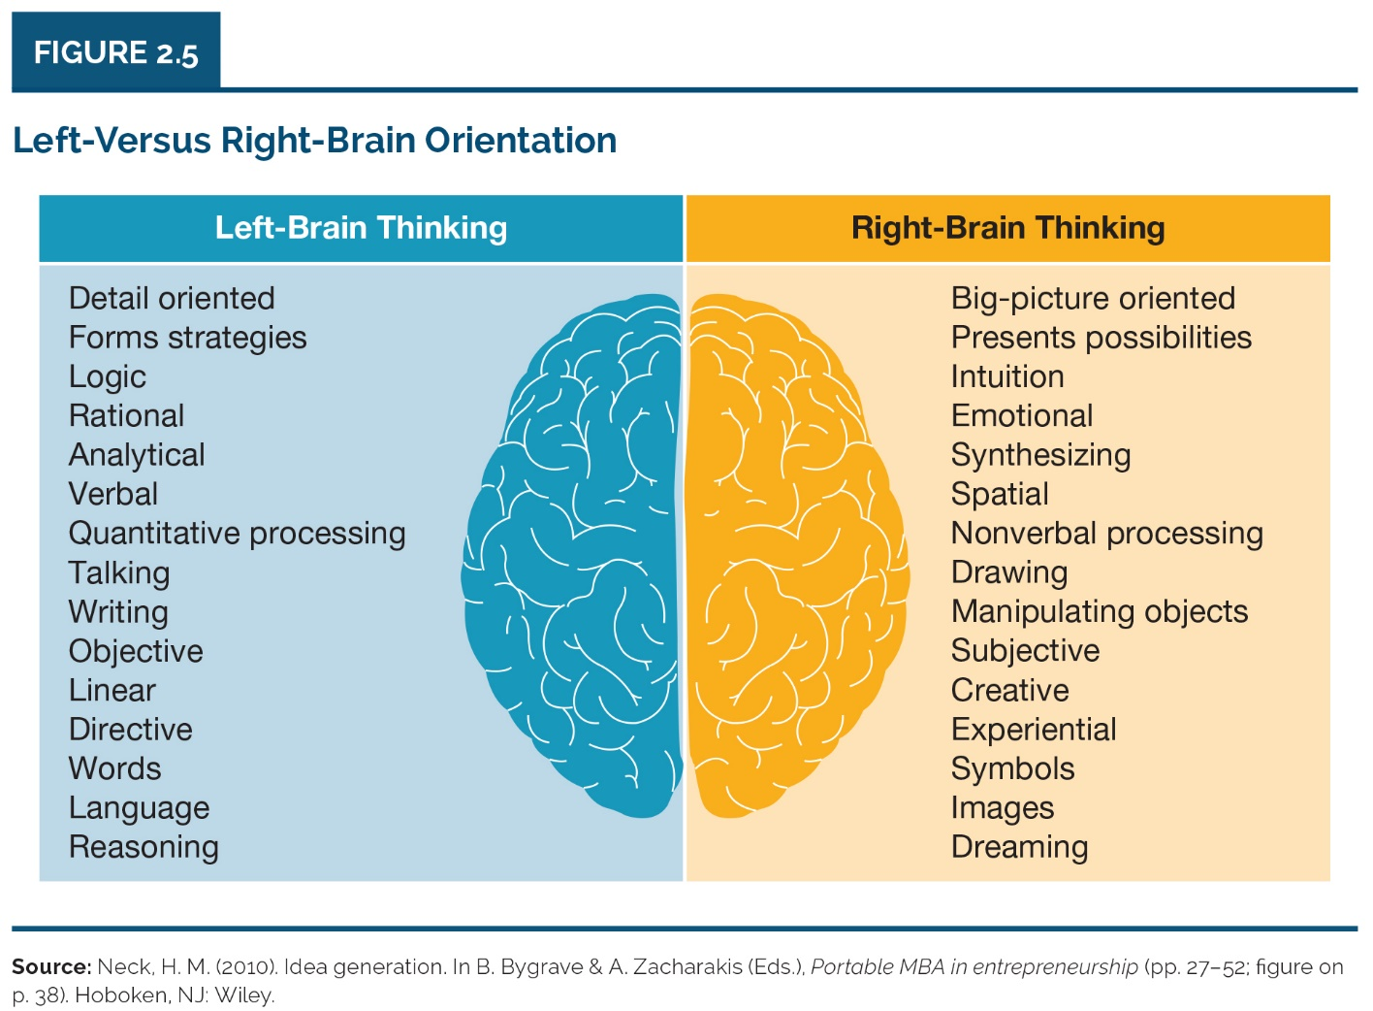
Creativity
Illustration taken from: Entrepreneurship : the practice and mindset, by Heidi M. Neck, Christopher P. Neck and Emma L. Murray; Sage Publishing, 2020
Notes:
The way human brains are structured reflects the importance of navigating the uncharted waters of an uncertain world in the history of mankind.
You may have heard about people being left-brained or right-brained. There is little scientific support for this model.
It does, however, corroborate with some research on personality traits of creative people (Csinkszentmihalyi, 1996). The research showed that these people exhibited seemingly polarized traits like discipline and playfulness, a strong sense of reality and vivid imagination, and pride and humility. If you compare the „polarized“ traits with the left and right brain characteristics you will see striking similarities, suggesting that creativity involves integrating „both sides“ of the brain.
Although successful entrepreneurs definitely do not fit into a single profile, therre is some commonality in their mindset. They envision success while also preparing for failure. They value autonomy in deciding and acting and, therefore, assume responsibility for problems and failures. They have a tendency of being intolerant of authority, exhibit good salesmanship skills, have high self-confidence, and belive strongly in their abilities. They also tend to be both optimistic and pragmatic. They work hard and are driven by an intense committment to the success of the organization.

Slide 29
Creativity
Certain techniques to learn creative thinking
Mind Mapping
Six Thinking Hats
Biomimicry
Analogies …
https://www.peterfisk.com/wp-content/uploads/2016/01/27-Creativity-Tools-for-Divergent-and-Convergent-Thinking.pdf
https://www.koozai.com/blog/content-marketing-seo/eight-awesome-creative-thinking-techniques-plus-tools/
Notes:
White Hat – Facts – data and information already known or needed relating to the theme
Red Hat – Emotions – looks at feelings, initial instinct and intuition
Black Hat – Judgement, Caution – looks at potential problems and difficulties
Yellow Hat – Logic – looks at benefits and values
Green Hat – Creativity – possibilities, new ideas and alternatives
Blue Hat – Control – looks at managing the process – start with a focus, then detail the next steps, actions and plans

Slide 30
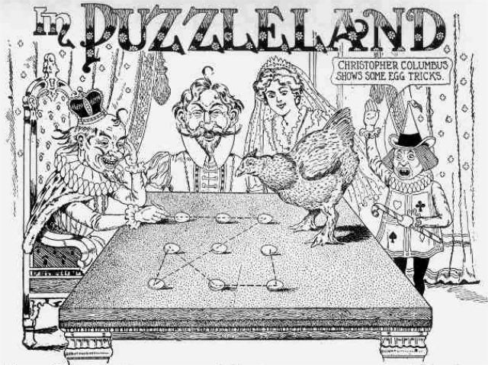
Creativity exercise 1
9 dots exercise: Try to connect nine equally spaced dots using four lines or fewer without lifting a pen and without retracing!
By Sam Loyd - Original scan online here cropped and brightened, Public Domain, https://commons.wikimedia.org/w/index.php?curid=1013387
Notes:
Description: 9 dots exercise (individually): Try to connect nine equally spaced dots using four lines or fewer without lifting a pen!

Slide 31
9 dots exercise explained (until 2:50´)

Slide 32
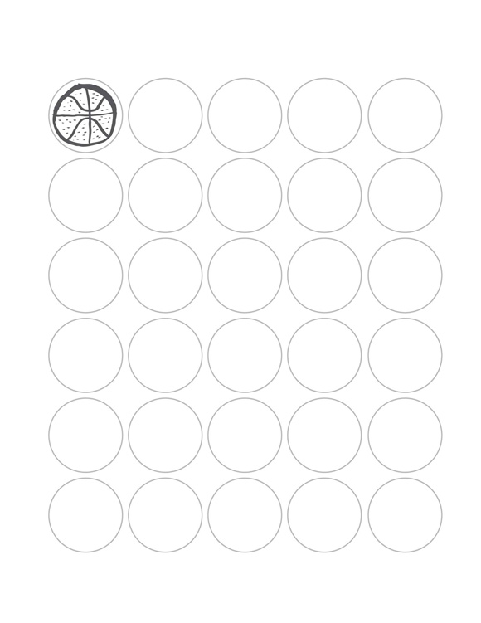
Creativity exercise 2
30 circles exercise (in pairs): Turn the circles into recognizable objects in just
3 minutes.
Notes:
INSTRUCTIONS:
Give each pair of participants one 30 Circles sheet of paper (see example) and something to draw with.
Ask them to turn as many of the blank circles as possible into recognizable objects in three minutes.
Compare results. Look for the quantity or fluency of ideas. Ask how many people filled in ten, 15, 20, or more circles? (Most people don’t finish.) Next, look for diversity or flexibility in ideas. Are the ideas derivative (a basketball, a baseball, a volleyball) or distinct (a planet, a cookie, a happy face)? If people were drawing their own circles, did anyone “break the rules” and combine two or more (a snowman or a traffic light)? Were the rules explicit, or just assumed?

Slide 33
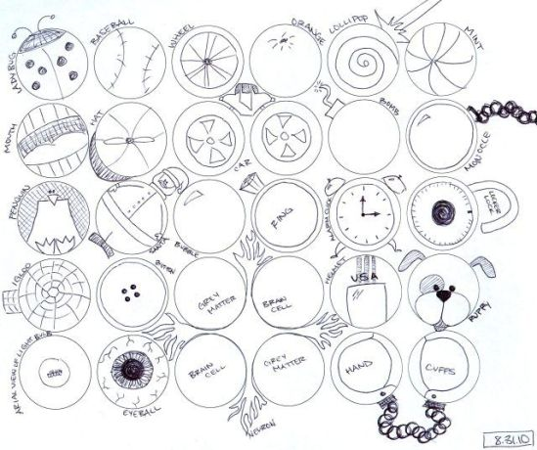
30 circles exercise example
Source: https://clubexperience.blog

Slide 34
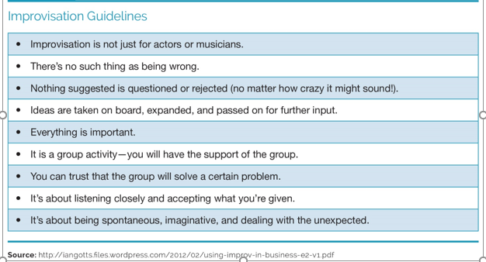
Improvisation
The art of spontaneously creating something without preparation
The ability to function in an uncertain world requires a degree of improvisation.
Illustration taken from: Entrepreneurship : the practice and mindset, by Heidi M. Neck, Christopher P. Neck and Emma L. Murray; Sage Publishing, 2020

Slide 35
Improvisation exercise
In groups
Someone mentions an idea in one sentence – the next person continues with another sentence that starts with “Yes, and…”.
Example: Peter: “I have a great idea for a healthy dried fruit snack for kids that contains less sugar than any other brand on the market.” Teresa: “Yes, and each snack could contain a card with a fun fact or some kind of riddle.” Sami: “Yes, and if enough cards are collected, you could go online and win a small prize.”
Notes:
Description: Participants will form groups and improvise a hypothetical, but relatable situation. One example is given in this slide, but there are other ways, such as acting a theatre scene and improvising how the story should continue.
In the given example, by continuing with “Yes, and” the idea does not get shot down. Instead, it is being elaborated on.

Slide 36
Mindset as a Pathway to Action
Entrepreneurial self-efficacy (ESE)is the belief that entrepreneurs have it in their own ability to begin new ventures.
It is an essential part of the entrepreneurial mindset and a good indicator of entrepreneurial intentions and a strong precursor to action.
There is a fine line between self-confidence, self-efficacy and arrogance!
People with high ESE tend to put in more effort, persist with an idea and persevere with a task more than those people with low levels of self-efficacy.
ESE can be heightened through training.

Slide 37
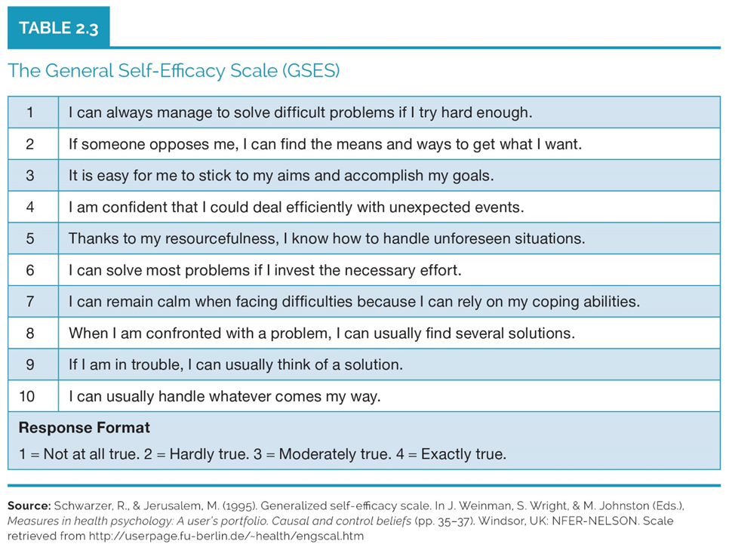
Mindset as a Pathway to Action
Notes:
The scale assesses the strength of an individual´s belief in his or her ability to respond to novel or difficult situations and to deal with any setbacks or obstacles.
It is a self-administered scale that takes 2-3 minutes to complete.
The higher the score, the greater is the individual´s generalized sense of self-efficacy.

Slide 38
Impact Statement Exercise
Bill Roche
The power of an entrepreneurial mindset.
TEDx, 2018
Watch this video (16:20´) for inspiration:
https://www.youtube.com/watch?v=Ihs4VFZWwn4
Notes:
The creator of PowerPlay Young Entrepreneurs, Bill has over 20 years of experience designing curriculum-based resources that focus on financial literacy, entrepreneurship and social responsibility.

Slide 39
Impact Statement Exercise
Group Activity II – due Friday!
Please write your EKC´s impact statements that will guide you through the entrepreneurial journey (refer back to slide 17).
Start with the means at hand
What’s the idea – how can you make an impact today with the means at hand?
You need to detail the resources you have available and the loss you can accept in the beginning.

