Slide 1
ENCORE
Entrepreneurship Knowledge Centers to Foster Innovative Entrepreneurship Practices in Education and Research
Duration
15.01.2021 - 14.01.2024

Slide 2
Developing the entrepreneurial path Developing creativity & innovativeness, support needed at each stage, creation of impact & measurement, decision-making skills & personal branding
Eduardo Sánchez García
Assistant professor at the University of Alicante
eduardo.sanchez@ua.es

Slide 3
The world has evolved thanks to creators. The economy has evolved thanks to entrepreneurs.
DYNAMISM
DIVERSITY
HOSTILITY
COMPLEXITY
UNCERTAINTY
COMPETITION
HOW TO START A BUSINESS?

Slide 4
How to start a business?
Remember yourself what are your beliefs, values, capacities and objectives: expose in a paper your main experiences, capacities, knowledge, values and objectives.
Analize the main sources of financial resources within your reach: can have a decisive influence on the success of your business.
Know what you want to do and the best way to do it: define your business ideas as clearly as possible, through those tools within your reach. You also must clearly define your main stakeholders to know how utilize them in case of need.
Do it as efficiently and effectively as possible: resources are limited, and you must use them as efficiently and effectively as possible to start your business project and earn income before you are broke.
Identify the main elements for the success of your business: you must know which are the main aspects that have a decisive influence on the success of your business model.

Slide 5
Remember yourself what are your beliefs, values, capacities and objectives
Before you start an activity, you must remember yourself what are your beliefs, values, capacities and objectives.
Spend some time thinking about your experiencies: they could unveil some interesting information about yourself, the people you ever had contact with, and some interesting ideas for your future plans.
Define your values and beliefs: the culture of companies reflects to a large extent the personality of their founders.
Analyze and assess your capabilities: this will help you to know your strengths and weaknesses with a view to the development of your business project.
Establish the objectives in your life and order them by priority: this will show you if you clearly want to start a business, you will have to prioritize this objective over other important aspects of your life.

Slide 6
Analize what are the main sources of financial resources within your reach
Internal financing:
Retained profits.
Maintenance financing (depreciations).
External financing:
Discount of bank checks and bills of exchange.
Credit policy.
Factoring (management of collection rights).
Bank loan (personal – mortgage).
Leasing (financial – operating – lease back) - purchase option at the end of the contract.
Renting (similar to operating leasing).
Capital increase (increase your investment).
Governmental subsidies.
Venture capital (seed – startup – expansion) – Business angels (Business angels networks).
Crowdfunding (donations – rewards – of shares – crowdlending – royalty).

Slide 7
Know what you want to do and the best way to do it
Design of the business model:
Inside the office
Build your business model canvas.
Develop a map of your main stakeholders.
Outside the office
Lean startup methodology allows us to develop our business model step by step, minimizing resource requirements at each stage of the initial development, which favors the viability of the business project.
State hypotheses and analyze your customers (create and validate your value proposition canvas)
Present and validate your solutions (build a Minimum viable product)
Validate your business model.

Slide 8
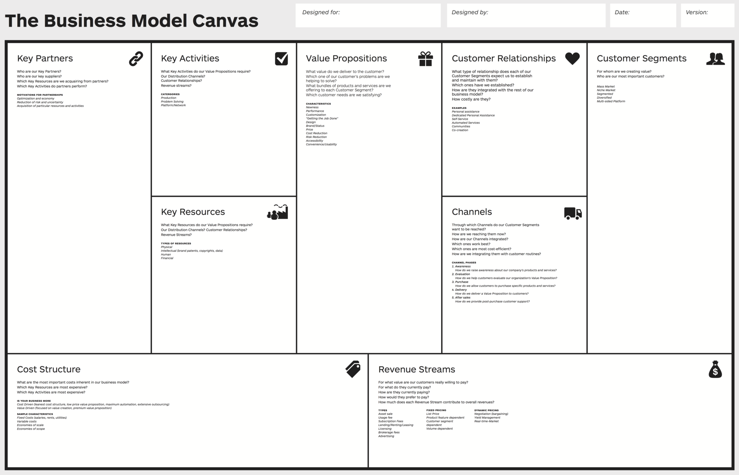
Know what you want to do and the best way to do it – Inside the office
Alexander Osterwalder & Yves Pigneur

Slide 9
Know what you want to do and the best way to do it – Inside the office
The CANVAS is just a template that allows us to describe the main points of our business model idea.
Business model canvas does not guarantee the success of the business model.
It is necessary to evaluate more information about the implementation of our business model and make the appropriate adjustments to try to maximize the probability of success before the startup of the business.
A successful business model is not achieved overnight, nor is it achieved thanks to a Canvas or any other tool, but is the result of hard work, perseverance, analysis and dedication, both on the part of the company's top manager and the rest of the company's components.

Slide 10
Know what you want to do and the best way to do it – Inside the office
Do not hesitate to design several different business model Canvas and to analyze all of them with numbers to better understand the details you are going to face.
When we begin to develop the canvas of our project we cannot take anything we do as true until we ensure, with real work, that everything we are proposing is validated. Our canvas will find a relative stability when all the information drawn on it is validated in the execution.
In the design of business models, as in many other issues in today's business world, the only constant is continuous change. So, you must keep all our senses alert to find improvements, new opportunities and new challenges.
The canvas is a living thing, in constant change:
Help us to foresee the situations we will face when implementing the business model.
Let us to draw the conclusions of the realities we are living through the execution.

Slide 11
Know what you want to do and the best way to do it – Inside the office
Develop a map of your main stakeholders.
Stakeholder identification should come from different people within the company (if possible).
Make a list of stakeholders, and briefly explain why you consider it a stakeholder (in which way they can help you to develop your business model).
Main stakeholders of the sector in which your business model is located
Stakeholders of other sectors.
People of interest in your environment.
Determine the importance of each stakeholder based on their potential influence on the successful development of your business model and develop a map.
Continuously develop your map, including new stakeholders and/or studying new possibilities.

Slide 12
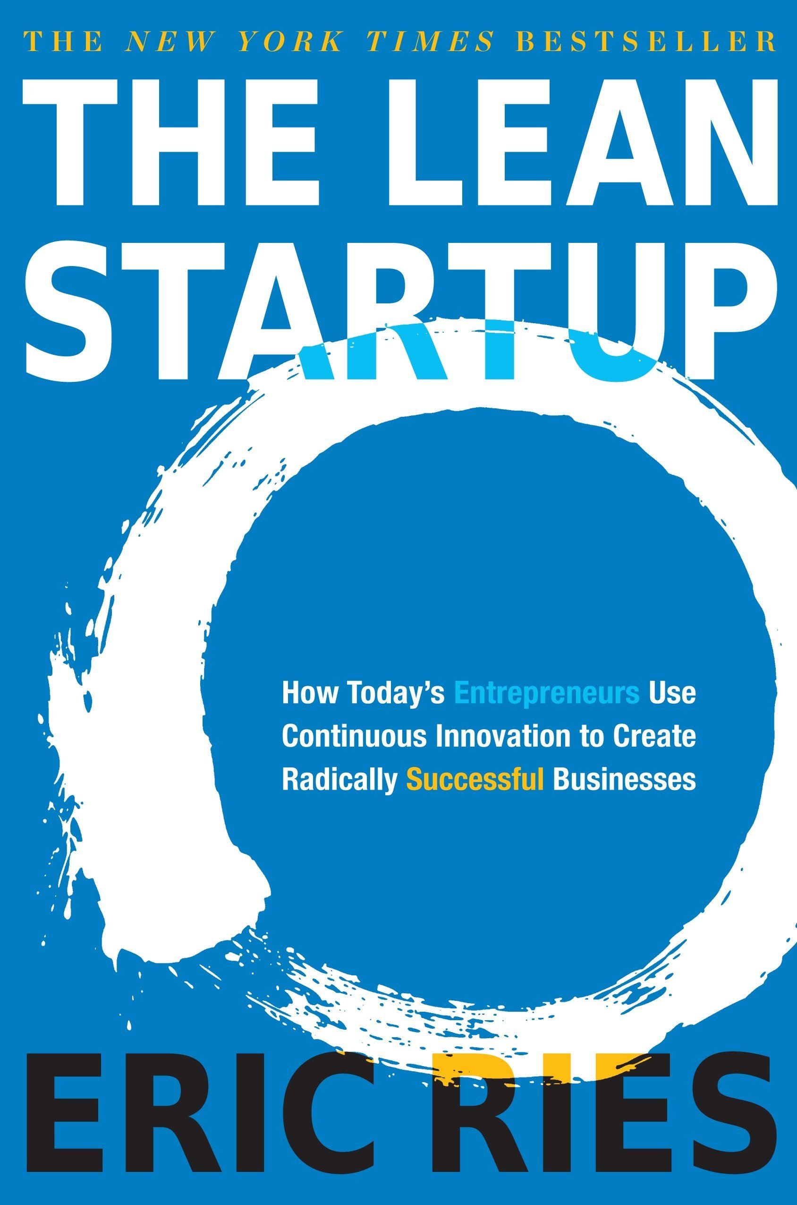
Know what you want to do and the best way to do it – Outside the office
LEAN STARTUP
The "Lean startup" methodology allows us to develop our business model step by step, minimizing resource requirements at each stage of the initial development.
Fundamental principles:
Develop your business step by step, learning on the cheap through small failures (make mistakes you can afford to make).
It is a pragmatic approach, helping to avoid "paralysis by analysis".
Perfection is not profitable (Vicente Sabater Sempere).
Validated learning, experimentation and iteration with the customer.
Create something that the customer wants and is willing to pay for.

Slide 13
Know what you want to do and the best way to do it – Outside the office
LEAN STARTUP
Common mistakes that the lean startup methodology try to correct:
We don't know how to find customers before we build the product.
There is a lot of theory and little practice of how to do things.
We are inclined to think our ideas are good, and our knowledge of the industry authorizes us to skip validation and start building the product directly.
We tend to believe that we have identified potential customers who are willing to pay us for our solution without having validated these ideas. But is this really the case?

Slide 14
Know what you want to do and the best way to do it – Outside the office
LEAN STARTUP - Cost management - Efficiency
Sometimes startup entrepreneurs present their projects to investors when they have almost no resources left, in search of funding to move forward, but without:
Real proof that the problem they are trying to solve exists.
Knowing if it is important and affects many people.
Having sold and, therefore, validated their business model.
At the beginning of the business project it is necessary to pay special attention to cost management, since there is not yet a constant source of income with which to finance the activities.
We will have to invest our resources efficiently to avoid running out of funds before validating our business model.

Slide 15
Know what you want to do and the best way to do it
The key is not to venture into designing all the plans and then build the structure, but to do it STEP BY STEP as we secure the way.
Validate customer segment. Check the fit between your value proposition and your customer segment.
Why start creating everything without having first validated it in a simple way?
Is it necessary to develop the whole application before checking that people will really be interested in it?
Validate value proposition. Build one or various prototypes (minimum viable product) that precisely cover the main need and with which we invest the minimum necessary for the product to work perfectly in its minimum expression.
Validate the price. One of the ways to know the most appropriate price for services or products is to work with the information gathered by the early adopters who are beginning to test the platform. We can ask them how much they are willing to pay for each service based on different variables.
For this it is important to learn about agile development methodologies such as Lean StartUp.

Slide 16
Know what you want to do and the best way to do it – Outside the office
Create a value proposition canvas, to design, test, and develop your company’s Value Proposition to Customers in a more structured and thoughtful way. Is composed of two blocks from the Business Model Canvas, and the goal is to achieve a better fit between them:
Value proposition Customer segment
Validate your customer segment through direct interaction with customers
Products and services
Pain relievers
Gain creators
Customer jobs
Customer pains
Customer gains
FIT
Source: Strategyzer.com & Alexander Osterwalder (Flickr)

Slide 17
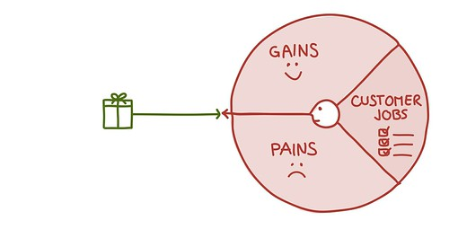
Know what you want to do and the best way to do it – Outside the office
Customer segment
Customer gains: describe the benefits your customer expects, desires, or would be surprised by. This includes functional utility, social gains, positive emotions, and cost.
Customer jobs: sketch out a customer profile, describe what are they trying to get done. It could be the tasks they are trying to perform and complete, the problems they are trying to solve, or the needs they are trying to satisfy.
Customer pains: describe negative emotions, undesired costs and situations, and risks that your customer experiences or could experience before, during, and after getting the job done.
Source: Strategyzer.com & Alexander Osterwalder (Flickr)

Slide 18
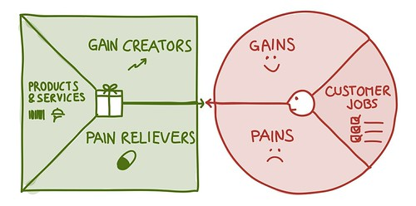
Know what you want to do and the best way to do it – Outside the office
Gain creators: describe how your products and services create benefits your customer expects, desires, or would be surprised by, including functional utility, social gains, positive emotions, and cost. Rank them according to their relevance for your customers.
Value proposition
Products and services: list the products and services you offer and define how they help your customer get either a functional, social, or emotional job done, or help him/her satisfy basic needs. Rank them according to their importance to your customer.
Pain relievers: describe how your products and services eliminate or alleviate negative emotions, undesired costs and situations, and risks your customer experiences or could experience before, during, and after getting the job done. Rank them according to their intensity for your customer.
Source: Strategyzer.com & Alexander Osterwalder (Flickr)

Slide 19
Know what you want to do and the best way to do it – Outside the office
Competing for customers:
Most Value Propositions compete with others for the same Customer Segment. This is kind of looking for an "open slot" that will be filled by the company with the best fit.
If you sketch out competing value propositions, you can easily compare them by mapping out the same variables (e.g., price, performance, risk, service quality, etc.)
What do we want to know?
Is the problem important for the people who we believe suffer from it?
Is there a significant number of people suffering from this problem?
Would they be willing to pay for a solution that solves the problem?
Are there current solutions on the market?
What are the main ones?
How can we open a slot among the closest competition?
Source: Strategyzer.com & Alexander Osterwalder (Flickr)

Slide 20
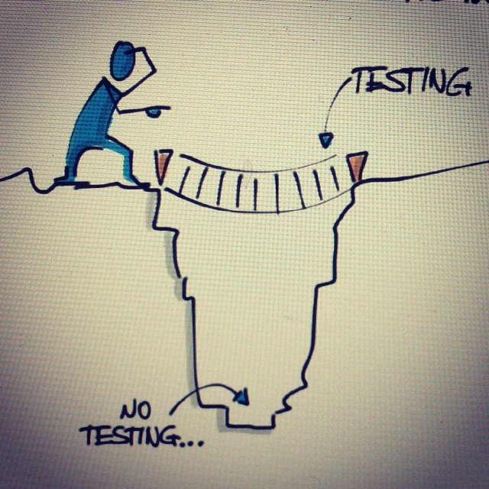
Know what you want to do and the best way to do it – Outside the office
LEAN STARTUP – Validate your solution
Understood and validated the problem (hypotheses of the customers and problems)
Defined the solution
Validate your solution:
We must validate it through direct interaction with customers (in different platforms). We are looking to do it with a special group of people, the early adopters:
They have a problem or need and are aware of it.
They are actively seeking for a solution and are willing to pay for it.
They are willing to take risks, enjoy experimenting and are financially solvent.
Tend to be very active on social media and often create reviews and other material about new products they like or dislike.
Source: Alexander Osterwalder (Flickr)

Slide 21
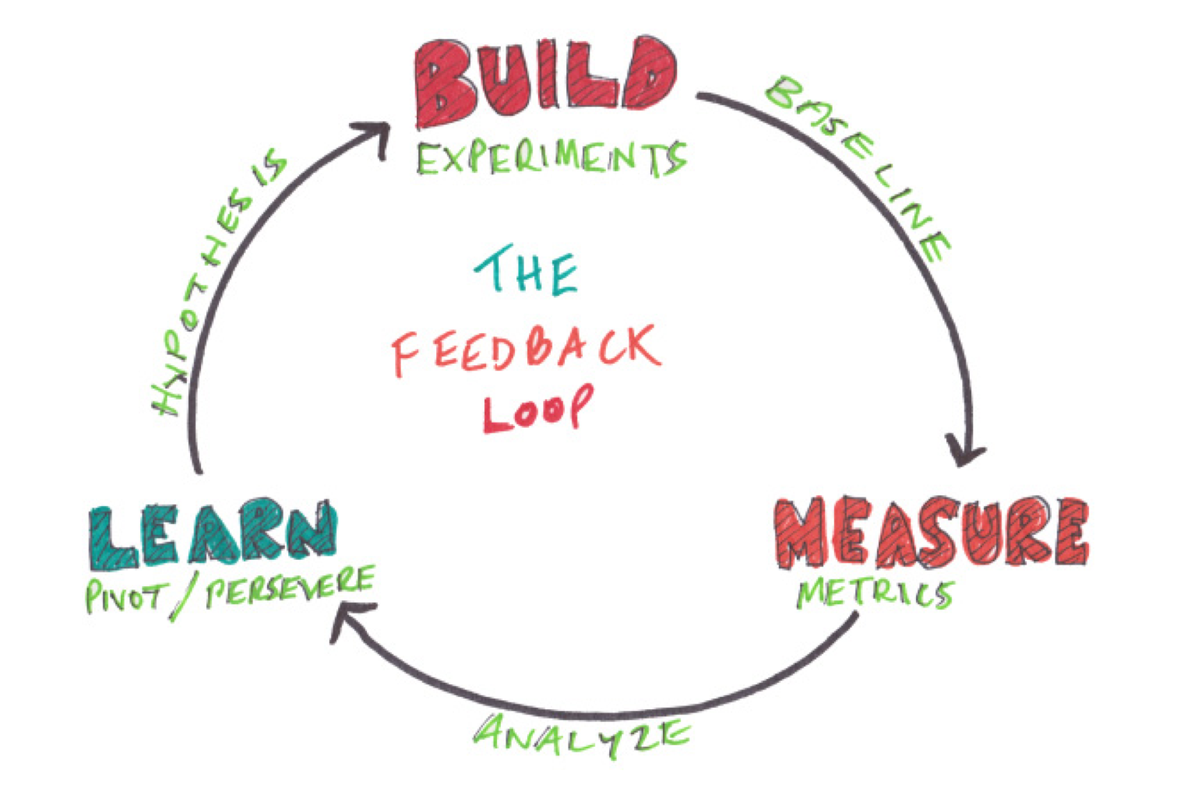
Know what you want to do and the best way to do it – Outside the office
LEAN STARTUP
Three key sequential and reiterative aspects:
Build: develop minimum viable product (MVP) that allow us to validate our solution hypotheses.
Design: the entrepreneurial team, after an observation process, designs the elements or characteristics to be validated in each iteration.
Development: with the design, the team will implement the functionalities to be validated in each iteration.
Measure: establish a set of metrics to assess the reaction of our potential customers.
Test: design and execution of the test or experiment that we are going to perform to validate our hypothesis.
Learn: from the results of experimentation.
Discovery: the results of the test or experiment we have conducted will help us to improve our business model by making the necessary adjustments, and to further develop the business.

Slide 22
Know what you want to do and the best way to do it – Outside the office
LEAN STARTUP – Validate your solution – Build a minimum viable product
Don't stop at analysis, you have to act, take action! Systematically apply the process of building, measuring and learning.
Build a Minimum Viable Product, with the essential functionalities you want to show to the early adopters
Simplify. If a lot of knowledge is required to develop the prototype or it has many functionalities, make different prototypes with simple functions, rather than a single complex prototype that integrates all functions:
Allow you to apply knowledge and learn in a feasible way.
Let you show more clearly each of the functionalities to potential customers.

Slide 23
Know what you want to do and the best way to do it – Outside the office
LEAN STARTUP – Validate your solution – Build a minimum viable product
The MVP allows you to determine if the solution proposed to your customers solves their problems, and if they are willing to pay for it.
The MVP must have the minimum set of functionalities that we need to show to the early adopters, so that they can assess the advantages and/or disadvantages in relation to what exists to date.
It has to transmit the "vision" beyond the operational functionalities of the product or service as far as possible.
The MVP is something living, moldable, which is developed based on a continuous learning process. This evolution takes us from the simplest MVPs known as Low Fidelity MVPs to the more complex ones that contain a greater number of functionalities and are known as High Fidelity MVPs.
The MVP allows us to validate our Value Proposition, and/or provides us with information about those aspects that we should improve, include or modify.

Slide 24
Know what you want to do and the best way to do it – Outside the office
LEAN STARTUP – Validate your solution – Build a minimum viable product
Once the MVP is developed, our goal is to refine our hypotheses according to the iteration process we have carried out with customers.
We must get answers to the following questions:
Are we building the right product/service?
Is it necessary to increase, reduce or modify its functionality?
Are we able to build it?
Are the benefits of our solution superior to what our customers currently find in the market?

Slide 25
Know what you want to do and the best way to do it – Outside the office
LEAN STARTUP – Validate your solution – Build a minimum viable product
You must remember that the MVP is not the final product. The goal is to learn and improve continuously, until you reach a viable product. Remember:
Don't let the desire for perfection block you.
Cost control at this stage is a top priority.
The process repeats itself continuously, until you validate your solution: build, measure and learn.
…

Slide 26
Know what you want to do and the best way to do it – Outside the office
LEAN STARTUP – Validate your solution – Metrics
Feedback: Show your MVP to your customers and try to get feedback (cualitative information) from them about your product or service, through interviews, questionnaires, meetings, blogs, social network, etc.
Generating attention from potential customers:
Traffic to our website.
Number of mentions to your product-service in social networks.
Participation of potential customers in your blog (about your product-service).
Information requests.
…
Linking and retention of potential customers:
Number of registrations: conversion rate of visits to users.
Subscriptions: conversion rate of visits to subscribers.
Followers in social networks.
Payments in advance for your product-service.
…

Slide 27
Know what you want to do and the best way to do it – Outside the office
LEAN STARTUP – Validate your solution – Redefine hypotheses or accept them and continue
As a consequence of the iterations and the application of the Build-Measure-Learn process, we are incrementally building the solution that will excite our customers.
With all the answers from the experiment, the team must sit down to analyze the information and draw conclusions.
We have to decide whether to validate or to pivot depending on the results and, therefore, to maintain or update the initial business model that we had set out in our business model canvas.
In case of pivoting, we must define new hypotheses based on our learning and iterate again with customers.
Validate the new problem hypotheses.
Validate the solutions again.

Slide 28
Know what you want to do and the best way to do it – Outside the office
LEAN STARTUP – Prepare to sell
In case of validating the solution, we seek to close the first sales in such a way that all our hypotheses are validated, not only the problem and solution hypotheses but also those related to the price, channels, etc., of our business model.
Prepare to sell (minimum-sellable-functional product-service / Minimum Marketable Features).
As an experiment, try to offer your product in different places and platforms, and sell it for different prices, in order to find out where is more valued for the appropriate customers and/or what could be the appropriate price.
This methodology let us to validate a solid product-market fit step by step, taking controlled risks and minimizing costs.

Slide 29
Tools and governmental support for entrepreneurship
Platform to implement lean startup: https://leanstack.com/
Spanish association of business angels: https://www.aeban.es/
European association of business angels: https://www.eban.org/
https://www.businessangelseurope.com/
Business Angels in South Asia: https://www.bansea.org/
European supporting for entrepreneurship: https://ec.europa.eu/growth/smes/supporting-entrepreneurship_en
Guide to doing business in Europe: https://europa.eu/youreurope/business/index_en.htm
Interreg Europe program: https://www.interregeurope.eu/
Europ. Entrep. Educ. Network: http://ee-hub.eu/about.html
Funding: https://ec.europa.eu/growth/access-finance_en
https://ec.europa.eu/info/funding-tenders_en
https://ec.europa.eu/growth/access-finance/investeu/investeu-fund-sme-window_en
Erasmus for young entrepreneurs: https://www.erasmus-entrepreneurs.eu/index.php?lan=en
Association for funding (nesst): https://es.nesst.org/
Youth Co:Lab program: https://www.youthcolab.org/about
Support entrepreneurs south Asia: https://sea.500.co/
Network of development entrepreneurs: https://www.andeglobal.org/esea/
Ipyme Spain http://www.ipyme.org/es-ES/Paginas/Home.aspx

Slide 30
Tools and governmental support for entrepreneurship
Tool to validate your business model https://www.launchrock.com/
Simple online survey tool https://www.google.es/intl/es/forms/about/
Integrated social network management https://www.data.ai/en/
Create automated workflows https://zapier.com/
https://ifttt.com/
Business management and development https://insightsoftware.com/
More about lean startup and other related tools http://theleanstartup.com/#principles
https://hbr.org/2013/05/why-the-lean-start-up-changes-everything
https://steveblank.com/tools-and-blogs-for-entrepreneurs/
Online community for creative assets, tools and talent https://www.envato.com/about/
Online marketing tool https://unbounce.com/

Slide 31
Partners
Fachhochschule Joanneum / Austria
University of Alicante / Spain
Haaga-Helia UAS / Finland
Royal University of Bhutan (Gedu College of Business Studies) / Bhutan
Royal Thimphu College in Bhutan
Tribhuvan University (Institute of Crisis Management Studies) / Nepal
Global College International / Nepal
Souphanouvong University / Laos
National University of Laos / Laos

