Slide 1
ENCORE Entrepreneurship Knowledge Centers to Foster Innovative Entrepreneurship Practices in Education and Research
Training of Trainers 4
The Entrepreneurial Path & Ecosystem
May 9th - 11th, 2022
University of Alicante
Project ref.: 617589-EPP-1-2020-1-AT-EPPKA2-CBHE-JP

Slide 2
Welcome to Alicante!

Slide 3
Introduction to the training
The Entrepreneurship Ecosystem & Path
Support for Entrepreneurship
Entrepreneurship Knowledge Centers

Slide 4
Agenda
Changes
to the
print version

Slide 5
Reminder for next location!
TUESDAY & WEDNESDAY:
Meet at 8.45am
Hotel Lucentum
Viktoriia
UA - Sede San Fernando
For security reasons, we are asked to access the building as a group

Slide 6
Agenda

Slide 7
Agenda

Slide 8
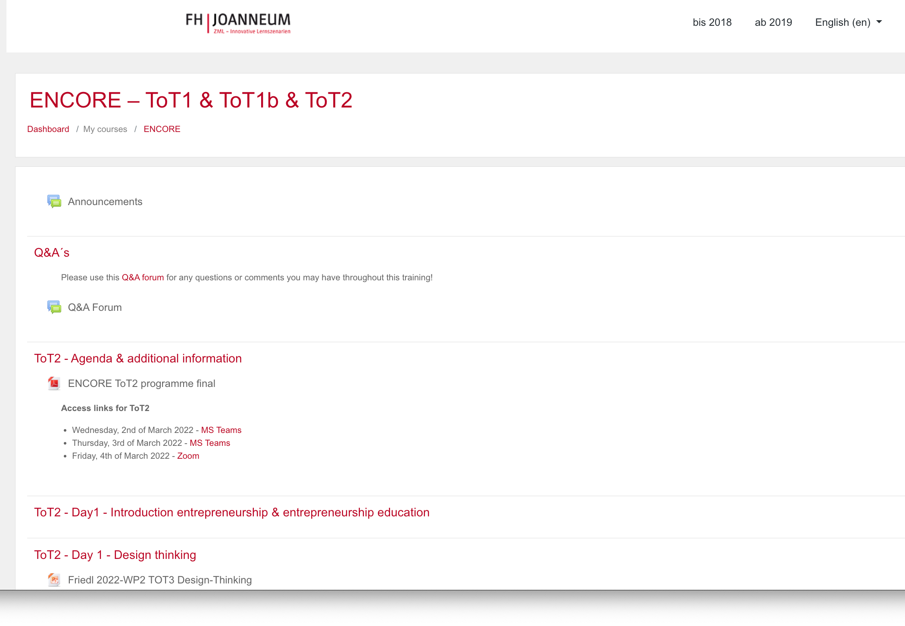
Training materials: Moodle
Remember: All ToT 3 & 4 Materials are uploaded to the Moodle platform

Slide 9
BIENVENIDOS!
We hope you enjoy the training and your stay in Alicante! ☺

Slide 10
ENCORE
Entrepreneurship Knowledge Centers to Foster Innovative Entrepreneurship Practices in Education and Research
Project ref.: 617589-EPP-1-2020-1-AT-EPPKA2-CBHE-JP

